Slide 1
Basic Linux for EPICS Task
Keerati Manasatitpong
Natthawut Suradet
Workshop on Development of EPICS based instrumentation control system in accelerator research facilities
10-14 June 2024, BRIN, Yogyakarta, Indonesia

Slide 2
Contents
What is Linux?
There are so many Linux, what should I used?
Can I run Linux on Windows?
Set up your Linux system
Access your Linux
Understand Linux
Some advance configurations
Lesson learned

Slide 3
What is Linux?
Who am I?

Slide 4
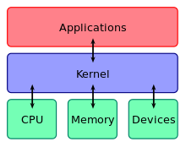
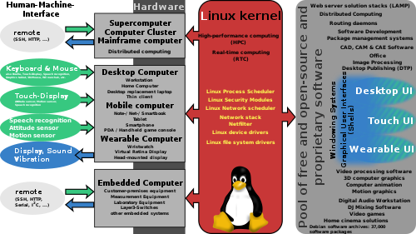
What is Linux (2)
source : Wikipedia
An operating system kernel
Wait! What is kernel?
First release in 1991 by Linus Torvalds
A POSIX (Unix-like) system
Free and open-source software
Run on coin-size computer to supercomputer
Everyone using computer should at least know basic Linux command!!

Slide 5
There are so many Linux, what should I used?
According to Wikipedia, over 1000 Linux distributions (distros) exist https://en.wikipedia.org/wiki/List_of_Linux_distributions#/media/File:KnoppixFamilyTree1210.svg
They are using the same Linux kernel (some use modified kernel)
They differ in user-space application, package management and how they configure their systems
Notable base distribution: Red Hat, Debian and SUSE
Then, what should we use? spoiler: Ubuntu
It should be easy to use and manage
Active development
Lots of resources when help is needed
Support our use case; i.e., hosting a control system
Yes, most important, it should be free to use

Slide 6
There are so many Linux, what should I used? (2)
Yes, Ubuntu answer our needs
Ubuntu is a Linux distro based on Debian
The most recent version is 24.04 LTS
Ubuntu support large variety of hardware
Ubuntu is completely free without any restriction
Desktop version is very easy to use, the only problem I cannot completely migrate to Ubuntu (and Linux in general) is that many software I use do not have Linux port
https://ubuntu.com/

Slide 7
Can I run Linux on Windows?
What different between Windows and Linux?
Let’s discus this in detail, it will benefit us in the long run, let’s start with this: https://www.linkedin.com/pulse/comprehensive-comparison-linux-vs-windows-angelo-kannangara-mizcc
Let me fact check, Are most of you using Windows and who have experience in using Linux?
At this point, if you are forcing to use Linux while working here, do you think you can live with it? spoiler: don’t worry, we can run Linux on Windows
Then, if we just want to test and develop some applications, do we need to fully migrate from Windows to Linux?
Can’t we just run Linux application on Windows?

Slide 8
Can I run Linux on Windows? (2)
The answer is no, you don’t
There are many way to run Linux applications on Windows
The old ways – compile Linux apps on Windows with frameworks (Cygwin, MinGW)
The fat way – Virtual machine with hypervisor (VMWare Workstation, VirtualBox, Hyper-V)
The modern way – Windows Subsystem for Linux (WSL)

Slide 9
Can I run Linux on Windows? (3)
We will consider only 2 choices since they are very similar in concept, the virtual machine and WSL
For WSL, you need to be on Windows 10 (with recent patches) or Windows 11, if not, only virtual machine is the solution
WSL is a Microsoft effort trying to win back developers who defected to Linux 😂
And they’re succeed…
They are 2 versions, version 1 has modified Linux kernel running alongside Windows kernel, but some system calls failed
Version 2 addressed this problem by using real Linux running in a (stripped down) virtual machine
The result is version 1 has better integration with Windows and version 2 has better application compatibility
You need to install some Windows components, however, with the newer installer, they will install them for you automatically with the WSL

Slide 10
Can I run Linux on Windows? (4)
For virtual machine, you will need a Hypervisor
Wait! What is hypervisor?
Let’s ask google
Hypervisor is a piece of software functions very similar to an OS kernel
It provides interfaces to access hardware for other software
For OS kernel, those pieces of software are called application
But for hypervisor, those hardware are OSes, called guest OS
The computer running hypervisor is called a host
With Windows 10 or 11, we can use Hyper-V from Microsoft
Other options are Workstation from VMWare and VirtualBox from Oracle
We will use Hyper-V because it is tightly integrated with Windows

Slide 11
Can I run Linux on Windows? (5)
So, WSL or Virtual machine?
Let me say, you need both
WSL is suitable for developing software but if you want to deploy it in production environments, virtual machine is more robust and a lot easier to manage
Moreover, working with virtual machine will help you on how to manage hypervisor, which will benefit you in a long run
Now, let’s stop the boring part (5 pages!) and start real exercise!

Slide 12
Set up your Linux System
I will assume that you have compatible Windows version (10 or 11 with latest update)
If not, please let me know
Let’s start with WSL installation
Open PowerShell as dministrator
PS C:\somefolder> wsl –install
Wait, and done
If Ubuntu is not installed automatically, manually install it
PS C:\somefolder> wsl –install –d Ubuntu

Slide 13
Set up your Linux System (2)
Let’s continue with virtual machine installation
Hyper-V is not officially supported on Windows Home edition
If you use Home edition, we will need extra steps
ref https://www.itechtics.com/enable-hyper-v-windows-10-home/
Open notepad and save the following content to desktop with filename setup_hyperv.bat
pushd "%~dp0“ dir /b %SystemRoot%\servicing\Packages\*Hyper-V*.mum >hyper-v.txt for /f %%i in ('findstr /i . hyper-v.txt 2^>nul') do dism /online /norestart /add-package:"%SystemRoot%\servicing\Packages\%%i“ del hyper-v.txt Dism /online /enable-feature /featurename:Microsoft-Hyper-V -All /LimitAccess /ALL pause
Open it as administrator

Slide 14
Set up your Linux System (3)
Answer ‘yes’ or ‘y’ when asked
It will download and install Hyper-V for us, which may take some time
You will need to reboot after finish
After reboot we should have a working Hyper-V hypervisor
In the case Hyper-V is not working or some errors occur, seek help! You may need to install another hypervisor
Next, we will install Linux in Hyper-V (or another installed hypervisor)

Slide 15
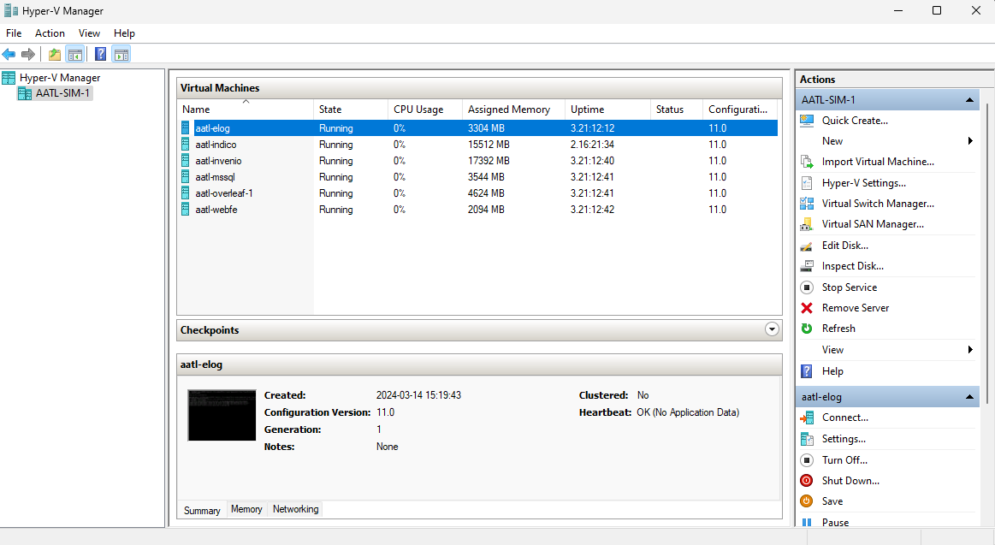
Set up your Linux System (4)
First, start the hypervisor management app (Hyper-V manager for Hyper-V)

Slide 16
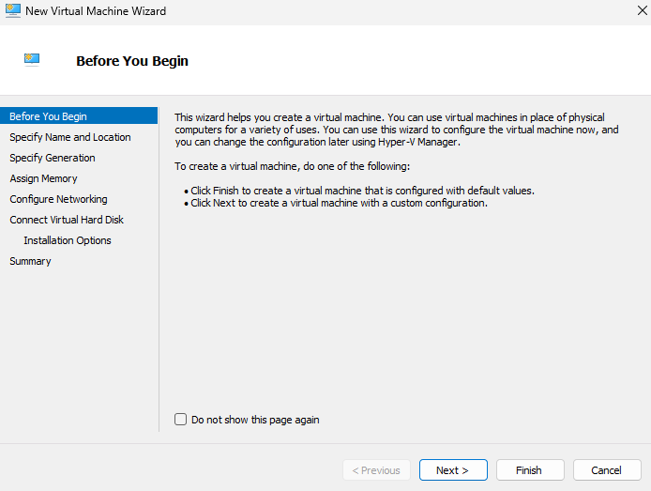
Set up your Linux System (5)
Click New > Virtual Machine
Enter required information accordingly
At least 2 processor cores, 20 GB disk and 2 GB of RAM is recommended for Ubuntu

Slide 17
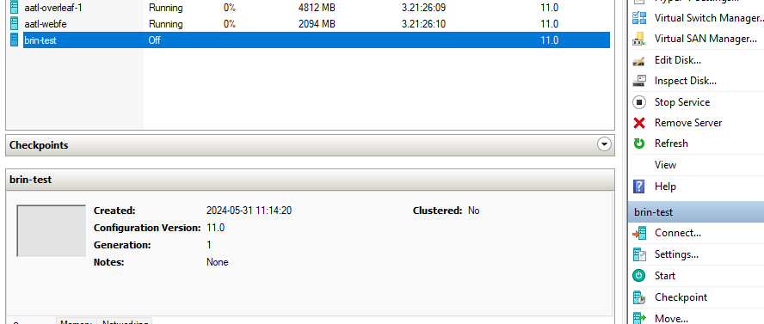
Set up your Linux System (6)
After finish, you should have a virtual computer ready to install Linux
Now, prepare Ubuntu image by download (Ubuntu Server 2024) from official website or copy from me (take your flash drive to me)
Then select your newly created VM in manager app and click setting

Slide 18
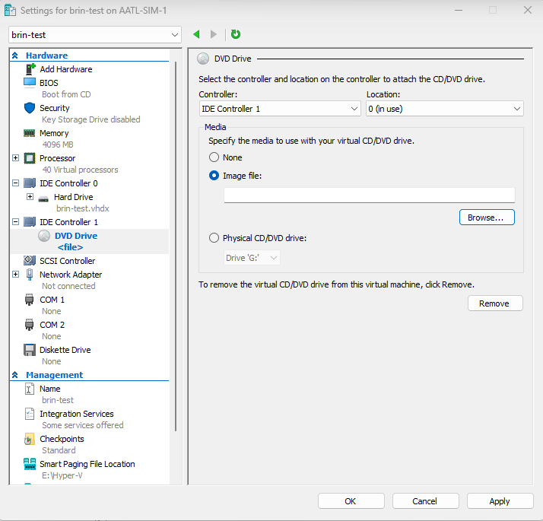
Set up your Linux System (7)
We will need to mount the Ubuntu image file to the VM
Select the DVD Drive then choose Image file then click Browse
Select your Ubuntu image file

Slide 19
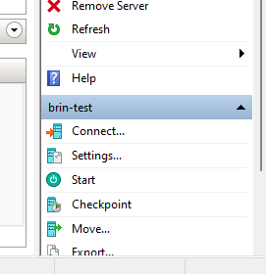
Set up your Linux System (8)
Now you can click start to start the VM
Click connect to open VM console
Wait for the installed to be fully loaded
Follow my instruction to install Ubuntu
You can use official guide as reference
https://ubuntu.com/server/docs/basic-installation
We should have functional Ubuntu after installation finish
Good job, next we will learn how to use and configure Ubuntu

Slide 20
Access your Linux
We can use PowerShell or VM console to command the Linux
But that is not a practical way to control your machine
Imagine, you have a PC in a room next to a reactor and you are in a control room few kilometers away, how can you quickly control your PC?
We will use SSH (Secure SHell), it a protocol to access remote terminal securely widely use in Unix-like systems
Wait! What is a terminal
Well, let’s ask google

Slide 21
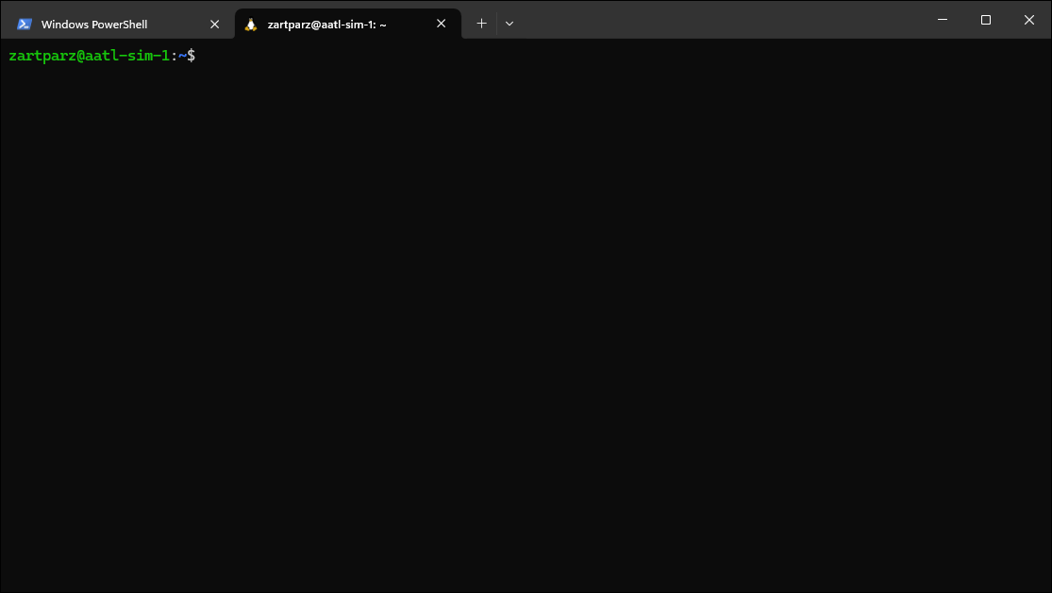
Access you Linux (2)
But before that we need ssh client, and we need ssh server to be installed on Linux (If you follow my instruction, it should be running)
One option is to use putty (a multi-protocol remote client)
But I recommend to use WSL as a client together with Windows Terminal app
You can download Windows Terminal app from Windows store
It support many command shells

Slide 22
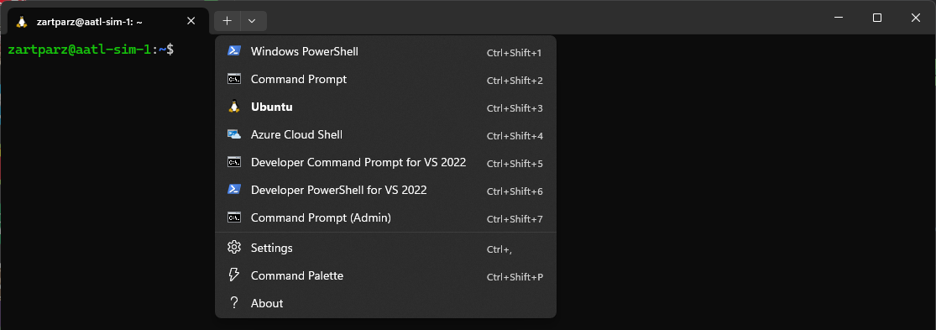
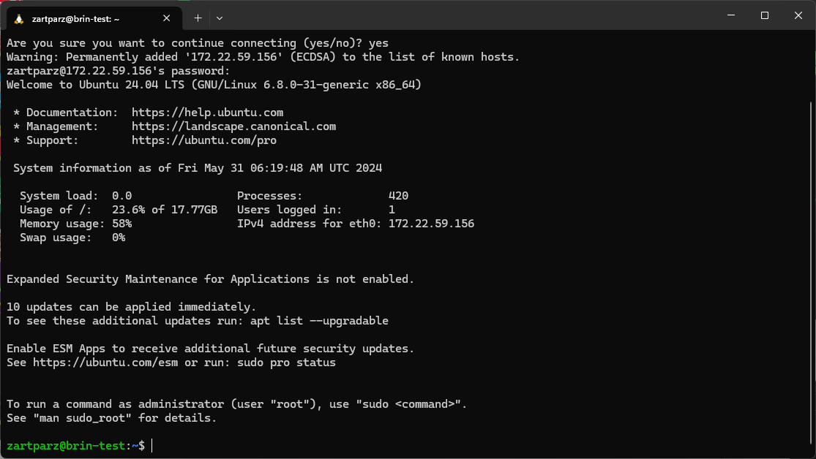
Access your Linux (3)
Find out IP address of your Ubuntu by logging into VM console and use ip a command, for example, 172.22.59.156
To many IP address show up? Seek help!
Usually, address start with 10, 172 or 192 is good, but we will discuss this in the networking session
Open terminal app and open Ubuntu
Type ssh yourname@yourserverip
If your username on Ubuntu VM is the same as in WSL you don’t need to specify username
Ex. ssh keerati@172.22.59.156
You can now use your Ubuntu VM, if not, seek help!

Slide 23
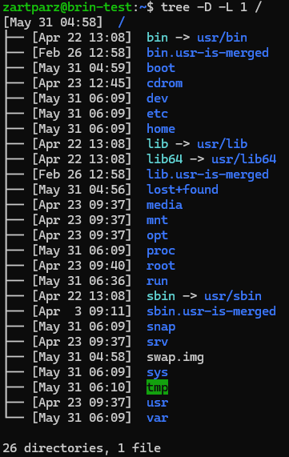
Understand Linux: File system
A hierarchy file system (FHS) which all directories share a common root called root directory (/) ref https://refspecs.linuxfoundation.org/fhs.shtml
Physical disk can be mount on arbitrary directory
/ mean root directory
. mean current working directory
.. mean one-level-up parent directory
cd is a command for changing working directory
Let’s do some practices

Slide 24
Understand Linux: File system commands
Command to learn (basic directory and file operations):
cd – change directory
pwd – print working directory
mkdir – make directory
cp – copy
mv – move
ls – list
cat – print file content
ln – link file

Slide 25
Understand Linux: Basic I/O commands
source: redhat.com
ref https://www.redhat.com/sysadmin/linux-shell-redirection-pipelining
>, >> - output operator
< - input operator
less – scroll though long output
| - pipe operator
&& - and operator

Slide 26
Understand Linux: General commands
sudo – privilege elevation
nano – simple text editor
apt – Debian (and its derivatives) package manager
df – check disk space
free – check RAM usage
du – check disk usage
lsb_realease – check Linux information
chown – change owner of the file or directory
chmod – change file permission

Slide 27
Understand Linux: General commands (2)
adduser – add new user
deluser – delete user
usermod – modify user parameter
tar – archive management
wget – http(s) client
ssh – secure shell client
telnet – telnet client
export – set environment variable

Slide 28
Understand Linux: How to execute program
If the program is in a directory included in $PATH variable, type the program name to execute program
ex1. system program
myname@myserver:~$ someprogram
ex2. you can also provide a complete path to eliminate ambiguity
myname@myserver:~$ ../myfriendsname/otherprogram
If not, you must type a complete name of the program to execute it
ex1. program in current working directory
myname@myserver:~$ ./myprogram
ex2. program is outside current directory
myname@myserver:/somedirectory$ /home/myname/myprogram

Slide 29
Understand Linux: Environment variables
They are variables that programs use to define their behavior
Every terminal has their copy of variables
use $ sign to refer to variable
use export command to set a variable (BASH shell)
use env command to list all variables
use echo command to print
automatically load environment variable at start up using ~/bashrc , ~/bash_aliases or /ect/environment

Slide 30
Some advance configurations: Network
main configuration utility: ip
some commonly used object:
ip a
ip r
the configuration tool: netplan
check host availability: ping
check routing: traceroute

Slide 31
Some advance configurations: System
Package management: apt
Service management: systemctl
Host name configuration: hostnamectl
Date and time configuration: timedatedctl
Time synchronization: ntp

Slide 32
Lesson learned
You learn something about Linux
You learn difference between Linux and Windows
You have experience with virtual machine
You have experience on install Linux
You have experience with some Linux command

Slide 33
THANK YOU

