Slide 1
EPICS Client Tools
Keerati Manasatitpong
Natthawut Suradet
Workshop on Development of EPICS based instrumentation control system in accelerator research facilities
10-14 June 2024, BRIN, Yogyakarta, Indonesia

Slide 2
Contents
Client-server architecture
The basic: command line client
The standard: Control System Studio – Phoebus (CSS)
The advance: Python binding
Bonus: The convenience: WebSocket client
Bonus: The freedom: C/C++ binding
Lesson learned

Slide 3
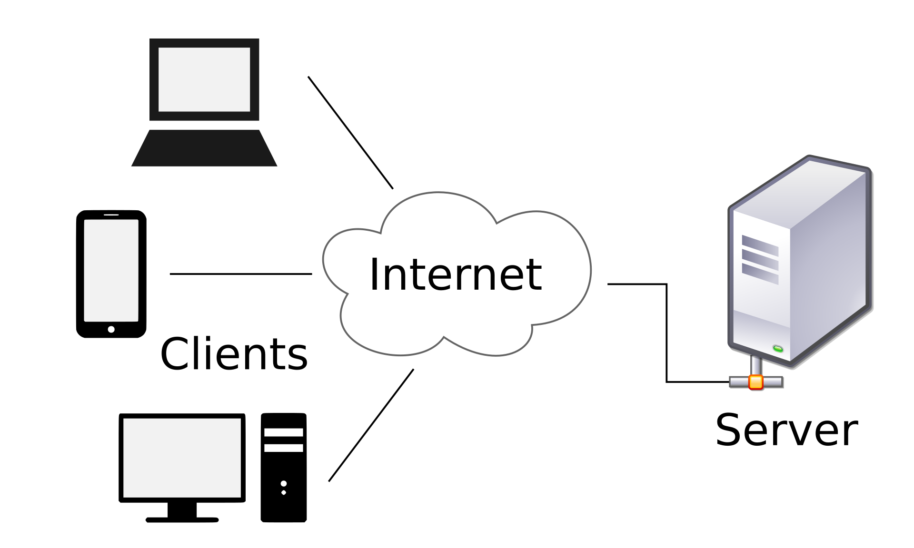
Client-server architecture
EPICS CA use client-server model
Support communication patterns:
Request-reply
Publish-subscribe
Communication using
TCP/IP
UDP/IP
source: Wikipedia

Slide 4
The basic: command line client
Read a PV named <NAME>
caget NAME
Write a PV named <NAME>
caput NAME value
Get information about that Record
cainfo NAME
Start a monitor
camonitor NAME
(Cancel with [Ctrl] + [c])
>caget ARIDI-PCT:CURRENT
ARIDI-PCT:CURRENT 350.56
>
>caput ARIDI-PCT:CURRENT 401.5
Old: ARIDI-PCT:CURRENT 350.56
New: ARIDI-PCT:CURRENT 401.5
>
>cainfo ARIDI-PCT:CURRENT
ARIDI-PCT:CURRENT
State: connected
Host: sls-cagw-1
Access: read, no write
Data type: DBR_DOUBLE
Element count: 1
>
>camonitor ARIDI-PCT:CURRENT
ARIDI-PCT:CURRENT 250.542
ARIDI-PCT:CURRENT 250.537
ARIDI-PCT:CURRENT 250.533
ARIDI-PCT:CURRENT 250.525
>

Slide 5
The basic: command line client (2)
You can use –help option to show usage manual
For simple task you can use shell script with command line tools to create sequence
You also can call command line tools in programming language with system call

Slide 6
The standard: Control System Studio – Phoebus (CSS)
This is a graphic user interface development tool
Download ➔ http://download.controlsystemstudio.org/release/4.5/cs-studio-4.5.9-win32.win32.x86_64.zip
You also need Java runtime ➔ https://download.java.net/openjdk/jdk17/ri/openjdk-17+35_windows-x64_bin.zip
After download finish, extract both file in the same folder and edit Java path or you can rename Java directory to jdk to use default path (follow my instruction)
phoebus.bat is the startup file for Phoebus

Slide 7
The standard: Control System Studio – Phoebus (CSS) (2)

Slide 8
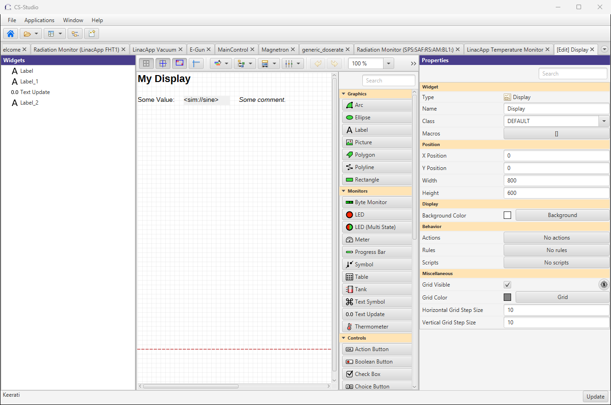
The standard: Control System Studio – Phoebus (CSS) (3)
To create new GUI, click Applications > Display > New display
You will be asked to enter the new GUI name
You will be ready to create GUI now
Follow my instruction to learn about widget

Slide 9
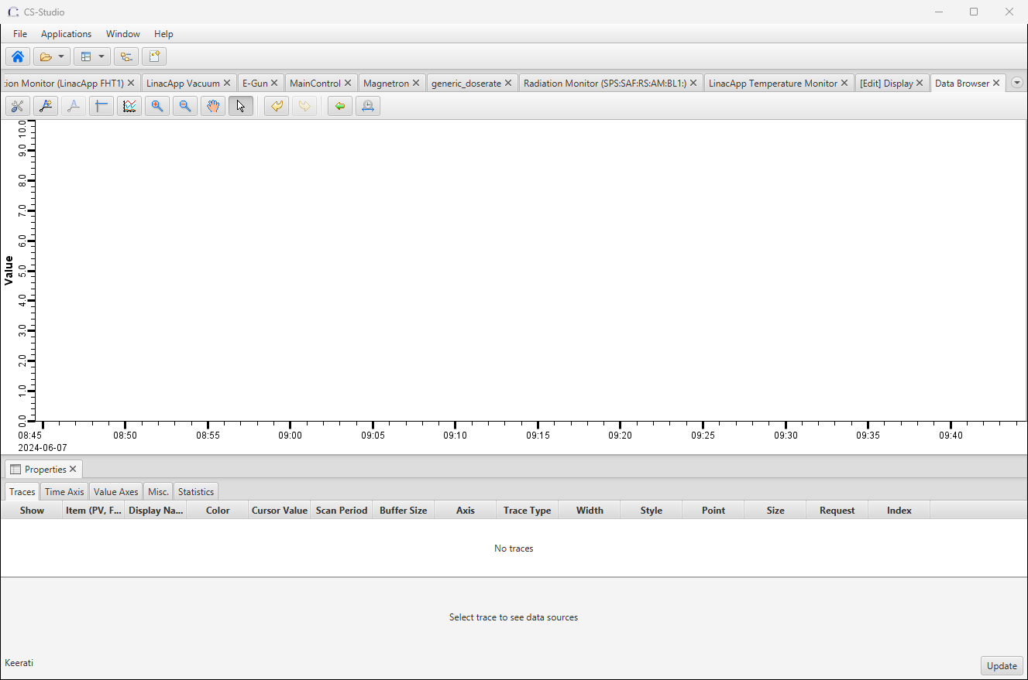
The standard: Control System Studio – Phoebus (CSS) (4)
To create new graph from archive data, click Applications > Display > Data browser
Follow my instruction to add Appliance and PVs

Slide 10
The standard: Control System Studio – Phoebus (CSS) (5)
Each widget has its own behavior
Phoebus support Action and Rule
Phoebus support JavaScript and Python scripting
Be careful with PV data type, conversion can cause unexpected behavior
Be careful with floating precision and format, the data may not be shown correctly if you set it wrong

Slide 11
The advance: Python binding
import epics
import datetime
# import os
count = 0
pv = "linacapp:vac:tpg1:P_Vacuum"
pv2 = "linacapp:env:adaq1:Temp1"
def monitor_callback(pvname, value, timestamp, **kwargs):
global count
dt = datetime.datetime.fromtimestamp(timestamp)
print("(" + str(count) + ") " + pvname + " at " + str(dt) + " is " + str(value))
count += 1
if count > 5:
epics.camonitor_clear(pvname)
print("stop")
# epics.ca.find_libca()
# epics.ca.find_libCom()
# os.environ["EPICS_CA_ADDR_LIST"] = "10.110.0.101"
vacuum = epics.caget(pv)
temperature = epics.caget(pv2)
print("vacuum=" + str(vacuum) + " temperature=" + str(temperature))
epics.camonitor(pv, callback=monitor_callback)
You will need Channel access for Python install by using command:
pip install pyepics
Then import epics package in the code
Example ➔

Slide 12
The advance: Python binding (2)
import matplotlib.pyplot as plot
import matplotlib.dates as md
import http.client
import json
import datetime as dt
import time
import matplotlib.pyplot as plt
connection = http.client.HTTPConnection('10.0.0.10', 17668)
connection.request("GET","/retrieval/data/getData.json?pv=linacapp%3Avac%3Atpg1%3AP_Vacuum&from=2022-11-15T12%3A00%3A00.000Z&to=2022-11-16T12%3A00%3A00.000Z")
response = connection.getresponse()
data = json.load(response)
secs = [x['secs'] for x in data[0]['data']]
dates = [dt.datetime.fromtimestamp(t) for t in secs]
vals = [x['val'] for x in data[0]['data']]
fmt = md.DateFormatter('%Y-%m-%d %H:%M:%S')
ax = plt.gca()
ax.xaxis.set_major_formatter(fmt)
plot.scatter(dates, vals)
plot.show()
You can also access Appliance from Python
We will use common http client
Example ➔

Slide 13
Bonus: The convenience: WebSocket client
In this topic, we will need epics2web to be installed
epics2web is a Tomcat servlet that convert CA to WebSocket (WS)
WS is a standard protocol defined in HTTP protocol suite
It design to be a bidirectional communication protocol to supplement HTTP
epics2web provide JavaScript client to program webpage to access PV
get and monitor are available, but no put

Slide 14
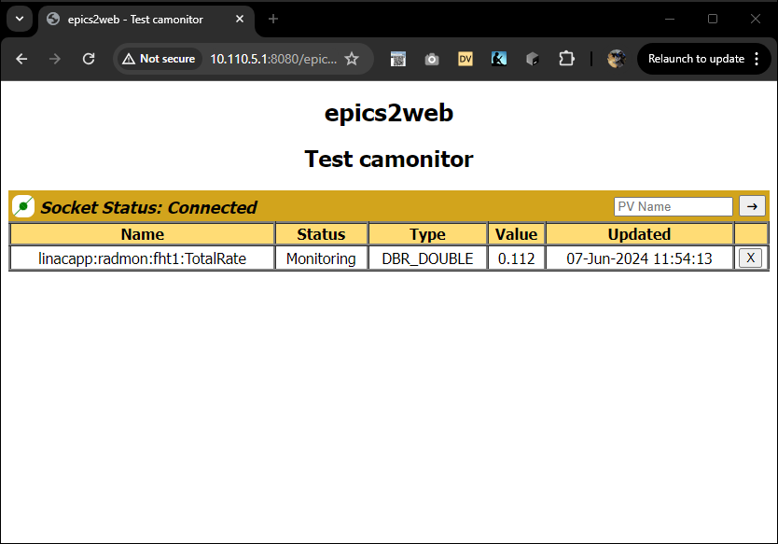
Bonus: The convenience: WebSocket client (2)

Slide 15
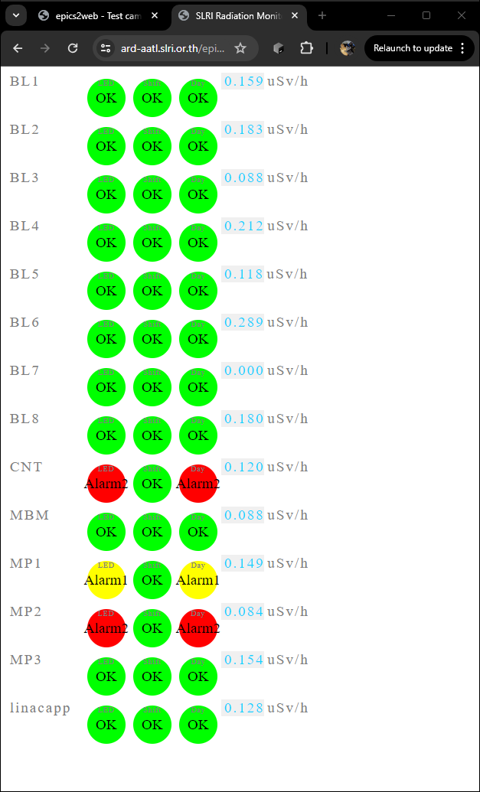
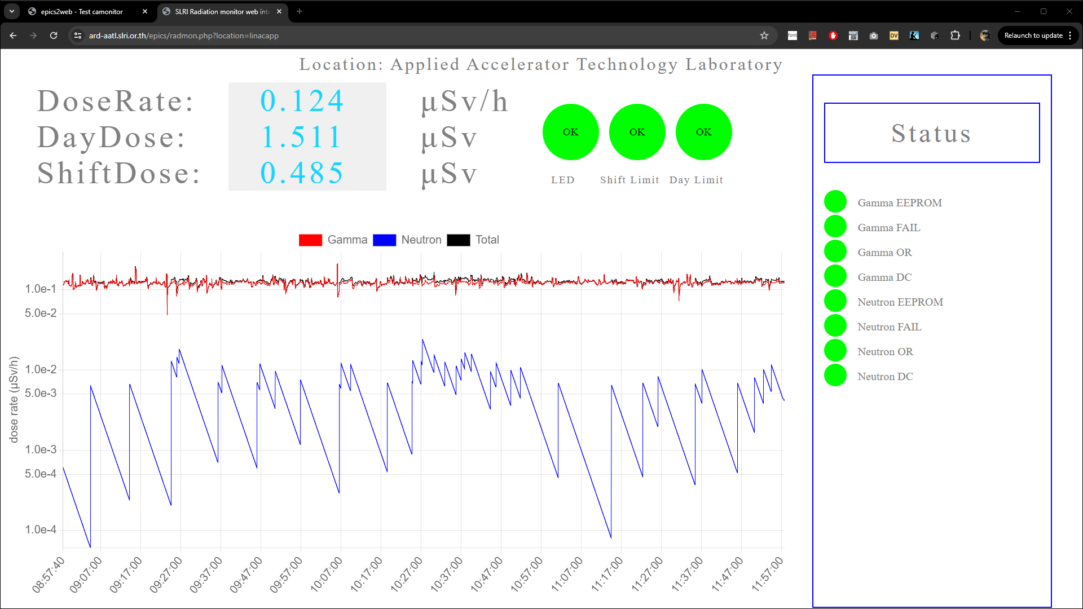
Bonus: The convenience: WebSocket client (3)
Example application

Slide 16
Bonus: The freedom: C/C++ binding
The most advance form to make a client is C/C++ binding
You can do everything up to your C/C++ skill
C/C++ code can be called from most languages
The best example code can be found in EPICS base code
/opt/brin/app/epics/base/modules/ca/src/tools
In this directory you can find all 4 command line clients (caget/caput/camonitor/cainfo)
Let’s look inside together

Slide 17
Lesson learned
You have experience in using command line clients
You have experience in use and develop the GUI using Phoebus
You have been demonstrated on how other languages and platforms connect with EPICS PV using CA

Slide 18
THANK YOU

