Slide 1
Progress Report
Thakonwat Chanwattana
AIS Meeting
19 May 2025

Slide 2
Work in Progress
SPS-I injector improvement
SPS-II DDR: transfer lines for 250-MeV linac
Proton Therapy: submitted CAS-ANSO Fellowship Program 2025
Ion beam transport and diagnostics for Proton Beam Radiotherapy Technology Development Center Project (ST69)
SEM: Collaboration project + internal project
Talks and Lectures:
Regional Particle Physics Summer Camp 2025 @IF, NU on 3 May 2025
Asian Science Camp 2025 @ SUT on 2 Aug 2025
Conferences:
IPAC’25: poster x2
IBIC2025: poster x2
OCPA-2025: lecture on Accelerator Technology
มหกรรมวิทย์: คณะทำอุปกรณ์โชว์

Slide 3
SPS-I Injector Beam Current Measurement

Slide 4
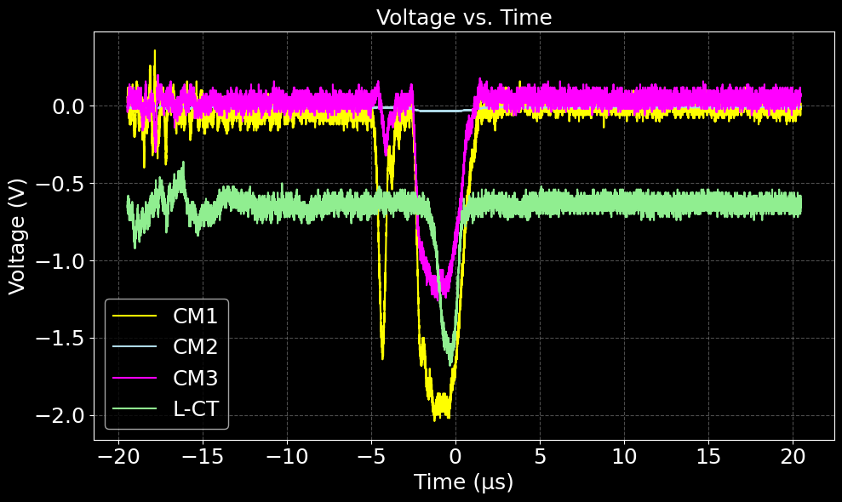
Measurement by control room oscilloscope saving data with floppy disks

Slide 5
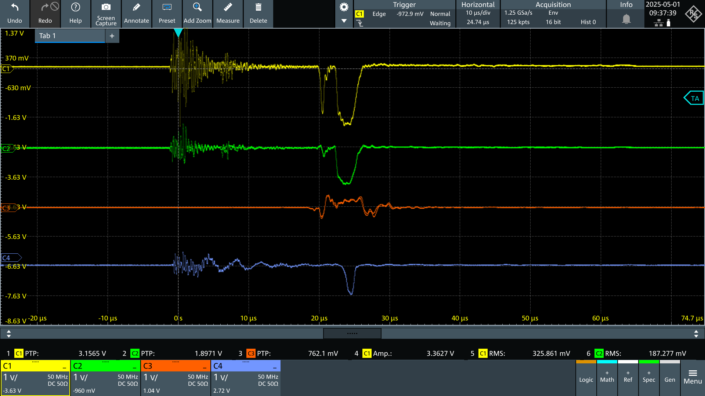
Measurement by RS oscilloscope MXO44

Slide 6
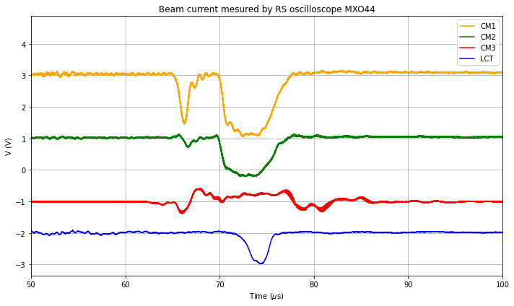
Plot from data taken by RS oscilloscope MXO44

Slide 7
Next Steps
Check CM3 (ACCT)
Use cable in the package or not
Ground wiring of sensor and power supply
Check if common mode filter used or not
Calibration factor: 10 V ~32 mA
Check how to repair pneumatic of SCM2?
Discuss about setting up a cable BLM at FC.

Slide 8
LBT Simulation

Slide 9
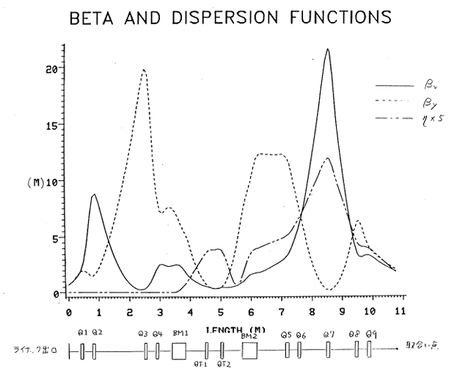
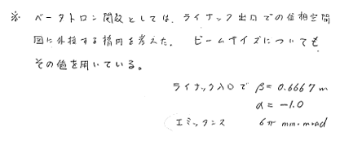
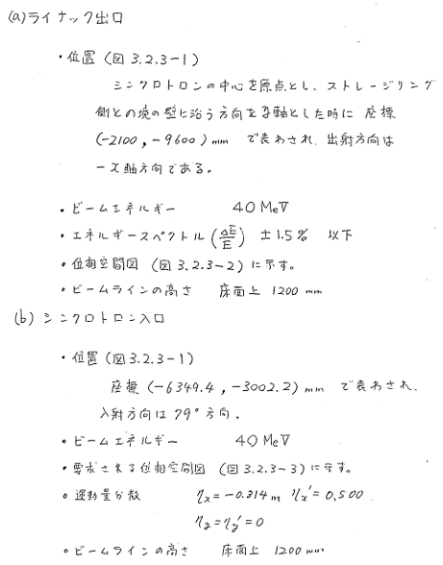
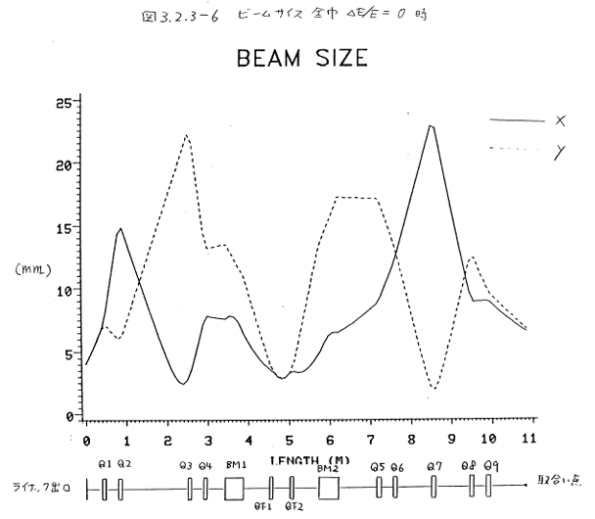
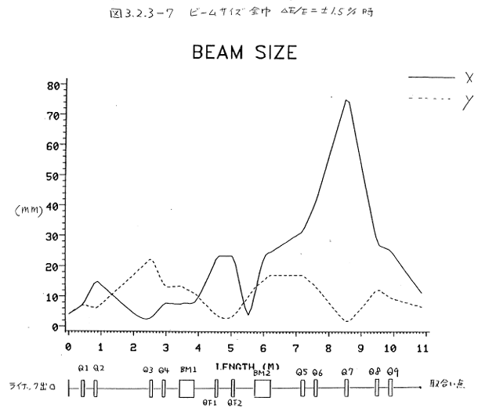
References from Conceptual Design (SOR045)
Linac exit
Booster entrance
$β_{x,y}≈2 m$

Slide 10
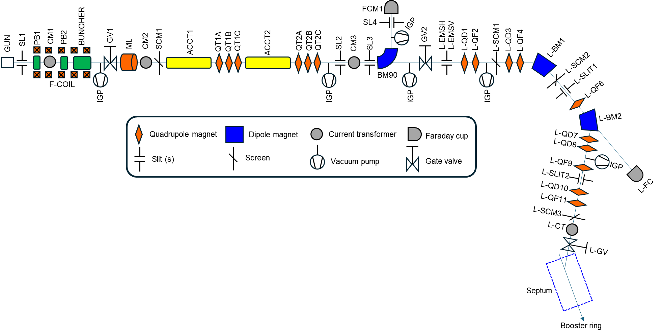
Simulation Region
Start point
End point

Slide 11
SPS-I LBT Lattice
Section | Names | Descriptions | Start Positions | End Positions | Middle Positions | Length | Remarks
 | PUMP |  | 8980.50 | 9089.00 |  | 108.50
 | GV2 | gate valve | 9089.00 | 9141.00 | 9115.00 | 52.00
 | DRIFT |  | 9141.00 | 9233.00 |  | 92.00
 | BELLOW |  | 9233.00 | 9327.00 |  | 94.00
LBT | BELLOW |  | 9327.00 | 9421.00 |  | 94.00
 | L-EMSV & L-EMSH | Slit | 9421.00 | 9581.00 | 9501.00 | 160.00 | For emittance measurements
 | DRIFT |  | 9581.00 | 9709.50 |  | 128.50
 | L-QD1 | Quadrupole magnet | 9709.50 | 9809.50 | 9759.50 | 100.00
 | DRIFT |  | 9809.50 | 10109.50 |  | 300.00
 | L-QF2 | Quadrupole magnet | 10109.50 | 10209.50 | 10159.50 | 100.00
 | DRIFT |  | 10209.50 | 10635.00 |  | 425.50
 | L-STV1 | Steering magnet | 10635.00 | 10685.00 | 10660.00 | 50.00
 | DRIFT |  | 10685.00 | 10985.00 |  | 300.00
 | BELLOW |  | 10985.00 | 11084.00 |  | 99.00
 | PUMP | Vacuum pump | 11084.00 | 11334.00 |  | 250.00
 | L-SCM1 | Screen station | 11334.00 | 11614.00 | 11474.00 | 280.00 | Seems to be an SLRI designed screen station replaced an original one
 | DRIFT |  | 11614.00 | 11782.50 |  | 168.50
 | L-QD3 | Quadrupole magnet | 11782.50 | 11882.50 | 11832.50 | 100.00
 | DRIFT |  | 11882.50 | 12182.50 |  | 300.00
 | L-QF4 | Quadrupole magnet | 12182.50 | 12282.50 | 12232.50 | 100.00
 | DRIFT |  | 12282.50 | 12445.70 |  | 163.20
 | BELLOW |  | 12445.70 | 12555.70 |  | 110.00
 | DRIFT |  | 12555.70 | 12739.70 |  | 184.00
 | L-BM1 | Bending magnet | 12739.70 | 13180.40 |  | 440.70 | 50.5° bending, R=500mm, yoke mechanical length = 411.3 mm, length is point-curve_path-point of yoke
 | DRIFT |  | 13180.40 | 13364.40 |  | 184.00
 | L-STV-M3 | steering magnet | 13364.40 | 13724.40 |  | 360.00
 | L-SCM2 | Screen station | 13724.40 | 14004.40 | 13864.40 | 280.00
 | L-SLIT1 | Slit | 14004.40 | 14224.40 | 14114.40 | 220.00 | New manually named. To be checked the actual label at the device
 | DRIFT |  | 14224.40 | 14314.40 |  | 90.00
 | L-QF6 | Quadrupole magnet | 14314.40 | 14414.40 | 14364.40 | 100.00
 | DRIFT |  | 14414.40 | 15048.25 |  | 633.85
 | L-BM2 | Bending magnet | 15048.25 | 15488.95 |  | 440.70 | Similar to L-BM1
 | DRIFT |  | 15488.95 | 15672.95 |  | 184.00
 | BELLOW |  | 15672.95 | 15782.95 |  | 110.00
 | DRIFT |  | 15782.95 | 16435.45 |  | 652.50
 | L-QD7 | Quadrupole magnet | 16435.45 | 16535.45 | 16485.45 | 100.00
 | DRIFT |  | 16535.45 | 16835.45 |  | 300.00
 | L-QF8 | Quadrupole magnet | 16835.45 | 16935.45 | 16885.45 | 100.00
 | DRIFT |  | 16935.45 | 17075.45 |  | 140.00
 | L-STH-M4 | Steering magnet horizontal | 17075.45 | 17275.45 |  | 200.00
 | DRIFT |  | 17275.45 | 17395.45 |  | 120.00
 | PUMP | Vacuum pump | 17395.45 | 17645.45 |  | 250.00
 | DRIFT |  | 17645.45 | 17785.45 |  | 140.00
 | L-QF9 | Quadrupole magnet | 17785.45 | 17885.45 | 17835.45 | 100.00
 | DRIFT |  | 17885.45 | 18015.45 |  | 130.00
 | L-SCM3 | Slit | 18015.45 | 18295.45 | 18155.45 | 280.00 | L-SLIT2 is new manually named. change to L-SCM3 to follow the label in SPS GUI
 | DRIFT |  | 18295.45 | 18395.45 |  | 100.00
 | L-STV5 | Steering magnet vertical | 18395.45 | 18595.45 |  | 200.00
 | DRIFT |  | 18595.45 | 18735.45 |  | 140.00
 | L-QD10 | Quadrupole magnet | 18735.45 | 18835.45 | 18785.45 | 100.00
 | DRIFT |  | 18835.45 | 19135.45 |  | 300.00
 | L-QF11 | Quadrupole magnet | 19135.45 | 19235.45 | 19185.45 | 100.00
 | DRIFT |  | 19235.45 | 19381.45 |  | 146.00
 | BELLOW |  | 19381.45 | 19491.45 |  | 110.00
 | L-SCM4 | Screen station | 19491.45 | 19771.45 | 19631.45 | 280.00 | Was L-SCM3 but change to L-SCM4 to follow the label in SPS GUI
 | L-CT | Current monitor | 19771.45 | 19961.45 |  | 190.00
 | L-GV | Gate valve | 19961.45 | 20036.45 | 19998.95 | 75.00 | New manually named
 | BELLOW |  | 20036.45 | 20135.45 |  | 99.00
 | SEPTUM |  | 20135.45 | 21757.95 |  | 1622.50 | 30° bending, R=850mm, Curve path ~445mm
Make a lattice file of LBT based on measured coordinates and magnet effective length based on magnet spreadsheet data.
Magnet | Effective length (mm)
QD type 1 | 133.253
QF type 1 | 133.215
QD type 2 | 151.433
QF type 2 | 151.936
BM1 | 502.831
BM2 | 503.435

Slide 12
SPS-I LBT Twiss matching
Initial parameters
$E=40 MeV$
$ε_{x,y}=6 πmm⋅rad$
$β_{x,y}=0.6667 m$
$α_{x,y}=−1$
$η_{x,y}=0 m$
${η′}_{x,y}=0$
Optimization terms
Max $β_{x,y}=25 m$
Final:
$η_{x}=−0.314 m$
${η′}_{x}=0.5$
QM type:
QD1, QF2, QD3, QF4,
QF6,QD7, QD8, QF9, QD10, QF11
Make a lattice file of LBT based on measured coordinates and magnet effective length based on magnet spreadsheet data.

Slide 13
SPS-I LBT Beam size
Beam size with energy spread 1.5%
Initial parameters
$E=40 MeV$
$ε_{x,y}=6 πmm⋅rad$
$β_{x,y}=0.6667 m$
$α_{x,y}=−1$
$η_{x,y}=0 m$
${η′}_{x,y}=0$
Optimization terms
Max $β_{x,y}=25 m$
Final:
$η_{x}=−0.314 m$
${η′}_{x}=0.5$
QM type:
QD1, QF2, QD3, QF4,
QF6,QD7, QD8, QF9, QD10, QF11

Slide 14
Next Steps
Initial parameters
$E=40 MeV$
$ε_{x,y}=6 πmm⋅rad$
$β_{x,y}=0.6667 m$
$α_{x,y}=−1$
$η_{x,y}=0 m$
${η′}_{x,y}=0$
Optimization terms
Max $β_{x,y}=25 m$
Final:
$β_{x,y}=2 m$
$α_{x,y}=1$
$η_{x}=−0.314 m$
${η′}_{x}=0.5$
Simulation
Set final $β$ and $α$.
Simulate with QM5 and without septum to compare with SOR045.
Vary QM type (QF/QD).
Diagnostics
How to repair pneumatic of SCM2?
Discuss about setting up a cable BLM.

