Slide 1
Transverse Dynamics
横向动力学
Gang XU
徐刚
IHEP, Beijing 100049
xug@ihep.ac.cn
Khaoyai, Thailand, July, 29, 2025

Slide 2
Content（内容）
Transverse Motion
（横向运动）
Equation of motion
（运动方程）
Matrix formalism
（矩阵形式）
Symplecticity
（辛）
Courant-Snyder formalism
（克朗特-施耐德形式）
Normal form
（规范形式）
Perturbation
（扰动）
Field error
（场误差）
Orbit distortion
（轨道扭曲）
Tune shift
（频移）
Adiabatic damping
（绝热阻尼）
Linear coupling
（线性耦合）
Nonlinear resonance
（非线性共振）
Chromatic effect
（色散效应）
Dispersion function
（色散函数）
Calculation of dispersion function
（色散函数的计算）
Dispersion suppressor
（色散的消除）
Momentum compaction
（动量的压缩）
Achromat cell
（消色散单元）
Chromaticity
（色品）

Slide 3
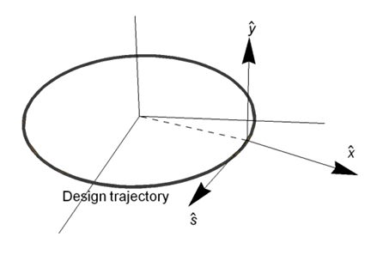

Coordinate system（坐标系）
See the following figure, the design trajectory has a local
curvature ρ, the path length along the trajectory is s. We
define three right-handed unit vectors ($\hat{x},$ $\hat{y}$, $\hat{s}$) .
The position of a particle in this coordinate system is
$\vec{R}=r \hat{x}+y \hat{y}$, where r=ρ+x, x and y are the functions
of s. To describe the transverse motion of the particle,
we need two more quantities $xˊ$(s)=dx(s)/ds and
$yˊ$(s)=dy(s)/ds. The 4-D space (x, $xˊ$,y, $yˊ$) constitutes
the transverse phase space.
The bending curvature ρ>>|x| ( |x| less than aperture
of vacuum chamber, far less than its length)
Note the particle motion on a circle, velocity will be $\frac{ds}{dt}$= $v_{s}$ $\frac{\text{ρ}}{r}$= $v_{s}$ $\frac{\text{ρ}}{\text{ρ}+x}$, it is different from $v_{s}$
ρ
The deep black circle is not correct, in most cases, it is only valid in a short arc, because ρ
is varied with s

Slide 4
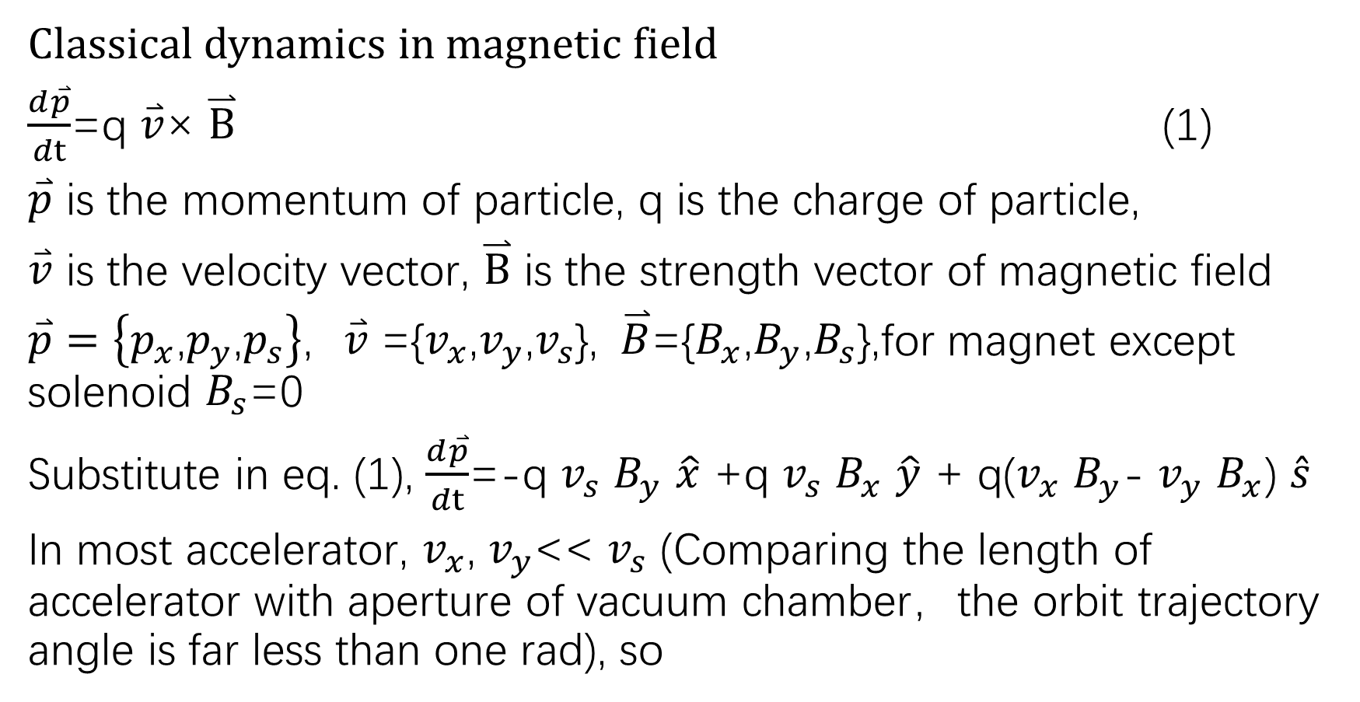
Equation of motion(运动方程)
Classical dynamics in magnetic field
$\frac{d\overset{⃑}{p}}{dt}$=q $\overset{⃑}{v}$× $\overset{⃑}{B}$ (1)
$\overset{⃑}{p}$ is the momentum of particle, q is the charge of particle,
$\overset{⃑}{v}$ is the velocity vector, $\overset{⃑}{B}$ is the strength vector of magnetic field
$\overset{⃑}{p}=\left\{p_{x}\text{,}p_{y}\text{,}p_{s}\right\}\text{,} \overset{⃑}{v}$ ={$v_{x}$,$v_{y}$,$v_{s}$}, $\overset{⃑}{B}$={$B_{x}$,$B_{y}$,$B_{s}$},for magnet except solenoid $B_{s}$=0
Substitute in eq. (1), $\frac{d\overset{⃑}{p}}{dt}$=-q $v_{s}$ $B_{y}$ $\hat{x}$ +q $v_{s}$ $B_{x}$ $\hat{y}$ + q($v_{x}$ $B_{y}$- $v_{y}$ $B_{x}$) $\hat{s}$
In most accelerator, $v_{x}$, $v_{y}$<< $v_{s}$ (Comparing the length of accelerator with aperture of vacuum chamber，the orbit trajectory angle is far less than one rad), so

Slide 5
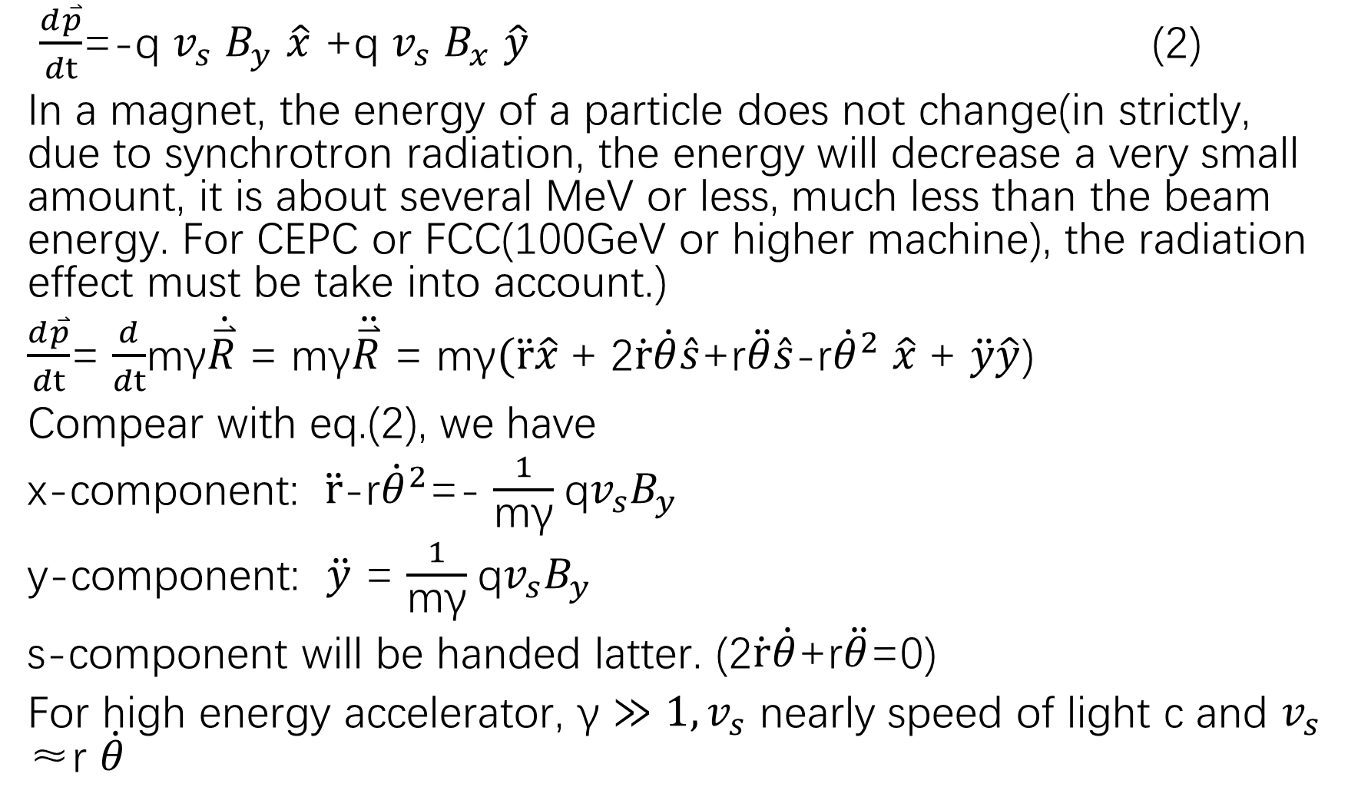
$\frac{d\overset{⃑}{p}}{dt}$=-q $v_{s}$ $B_{y}$ $\hat{x}$ +q $v_{s}$ $B_{x}$ $\hat{y}$ (2)
In a magnet, the energy of a particle does not change(in strictly, due to synchrotron radiation, the energy will decrease a very small amount, it is about several MeV or less, much less than the beam energy. For CEPC or FCC(100GeV or higher machine), the radiation effect must be take into account.)
$\frac{d\overset{⃑}{p}}{dt}$= $\frac{d}{dt}$mγ$\dot{\overset{⃑}{R}}$ = mγ$\ddot{\overset{⃑}{R}}$ = mγ$(\ddot{r}\hat{x}$+ 2$\dot{r}\dot{θ}\hat{s}$+r$\ddot{θ}\hat{s}$-r${\dot{θ}}^{2}$ $\hat{x}$+ $\ddot{y}\hat{y}$)
Compear with eq.(2), we have
x-component: $\ddot{r}$-r${\dot{θ}}^{2}$=- $\frac{1}{\text{m}\text{γ}}$q$v_{s}B_{y}$
y-component: $\ddot{y}$ = $\frac{1}{\text{m}\text{γ}}$q$v_{s}B_{y}$
s-component will be handed latter. (2$\dot{r}\dot{θ}$+r$\ddot{θ}$=0)
For high energy accelerator, $\text{γ}≫1,v_{s}$ nearly speed of light c and $v_{s}$ ≈r $\dot{θ}$

Slide 6
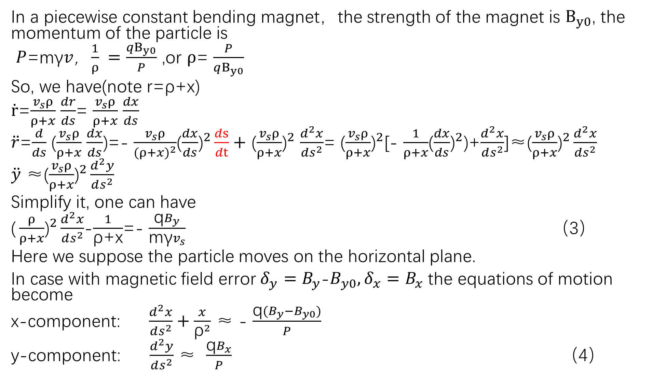
In a piecewise constant bending magnet，the strength of the magnet is $B_{y0}$, the momentum of the particle is
$P$=m$\text{γ}v$，$\frac{1}{ρ} =\frac{qB_{y0}}{P}$ ,or $ρ$= $\frac{P}{qB_{y0}}$
So, we have(note r=ρ+x)
$\dot{r}$=$\frac{v_{s}ρ}{ρ+x}$ $\frac{dr}{ds}$= $\frac{v_{s}ρ}{ρ+x}$ $\frac{dx}{ds}$
$\ddot{r}$=$\frac{d}{ds}$ ($\frac{v_{s}ρ}{ρ+x}$ $\frac{dx}{ds}$)=- $\frac{v_{s}ρ}{{(ρ+x)}^{2}}$($\frac{dx}{ds}{\text{)}}^{2}\frac{ds}{dt}+$ ($\frac{v_{s}ρ}{ρ+x}{\text{)}}^{2}$ $\frac{d^{2}x}{ds^{2}}$= ($\frac{v_{s}ρ}{ρ+x}{\text{)}}^{2}$[- $\frac{1}{ρ+x}$($\frac{dx}{ds}{\text{)}}^{2}$)+$\frac{d^{2}x}{ds^{2}}$]≈($\frac{v_{s}ρ}{ρ+x}{\text{)}}^{2}\frac{d^{2}x}{ds^{2}}$
$\ddot{y}$ ≈($\frac{v_{s}ρ}{ρ+x}{\text{)}}^{2}\frac{d^{2}y}{ds^{2}}$
Simplify it, one can have
$\text{(}\frac{ρ}{ρ+x}{\text{)}}^{2}\frac{d^{2}x}{ds^{2}}$-$\frac{1}{\text{ρ}\text{+}\text{x}}$=- $\frac{\text{q}B_{y}}{\text{m}\text{γ}v_{s}}$ （3）
Here we suppose the particle moves on the horizontal plane.
In case with magnetic field error$δ_{y}=B_{y}$-$B_{y0}, δ_{x}=B_{x}$ the equations of motion become
x-component: $\frac{d^{2}x}{ds^{2}}+\frac{x}{{\text{ρ}}^{2}}$ ≈ - $\frac{\text{q}{(B}_{y}−B_{y0})}{P}$
y-component: $\frac{d^{2}y}{ds^{2}}$ ≈ $\frac{\text{q}B_{x}}{P}$ （4）

Slide 7
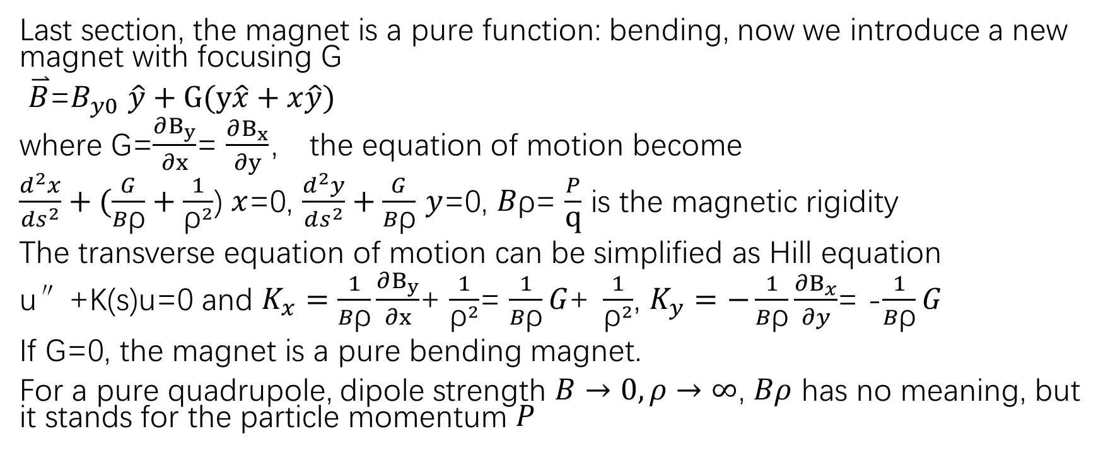
Combined-function magnet（组合磁铁）
Last section, the magnet is a pure function: bending, now we introduce a new magnet with focusing G
$\overset{⃑}{B}$=$B_{y0}$ $\hat{y}+G(y\hat{x}+x\hat{y})$
where G=$\frac{∂B_{y}}{∂x}$= $\frac{∂B_{x}}{∂y}$， the equation of motion become
$\frac{d^{2}x}{ds^{2}}+(\frac{G}{B\text{ρ}}+\frac{1}{{\text{ρ}}^{2}}$) $x$=0, $\frac{d^{2}y}{ds^{2}}+\frac{G}{B\text{ρ}}$ $y$=0, $B\text{ρ}$= $\frac{P}{\text{q}}$ is the magnetic rigidity
The transverse equation of motion can be simplified as Hill equation
u″+K(s)u=0 and $K_{x}=\frac{1}{B\text{ρ}}\frac{∂B_{y}}{∂x}$+ $\frac{1}{{\text{ρ}}^{2}}$= $\frac{1}{B\text{ρ}}G\text{+ }\frac{1}{{\text{ρ}}^{2}}$, $K_{y}=−\frac{1}{B\text{ρ}}\frac{∂B_{x}}{∂y}$= -$\frac{1}{B\text{ρ}}G$
If G=0, the magnet is a pure bending magnet.
For a pure quadrupole, dipole strength $B→0,ρ→∞$, $Bρ$ has no meaning, but it stands for the particle momentum $P$
obtain the following relations for the trajectory inside the magnet:
x(s) = x0 · cos |K| s p sin |K| s ,
(18)
|K|

Slide 8
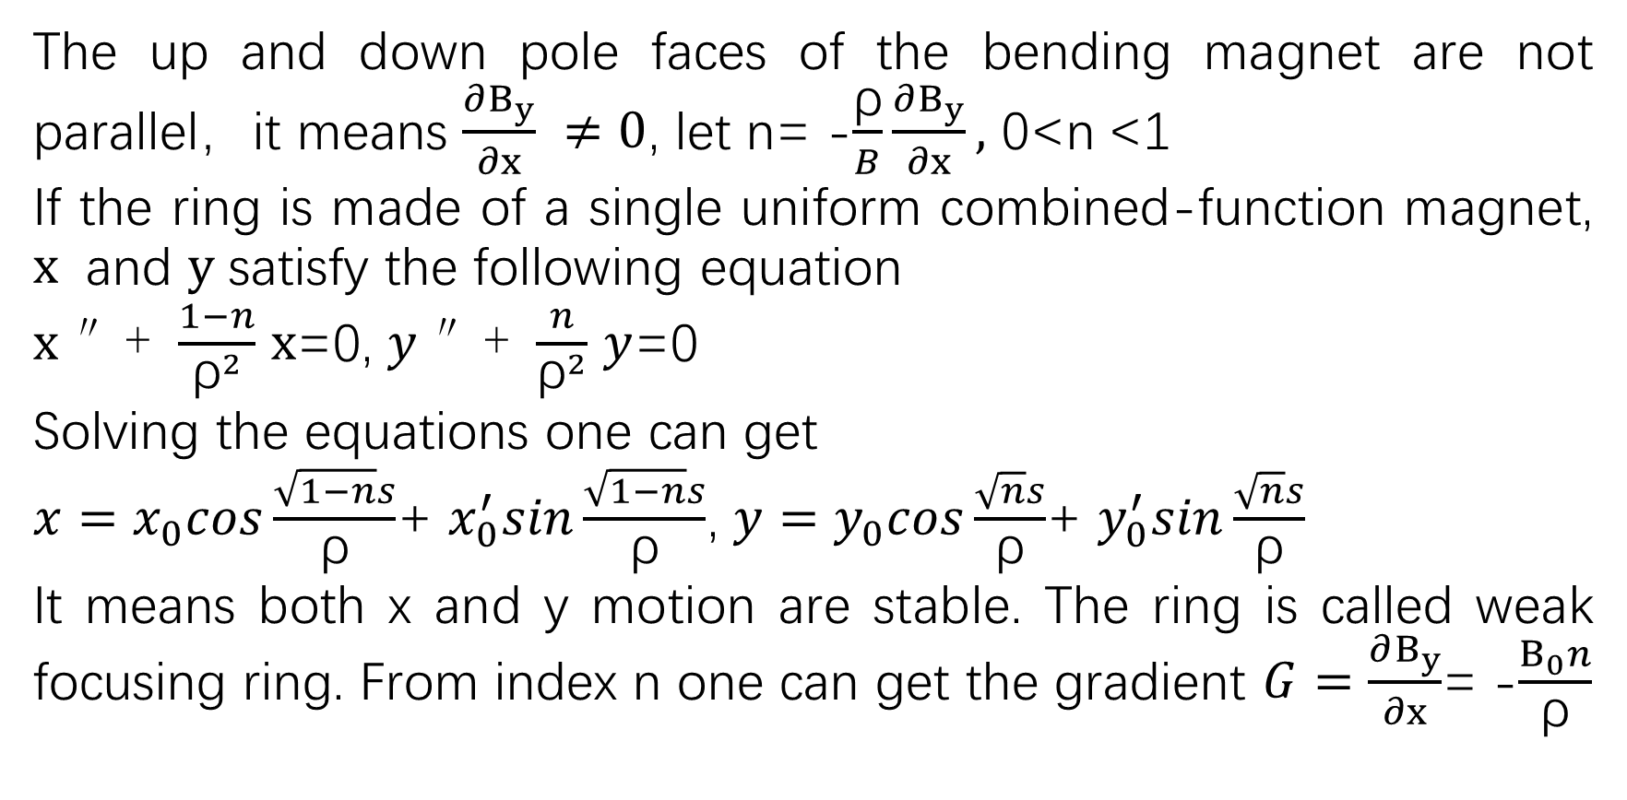
Weak focusing ring（弱聚焦环）
The up and down pole faces of the bending magnet are not parallel，it means $\frac{∂B_{y}}{∂x} ≠0$, let n= -$\frac{\text{ρ}}{B}\frac{∂B_{y}}{∂x},$ 0<n <1
If the ring is made of a single uniform combined-function magnet, $x$ and $y$ satisfy the following equation
$x$″+ $\frac{1−n}{{\text{ρ}}^{2}}$ $x$=0, $y$″+ $\frac{n}{{\text{ρ}}^{2}}$ $y$=0
Solving the equations one can get
$x=$ $x_{0}cos\frac{\sqrt{1−n}s}{\text{ρ}}$+ $x_{0}^{′}sin\frac{\sqrt{1−n}s}{\text{ρ}}$, $y=$ $y_{0}cos\frac{\sqrt{n}s}{\text{ρ}}$+ $y_{0}^{′}sin\frac{\sqrt{n}s}{\text{ρ}}$
It means both x and y motion are stable. The ring is called weak focusing ring. From index n one can get the gradient $G=\frac{∂B_{y}}{∂x}$= -$\frac{B_{0}n}{\text{ρ}}$

Slide 9
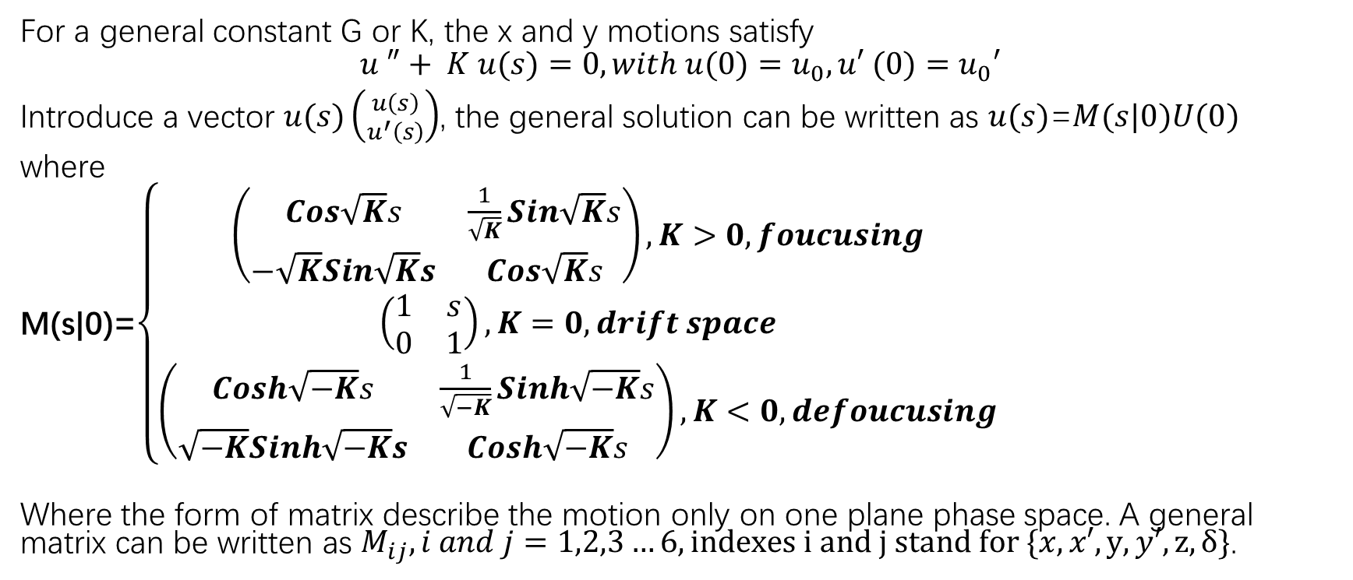
Matrix formalism（矩阵形式）
For a general constant G or K, the x and y motions satisfy
$$u ″+ K u(s)=0, with u(0)=u_{0}, u′ (0)=u_{0}′$$
Introduce a vector $u(s)\left({u\left(s\right) \atop u^{′}\left(s\right)}\right)$, the general solution can be written as $u(s)$=$M(s|0)U(0)$
where
M(s|0)=$\left\{\begin{aligned}\left(\begin{matrix}Cos\sqrt{K}s & \frac{1}{\sqrt{K}}Sin\sqrt{K}s \\ −\sqrt{K}Sin\sqrt{K}s & Cos\sqrt{K}s\end{matrix}\right),K>0,foucusing \\ \left(\begin{matrix}1 & s \\ 0 & 1\end{matrix}\right),K=0,drift space \\ \left(\begin{matrix}Cosh\sqrt{−K}s & \frac{1}{\sqrt{−K}}Sinh\sqrt{−K}s \\ \sqrt{−K}Sinh\sqrt{−K}s & Cosh\sqrt{−K}s\end{matrix}\right),K<0,defoucusing\end{aligned}\right.$
Where the form of matrix describe the motion only on one plane phase space. A general matrix can be written as $M_{ij},i and j=1,2,3…6,indexes i and j stand for \{x,x′,y,y′,z,δ\}$.

Slide 10

Thin-lens approximation（薄透镜近似）
Let $l→0, K→∞,$ $Kl=\frac{1}{f}$, $f$ is the focal length($f$>0), the transfer
matrixes are $M_{xf}$=$\left(\begin{matrix}1 & 0 \\ −\frac{1}{f} & 1\end{matrix}\right)$, $M_{y}$= $\left(\begin{matrix}1 & 0 \\ \frac{1}{f} & 1\end{matrix}\right)$, or
M= focusing magnet defocusing magnet

Slide 11

Sector dipole and rectangular dipole（扇形二极铁与矩形二极磁铁）
$M_{S}$=
$M_{R}$=
Sector dipole and rectangular dipole are different because they have different edge focusing effects.

Slide 12
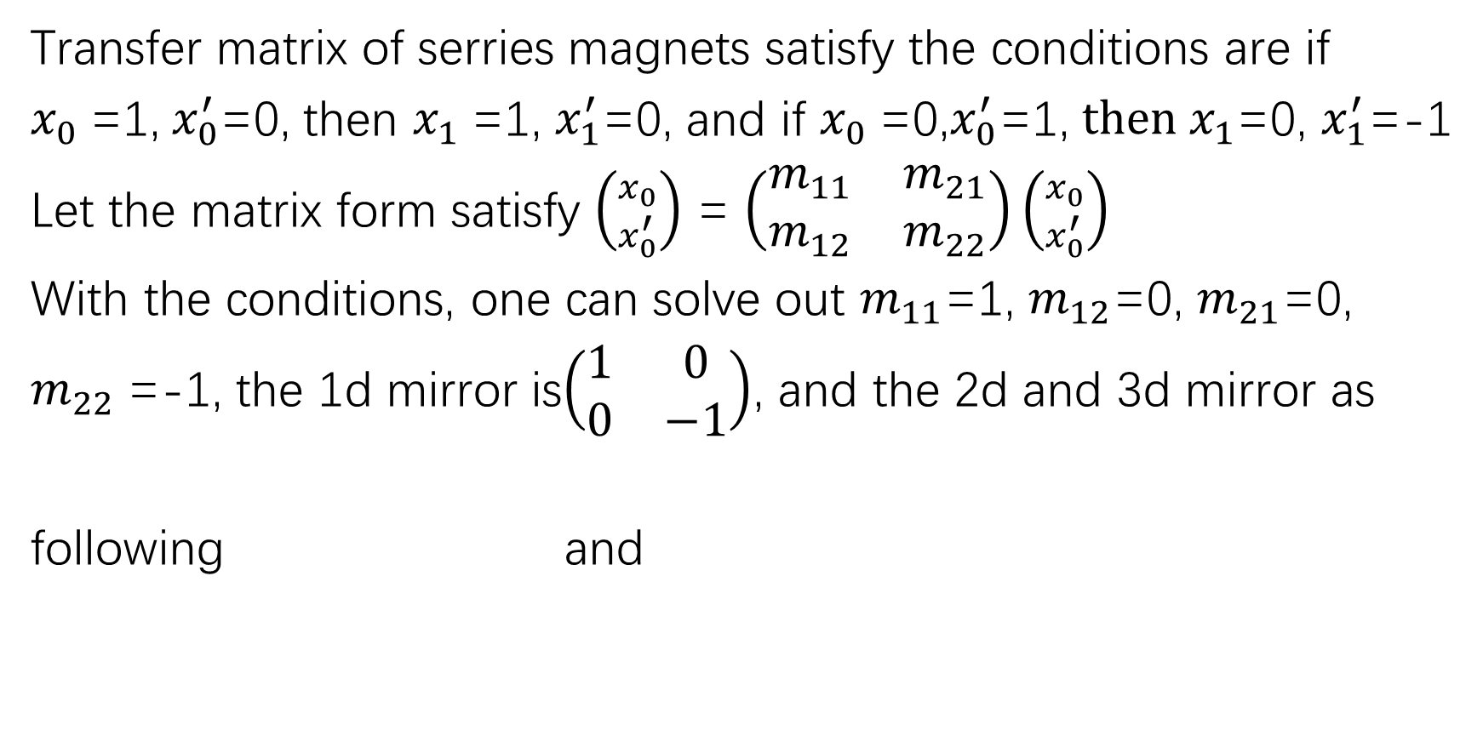

Mirror image system(镜像系统)
Transfer matrix of serries magnets satisfy the conditions are if
$x_{0}$=1,$x_{0}^{′}$=0, then $x_{1}$=1, $x_{1}^{′}$=0, and if $x_{0}$=0,$x_{0}^{′}$=1, ${then x}_{1}$=0, $x_{1}^{′}$=-1
Let the matrix form satisfy $\left({x_{0} \atop x_{0}^{′}}\right)$ = $\left(\begin{matrix}m_{11} & m_{21} \\ m_{12} & m_{22}\end{matrix}\right)\left({x_{0} \atop x_{0}^{′}}\right)$
With the conditions, one can solve out $m_{11}$=1, $m_{12}$=0, $m_{21}$=0,
$m_{22}$=-1, the 1d mirror is$\left(\begin{matrix}1 & 0 \\ 0 & −1\end{matrix}\right)$, and the 2d and 3d mirror as
following and
$$\left(\begin{matrix}1 & 0 & 0 & 0 & 0 & 0 \\ 0 & −1 & 0 & 0 & 0 & 0 \\ 0 & 0 & 1 & 0 & 0 & 0 \\ 0 & 0 & 0 & −1 & 0 & 0 \\ 0 & 0 & 0 & 0 & 1 & 0 \\ 0 & 0 & 0 & 0 & 0 & −1\end{matrix}\right)$$

Slide 13
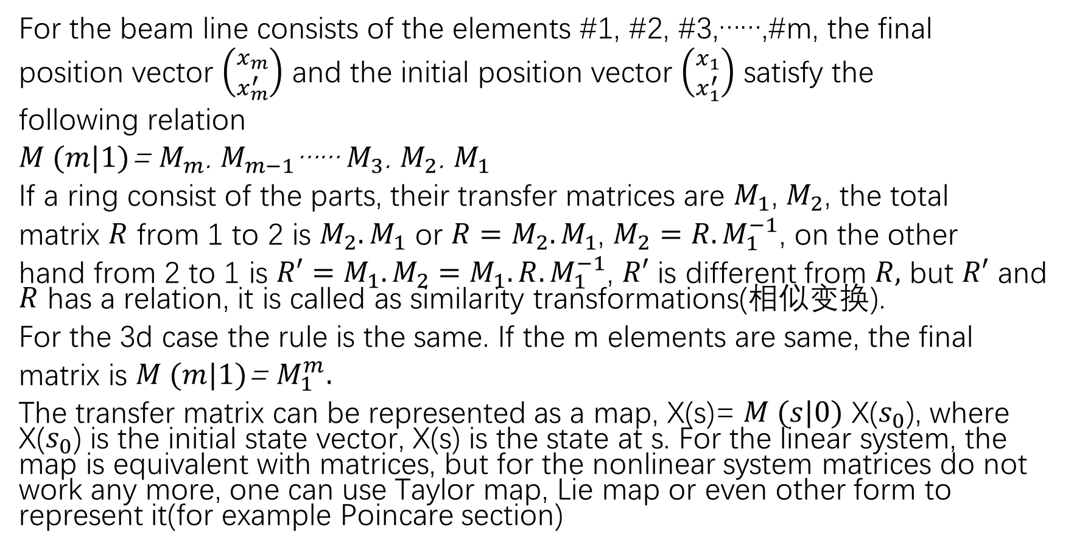
Chain of transfer matrices and map(传输矩阵链及映射)
For the beam line consists of the elements #1, #2, #3,……,#m, the final
position vector $\left({x_{m} \atop x_{m}^{′}}\right)$ and the initial position vector $\left({x_{1} \atop x_{1}^{′}}\right)$ satisfy the
following relation
$M (m|1)$= $M_{m}$. $M_{m−1}$…… $M_{3}$. $M_{2}$. $M_{1}$
If a ring consist of the parts, their transfer matrices are $M_{1}$, $M_{2}$, the total
matrix $R$ from 1 to 2 is $M_{2}.M_{1}$ or ${R=M}_{2}.M_{1}$, $M_{2}=R.M_{1}^{−1}$, on the other
hand from 2 to 1 is ${R′=M}_{1}.M_{2}=M_{1}.R.M_{1}^{−1}$, $R′$ is different from $R,$ but $R′$ and $R$ has a relation, it is called as similarity transformations(相似变换).
For the 3d case the rule is the same. If the m elements are same, the final
matrix is $M (m|1)$= $M_{1}^{m}.$
The transfer matrix can be represented as a map, X(s)= $M (s|0)$ X($s_{0}$), where X($s_{0}$) is the initial state vector, X(s) is the state at s. For the linear system, the map is equivalent with matrices, but for the nonlinear system matrices do not work any more, one can use Taylor map, Lie map or even other form to represent it(for example Poincare section)

Slide 14
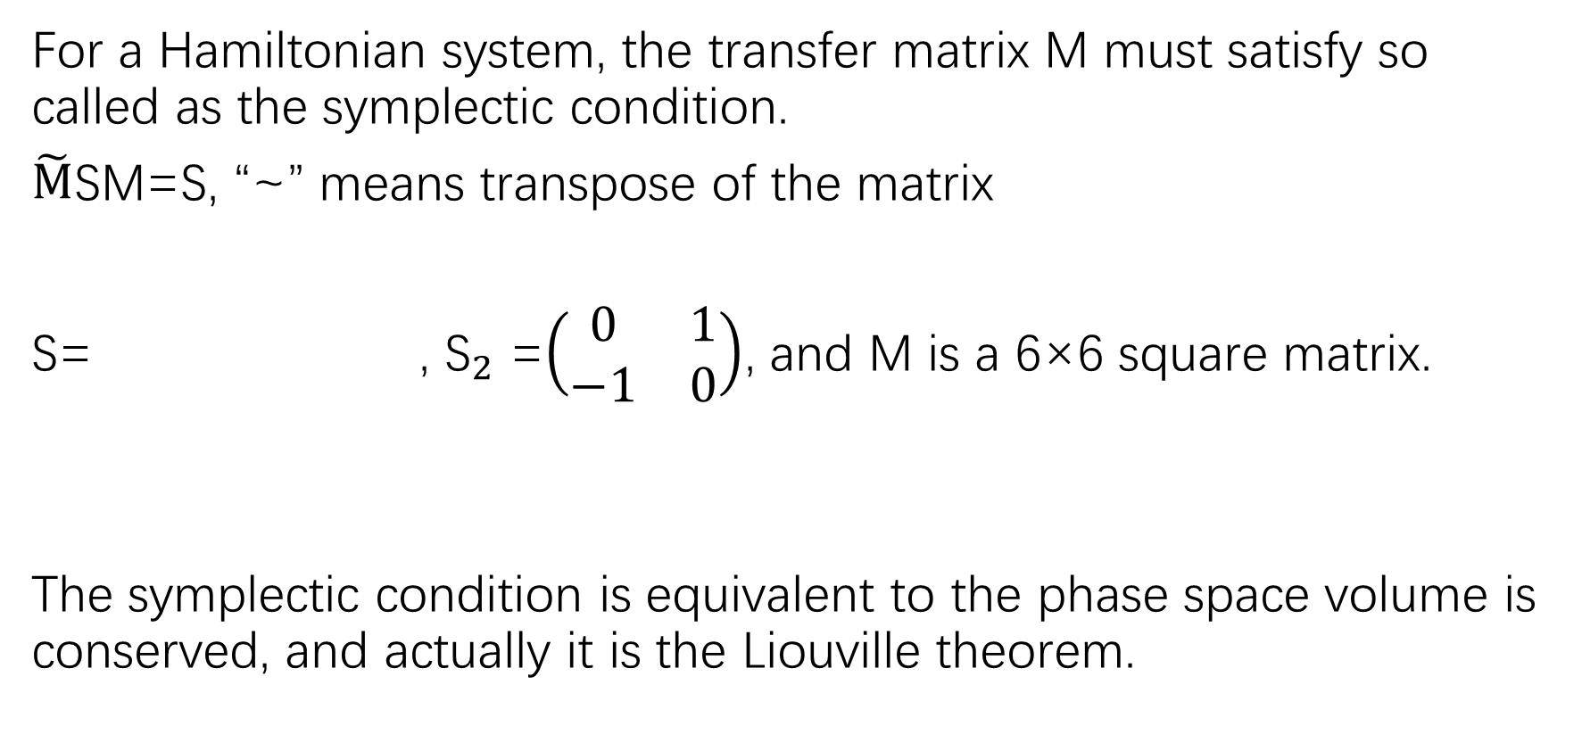
Symplecticity and Liouville theorem（辛和刘维定理）
For a Hamiltonian system, the transfer matrix M must satisfy so called as the symplectic condition.
$\tilde{M}$SM=S, “~” means transpose of the matrix
S= , ${\text{S}}_{2}$ =$\left(\begin{matrix}0 & 1 \\ −1 & 0\end{matrix}\right)$, and M is a 6×6 square matrix.
The symplectic condition is equivalent to the phase space volume is conserved, and actually it is the Liouville theorem.

Slide 15
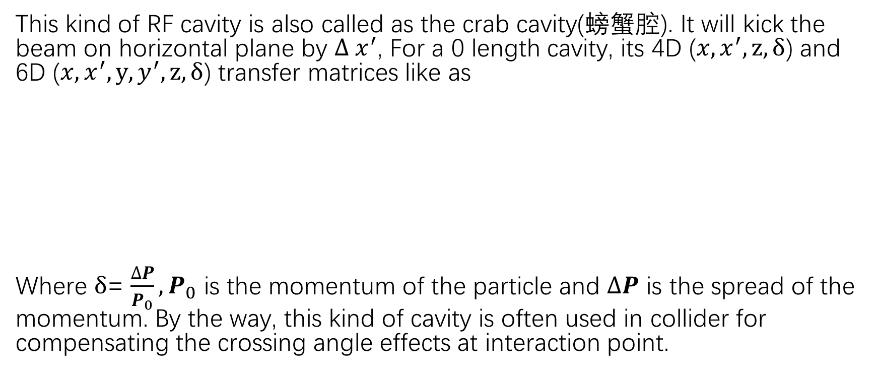
Transverse deflecting RF cavity(横向偏转腔)
This kind of RF cavity is also called as the crab cavity(螃蟹腔). It will kick the beam on horizontal plane by $∆ x^{′}$, For a 0 length cavity, its 4D ($x,x^{′},z,δ$) and 6D ($x,x^{′},y,y^{′},z,δ$) transfer matrices like as
Where $δ$= $\frac{∆P}{P_{0}},P_{0}$ is the momentum of the particle and $∆P$ is the spread of the momentum. By the way, this kind of cavity is often used in collider for compensating the crossing angle effects at interaction point.

Slide 16
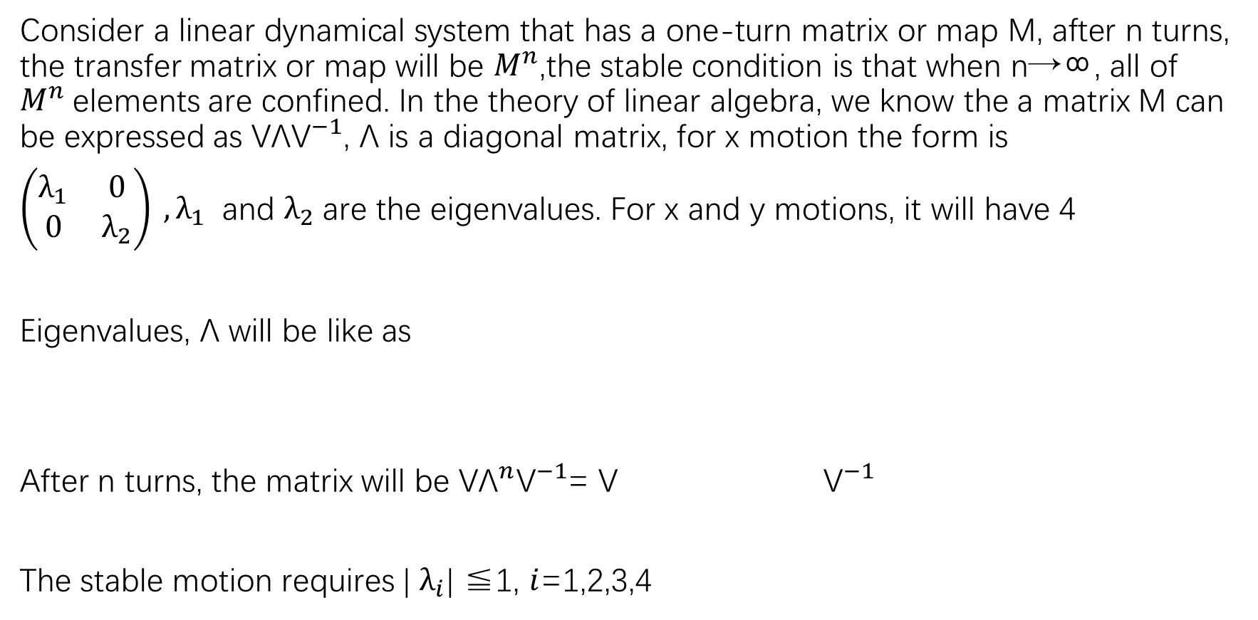
Stability criterion(稳定性判据)
Consider a linear dynamical system that has a one-turn matrix or map M, after n turns, the transfer matrix or map will be $M^{n}$,the stable condition is that when n→∞, all of $M^{n}$elements are confined. In the theory of linear algebra, we know the a matrix M can be expressed as ${\text{V}\text{Λ}\text{V}}^{−1}$, $\text{Λ}$ is a diagonal matrix, for x motion the form is
$\left(\begin{matrix}λ_{1} & 0 \\ 0 & λ_{2}\end{matrix}\right) ,λ_{1}$ and $λ_{2}$are the eigenvalues. For x and y motions, it will have 4
Eigenvalues, $\text{Λ}$ will be like as
After n turns, the matrix will be ${\text{V}\text{Λ}}^{n}{\text{V}}^{−1}$= $\text{V}$ ${\text{V}}^{−1}$
The stable motion requires | $λ_{i}\text{|}$ ≦1, $i$=1,2,3,4

Slide 17
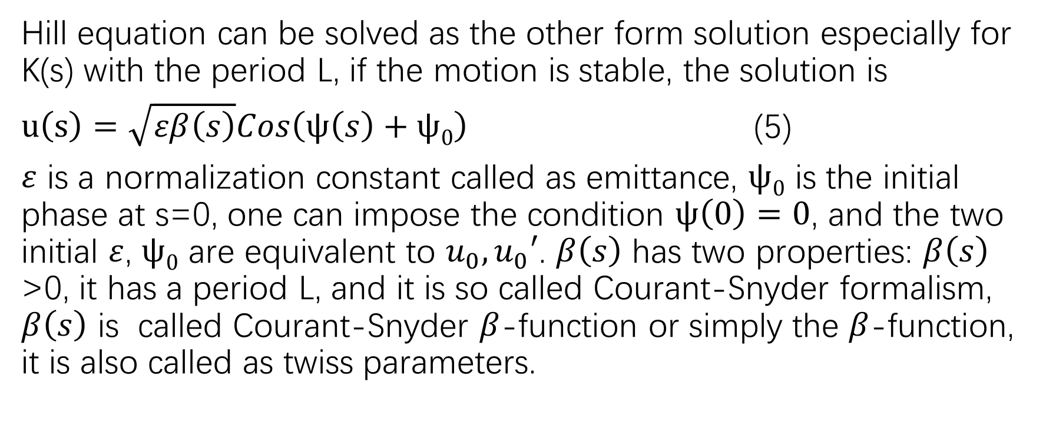
Courant-Snyder formalism(C-S形式)
Hill equation can be solved as the other form solution especially for K(s) with the period L, if the motion is stable, the solution is
$u\left(s\right)=\sqrt{εβ\left(s\right)}Cos\left(ψ\left(s\right)+ψ0\right)$ (5)
$ε$ is a normalization constant called as emittance, $ψ0$ is the initial phase at s=0, one can impose the condition $ψ\left(0\right)=0$, and the two initial $ε$, $ψ0$ are equivalent to $u_{0}, u_{0}′$. $β\left(s\right)$ has two properties: $β\left(s\right)$ >0, it has a period L, and it is so called Courant-Snyder formalism, $β\left(s\right)$ is called Courant-Snyder $β$-function or simply the $β$-function, it is also called as twiss parameters.

Slide 18
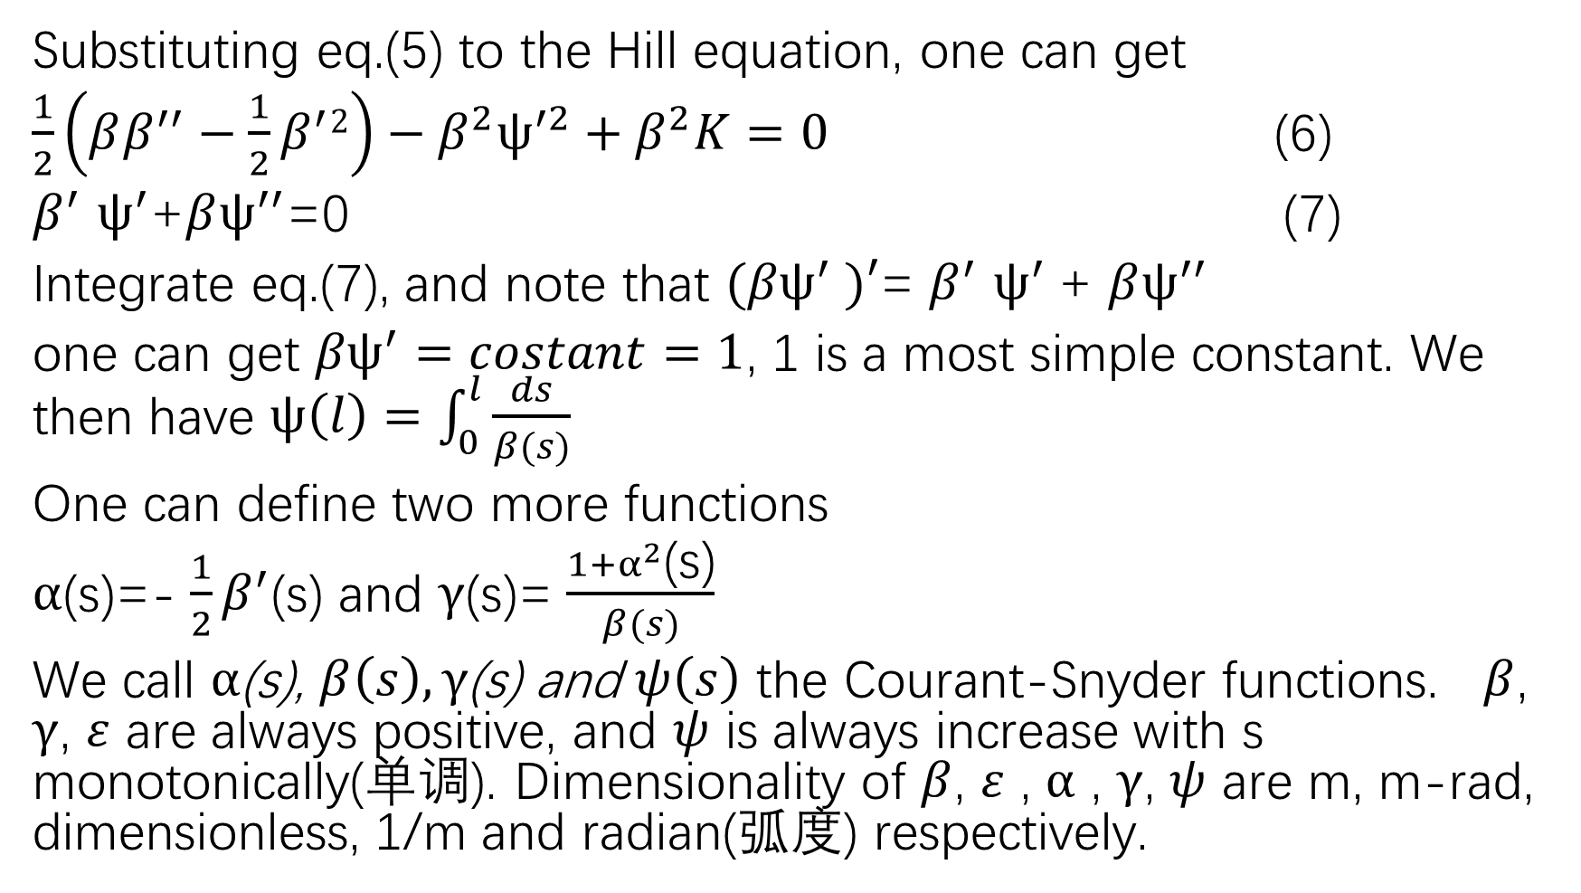
Substituting eq.(5) to the Hill equation, one can get
$\frac{1}{2}\left(ββ^{′′}−\frac{1}{2}β^{′}2\right)−β^{2}ψ^{′2}+β^{2}K=0$ (6)
$β^{′}$ $ψ^{′}$+$βψ^{′′}$=0 (7)
Integrate eq.(7), and note that ${(βψ}^{′} )′$= $β^{′}$ $ψ^{′}$+ $βψ^{′′}$
one can get ${βψ}^{′}=costant=1$, 1 is a most simple constant. We then have $ψ\left(l\right)=\int_{0}^{l}{\frac{ds}{β(s)}}$
One can define two more functions
$α$(s)=- $\frac{1}{2}β^{′}$(s) and $γ$(s)= $\frac{1+α^{2}\text{(}\text{s}\text{)}}{β(s)}$
We call $α$(s), $β\left(s\right),γ\text{(}\text{s}\text{)}$ and $ψ\left(s\right)$ the Courant-Snyder functions. $β$, $γ$, $ε$ are always positive, and $ψ$ is always increase with s monotonically(单调). Dimensionality of $β$, $ε$ , $α$ , $γ$, $ψ$ are m, m-rad, dimensionless, 1/m and radian(弧度) respectively.

Slide 19
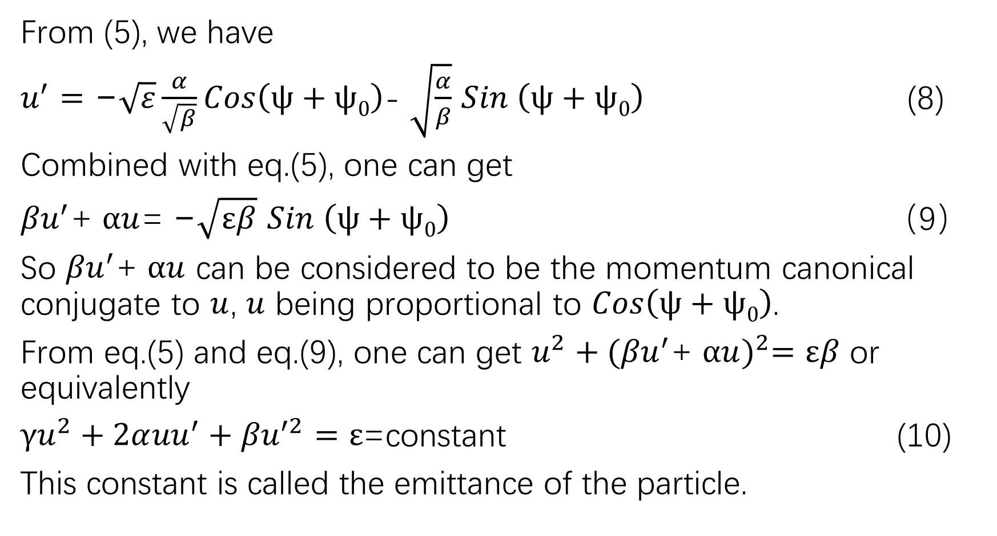
From (5), we have
$u^{′}=\text{−}\sqrt{ε}\frac{α}{\sqrt{β}}Cos\left(ψ+ψ0\right)$- $\sqrt{\frac{α}{β}}$ $Sin \left(ψ+ψ0\right)$ (8)
Combined with eq.(5), one can get
${βu}^{′}$+ $αu$= $\text{−}\sqrt{εβ}$ $Sin \left(ψ+ψ0\right)$ （9）
So ${βu}^{′}$+ $αu$ can be considered to be the momentum canonical conjugate to $u$, $u$ being proportional to $Cos\left(ψ+ψ0\right)$.
From eq.(5) and eq.(9), one can get $u^{2}+{({βu}^{′}\text{+} αu)}^{2}=εβ$ or equivalently
${γu}^{2}+2α{uu}^{′}+{βu}^{′2}=ε$=constant (10)
This constant is called the emittance of the particle.

Slide 20
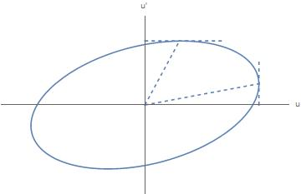






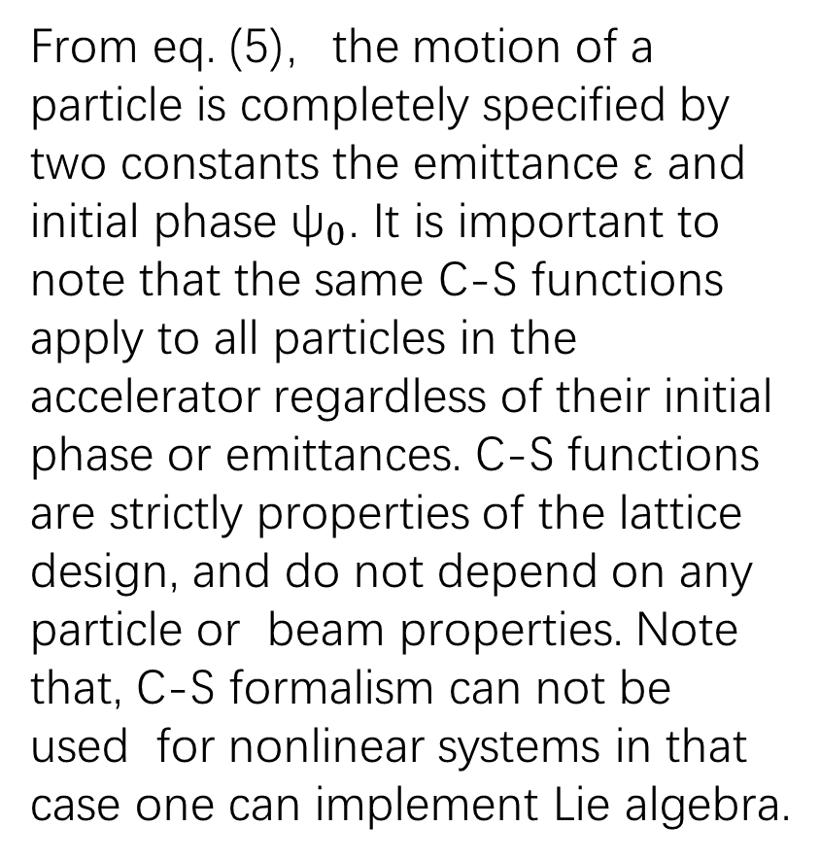
Phase space ellipse (相空间椭圆)
From eq. (5)，the motion of a particle is completely specified by two constants the emittance $\text{ε}$ and initial phase ${\text{ψ}}_{0}$. It is important to note that the same C-S functions apply to all particles in the accelerator regardless of their initial phase or emittances. C-S functions are strictly properties of the lattice design, and do not depend on any particle or beam properties. Note that, C-S formalism can not be used for nonlinear systems in that case one can implement Lie algebra.
$$\sqrt{\text{γε}}$$
$$\sqrt{\text{ε}\text{/}β}$$
$$\text{slop}\text{=−}\text{γ}/α$$
$$\text{slop}\text{=−}α/β$$
$$\sqrt{\text{ε}β}$$
$$\sqrt{\text{ε}\text{/}γ}$$
Area=πε
The Courant-Snyder phase space ellipse

Slide 21
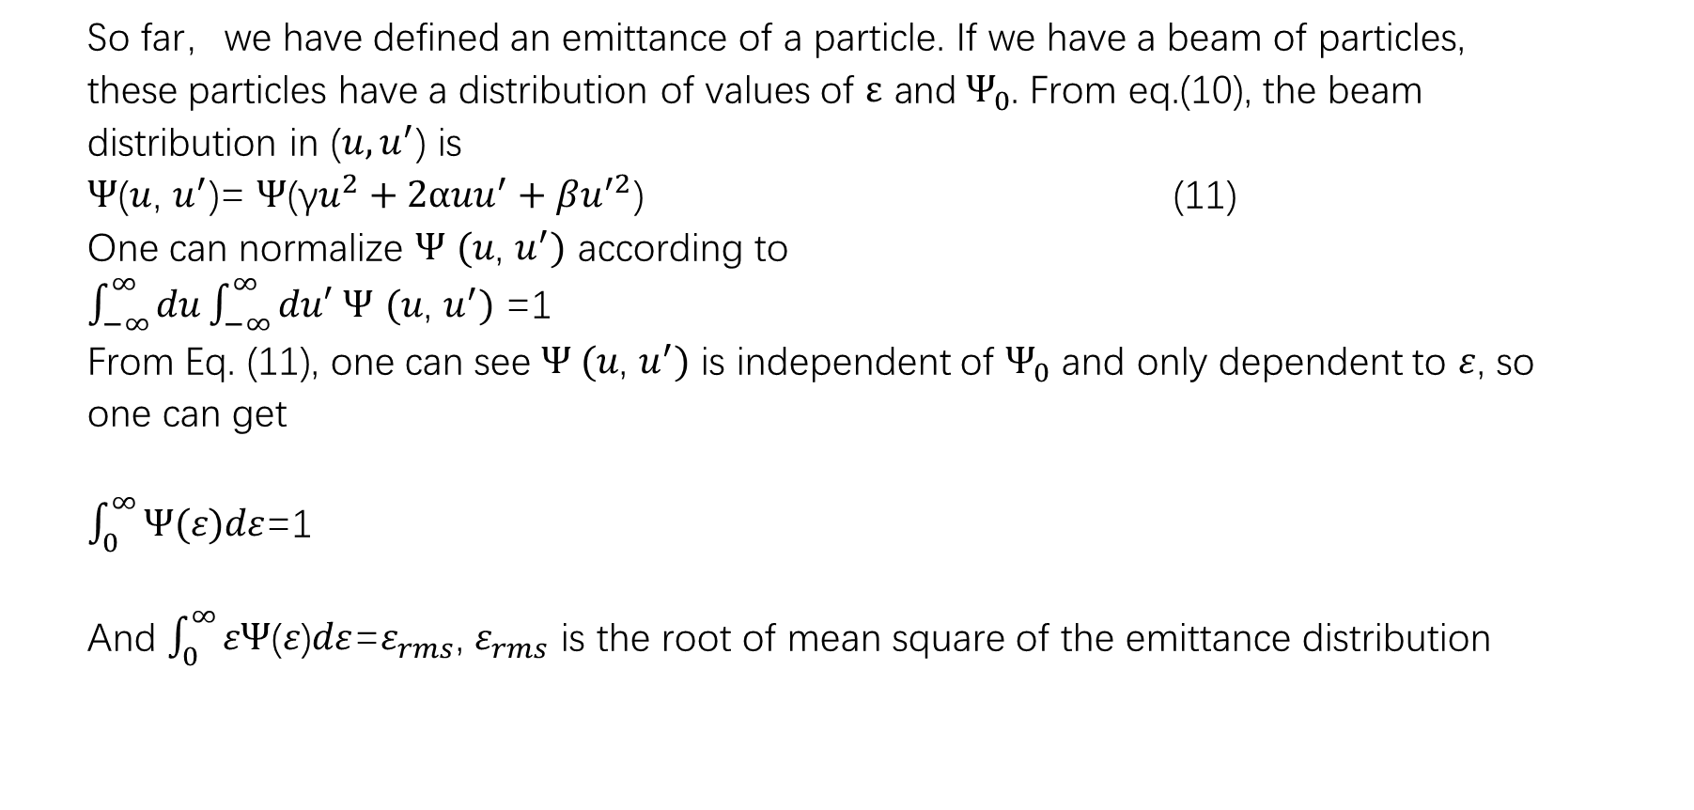
Beam emittance(束流发射度)
So far，we have defined an emittance of a particle. If we have a beam of particles,
these particles have a distribution of values of $ε{ \text{and} Ψ}_{0}$. From eq.(10), the beam
distribution in (${u,u}^{′}$) is
$Ψ$($u$, $u^{′}$)= $Ψ$(γ$u^{2}+2α{uu}^{′}+βu^{′2}$) (11)
One can normalize $Ψ$ $(u\text{, }u^{′})$ according to
$\int_{−∞}^{∞}{du}\int_{−∞}^{∞}{du′}$ $Ψ$ $(u\text{, }u^{′})$ =1
From Eq. (11), one can see $Ψ (u\text{, }u^{′})$ is independent of $Ψ_{0}$ and only dependent to $ε$, so
one can get
$\int_{0}^{∞}{Ψ\text{(}ε\text{)}dε}$=1
And $\int_{0}^{∞}{εΨ\text{(}ε\text{)}dε}$=$ε_{rms}$, $ε_{rms}$ is the root of mean square of the emittance distribution

Slide 22
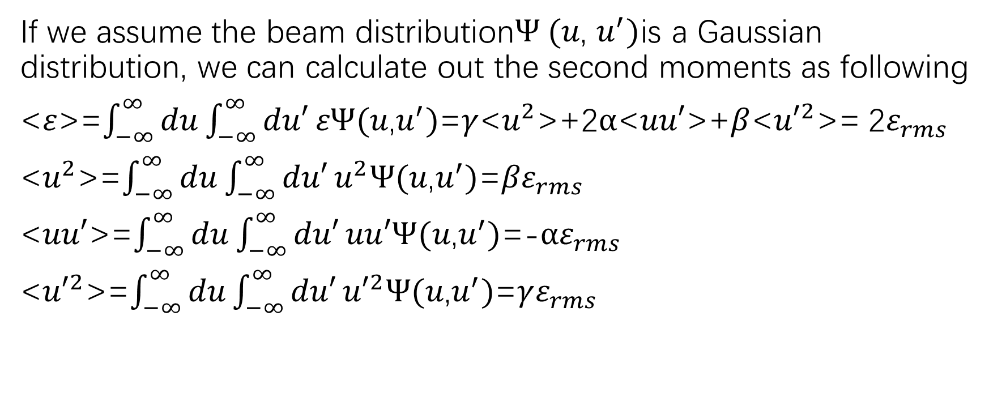
Beam distribution moments(束流分布矩)
If we assume the beam distribution$Ψ (u\text{, }u^{′})$is a Gaussian distribution, we can calculate out the second moments as following
<$ε$>=$\int_{−∞}^{∞}{du}\int_{−∞}^{∞}{du′}εΨ(u\text{,}u^{′})$=$γ$<$u^{2}$>+2$α$<$uu′$>+$β$<${u′}^{2}$>= 2$ε_{rms}$
<$u^{2}$>=$\int_{−∞}^{∞}{du}\int_{−∞}^{∞}{du′}u^{2}Ψ(u\text{,}u^{′})$=${βε}_{rms}$
<$uu′$>=$\int_{−∞}^{∞}{du}\int_{−∞}^{∞}{du′}uu′Ψ(u\text{,}u^{′})$=-$αε_{rms}$
<${u′}^{2}$>=$\int_{−∞}^{∞}{du}\int_{−∞}^{∞}{du′}{u′}^{2}Ψ(u\text{,}u^{′})$=$γε_{rms}$

Slide 23
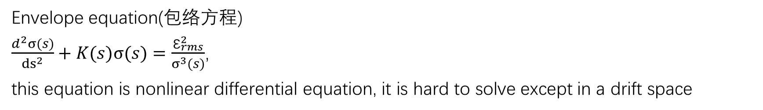
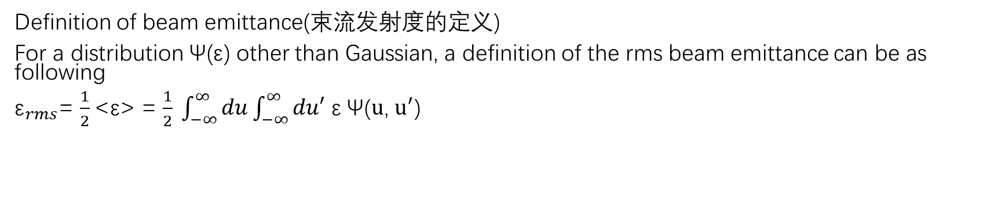
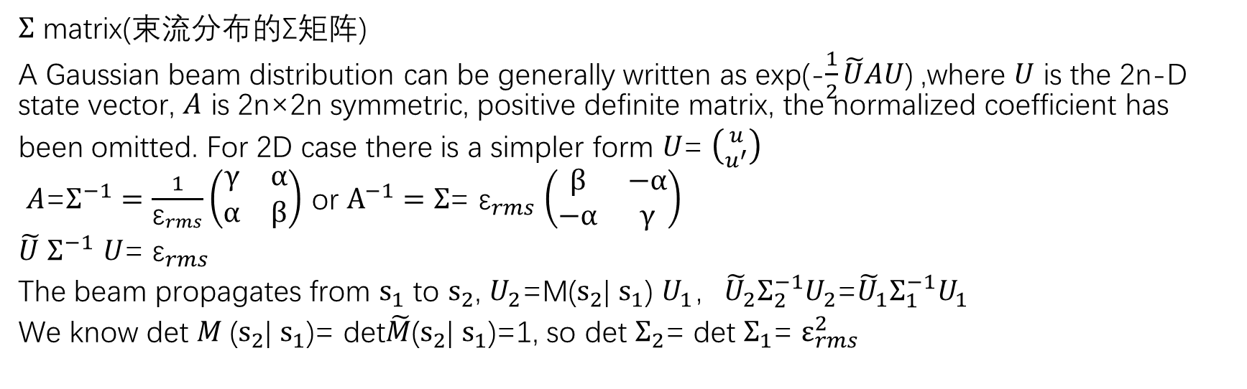
Definition of beam emittance(束流发射度的定义)
For a distribution $\text{Ψ}\text{(}\text{ε}\text{)}$ other than Gaussian, a definition of the rms beam emittance can be as following
${\text{ε}}_{rms}$= $\frac{1}{2}$<$\text{ε}$> = $\frac{1}{2} \int_{−∞}^{∞}{du}\int_{−∞}^{∞}{du′}$ $\text{ε}$Ψ($u$, $u^{′}$)
Envelope equation(包络方程)
$\frac{d^{2}σ(s)}{{ds}^{2}}+K(s)σ(s)=\frac{{\text{ε}}_{rms}^{2}}{σ^{3}(s)}$,
this equation is nonlinear differential equation, it is hard to solve except in a drift space
$Σ$ matrix(束流分布的Σ矩阵)
A Gaussian beam distribution can be generally written as exp(-$\frac{1}{2}\tilde{U}AU$) ,where $U$ is the 2n-D state vector, $A$ is 2n×2n symmetric, positive definite matrix, the normalized coefficient has
been omitted. For 2D case there is a simpler form $U$= $\left({u \atop u^{′}}\right)$
$A$=$Σ^{−1}=\frac{1}{{\text{ε}}_{rms}}\left(\begin{matrix}γ & α \\ α & β\end{matrix}\right)$ or $A^{−1}=Σ$= ${\text{ε}}_{rms}$ $\left(\begin{matrix}β & −α \\ −α & γ\end{matrix}\right)$
$\tilde{U}$ $Σ^{−1}$ $U$= ${\text{ε}}_{rms}$
The beam propagates from ${\text{s}}_{1}$ to ${\text{s}}_{2}$, $U_{2}$=M(${\text{s}}_{2}$| ${\text{s}}_{1}$) $U_{1}$，${\tilde{U}}_{2}Σ_{2}^{−1}U_{2}$=${\tilde{U}}_{1}Σ_{1}^{−1}U_{1}$
We know det $M$(${\text{s}}_{2}$| ${\text{s}}_{1}$)= det$\tilde{M}$(${\text{s}}_{2}$| ${\text{s}}_{1}$)=1, so det $Σ_{2}$= det $Σ_{1}$= $ε_{rms}^{2}$

Slide 24
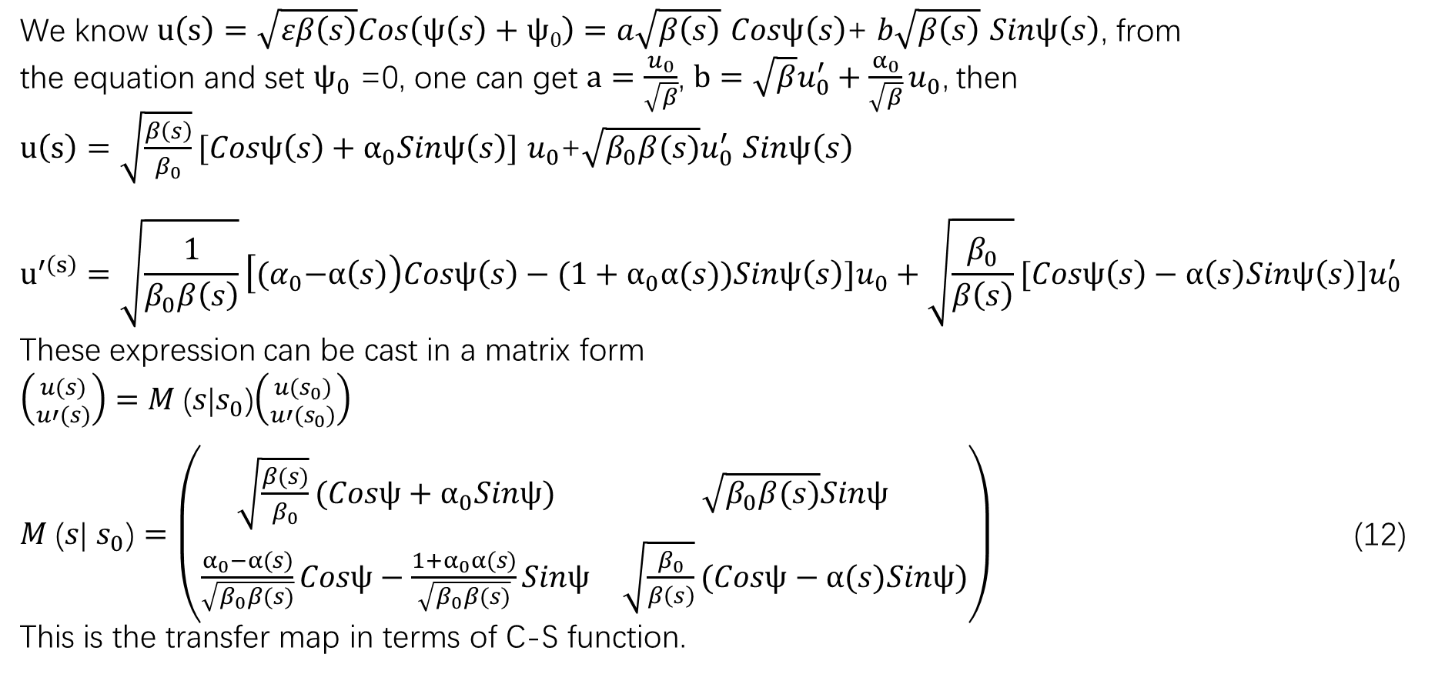
Transfer map in terms of C-S function(传输映射的C-S函数表示)
We know $u\left(s\right)=\sqrt{εβ\left(s\right)}Cos\left(ψ\left(s\right)+ψ0\right)=a\sqrt{β\left(s\right)}$ $Cosψ\left(s\right)$+ $b\sqrt{β\left(s\right)}$ $Sinψ\left(s\right)$, from
the equation and set $ψ_{0}$ =0, one can get $a=\frac{u_{0}}{\sqrt{β}}$, $b=\sqrt{β}u_{0}^{′}+\frac{α_{0}}{\sqrt{β}}u_{0}$, then
$u\left(s\right)=\sqrt{\frac{β\left(s\right)}{β_{0}}}[Cosψ\left(s\right)+α_{0}Sinψ\left(s\right)]$ $u_{0}$+$\sqrt{β_{0}β(s)}u_{0}^{′}$ $Sinψ\left(s\right)$
$$u^{′\left(s\right)}=\sqrt{\frac{1}{β_{0}β\left(s\right)}}\left[{(α}_{0}−α\left(s\right)\right)Cosψ\left(s\right)−(1+α_{0}α(s))Sinψ\left(s\right)]u_{0}+\sqrt{\frac{β_{0}}{β\left(s\right)}}[Cosψ\left(s\right)−α\left(s\right)Sinψ\left(s\right)]u_{0}^{′}$$
These expression can be cast in a matrix form
$\left({u(s) \atop u′(s)}\right)=M$($s$|$s_{0}$)$\left({u(s_{0}) \atop u′(s_{0})}\right)$
$M$($s$| $s_{0}$) $=\left(\begin{matrix}\sqrt{\frac{β(s)}{β_{0}}}(Cosψ+α_{0}Sinψ) & \sqrt{β_{0}β(s)}Sinψ \\ \frac{α_{0}−α(s)}{\sqrt{β_{0}β(s)}}Cosψ−\frac{{1+α}_{0}α(s)}{\sqrt{β_{0}β(s)}}Sinψ & \sqrt{\frac{β_{0}}{β\left(s\right)}}(Cosψ−α(s)Sinψ)\end{matrix}\right)$ (12)
This is the transfer map in terms of C-S function.

Slide 25
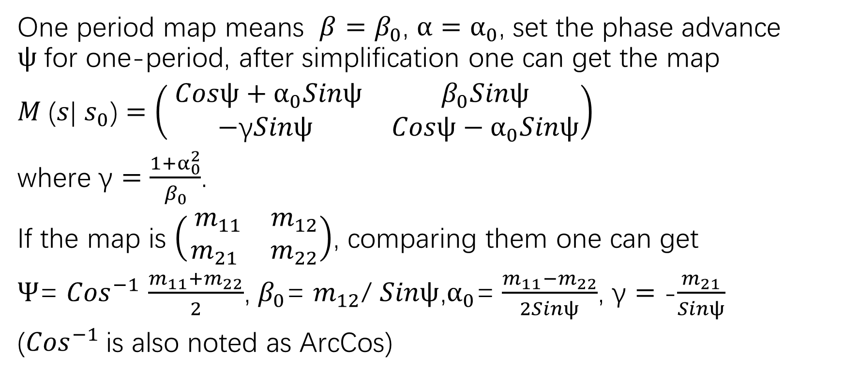
One-period map(一个周期的映射)
One period map means $β=β_{0}$, $α=α_{0}$, set the phase advance $ψ$for one-period, after simplification one can get the map
$M$($s$| $s_{0}$) $=\left(\begin{matrix} Cosψ+α_{0}Sinψ & β_{0}Sinψ \\ −\text{γ}Sinψ & Cosψ−α_{0}Sinψ\end{matrix}\right)$
where $\text{γ}=\frac{1+α_{0}^{2}}{β_{0}}$.
If the map is $\left(\begin{matrix} m_{11} & m_{12} \\ m_{21} & m_{22}\end{matrix}\right)$, comparing them one can get
$Ψ$= ${Cos}^{−1}$ $\frac{m_{11}+m_{22}}{2}$, $β_{0}$= $m_{12}$/ $Sinψ$,$α_{0}$= $\frac{m_{11}−m_{22}}{2Sinψ}$, $\text{γ}=$ -$\frac{m_{21}}{Sinψ}$
(${Cos}^{−1}$is also noted as ArcCos)

Slide 26
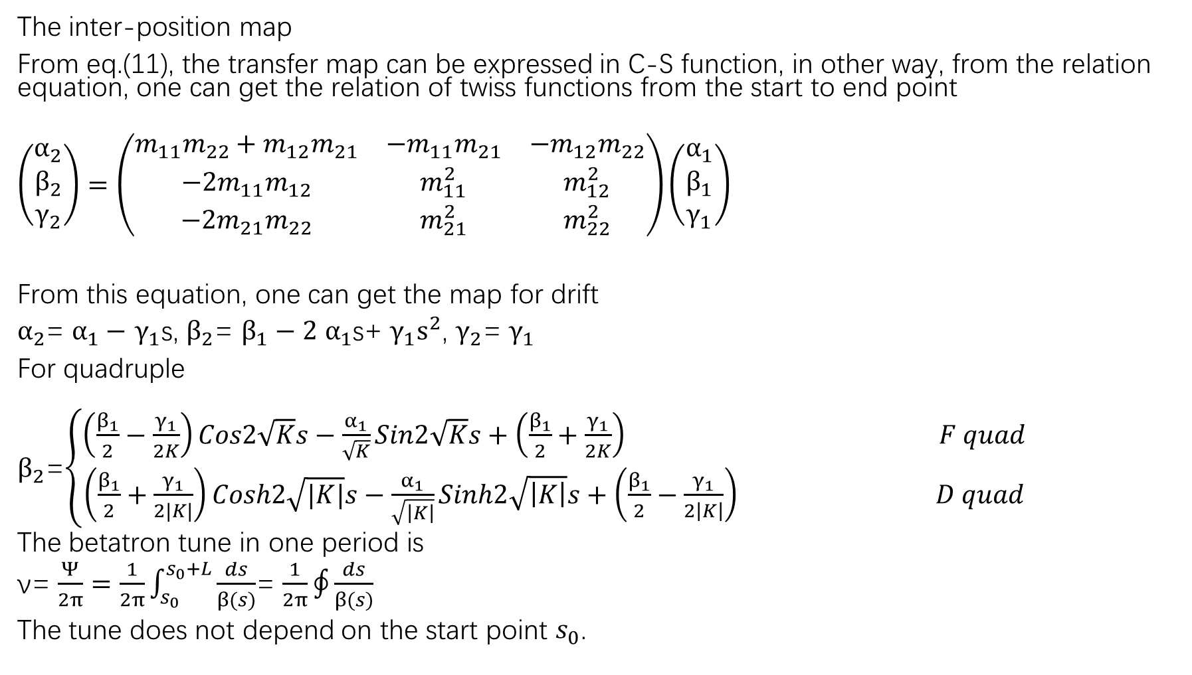
The inter-position map
From eq.(11), the transfer map can be expressed in C-S function, in other way, from the relation equation, one can get the relation of twiss functions from the start to end point
$$\left(\begin{matrix}α_{2} \\ β_{2} \\ γ_{2}\end{matrix}\right)=\left(\begin{matrix}m_{11}m_{22}+m_{12}m_{21} & {−m}_{11}m_{21} & {−m}_{12}m_{22} \\ {−2m}_{11}m_{12} & m_{11}^{2} & m_{12}^{2} \\ {−2m}_{21}m_{22} & m_{21}^{2} & m_{22}^{2}\end{matrix}\right)\left(\begin{matrix}α_{1} \\ β_{1} \\ γ_{1}\end{matrix}\right)$$
From this equation, one can get the map for drift
$α_{2}$= $α_{1}−$ $γ_{1}$s, $β_{2}$= $β_{1}−2$ $α_{1}$s+ $γ_{1}s^{2}$, $γ_{2}$= $γ_{1}$
For quadruple
$β_{2}$=$\left\{\begin{aligned}\left(\frac{β_{1}}{2}−\frac{γ_{1}}{2K}\right)Cos2\sqrt{K}s−\frac{α_{1}}{\sqrt{K}}Sin2\sqrt{K}s+\left(\frac{β_{1}}{2}+\frac{γ_{1}}{2K}\right) F quad \\ \left(\frac{β_{1}}{2}+\frac{γ_{1}}{2|K|}\right)Cosh2\sqrt{|K|}s−\frac{α_{1}}{\sqrt{\left|K\right|}}Sinh2\sqrt{\left|K\right|}s+\left(\frac{β_{1}}{2}−\frac{γ_{1}}{2\left|K\right|}\right) D quad\end{aligned}\right.$
The betatron tune in one period is
ν= $\frac{Ψ}{2π}=$ $\frac{1}{2π}\int_{s_{0}}^{s_{0}+L}{\frac{ds}{β(s)}}$= $\frac{1}{2π}\oint{\frac{ds}{β(s)}}$
The tune does not depend on the start point $s_{0}$.

Slide 27
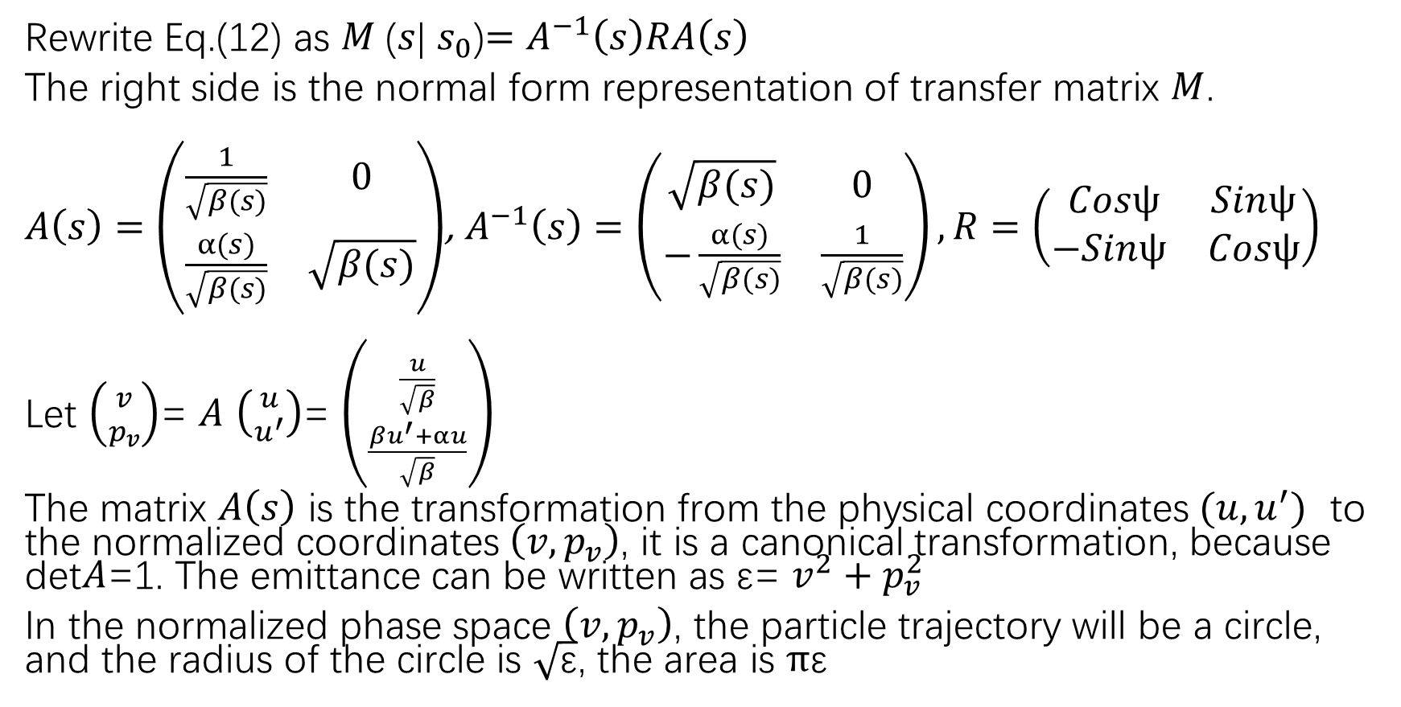
Normal form(规范形式)
Rewrite Eq.(12) as $M$($s$| $s_{0}$)$=A^{−1}\left(s\right)RA\left(s\right)$
The right side is the normal form representation of transfer matrix $M$.
$A\left(s\right)=\left(\begin{matrix}\frac{1}{\sqrt{β(s)}} & 0 \\ \frac{α(s)}{\sqrt{β(s)}} & \sqrt{β(s)}\end{matrix}\right)$, $A^{−1}\left(s\right)=\left(\begin{matrix}\sqrt{β(s)} & 0 \\ −\frac{α(s)}{\sqrt{β(s)}} & \frac{1}{\sqrt{β(s)}}\end{matrix}\right),R=\left(\begin{matrix} Cosψ & Sinψ \\ −Sinψ & Cosψ\end{matrix}\right)$
Let $\left({v \atop p_{v}}\right)$= $A$ $\left({u \atop u^{′}}\right)$= $\left({\frac{u}{\sqrt{β}} \atop \frac{βu^{′}+αu}{\sqrt{β}}}\right)$
The matrix $A\left(s\right)$ is the transformation from the physical coordinates $(u,u^{′})$ to the normalized coordinates $\left(v,p_{v}\right)$, it is a canonical transformation, because det$A$=1. The emittance can be written as ε= $v^{2}+p_{v}^{2}$
In the normalized phase space $\left(v,p_{v}\right)$, the particle trajectory will be a circle, and the radius of the circle is $\sqrt{\text{ε}}$, the area is $π\text{ε}$

Slide 28
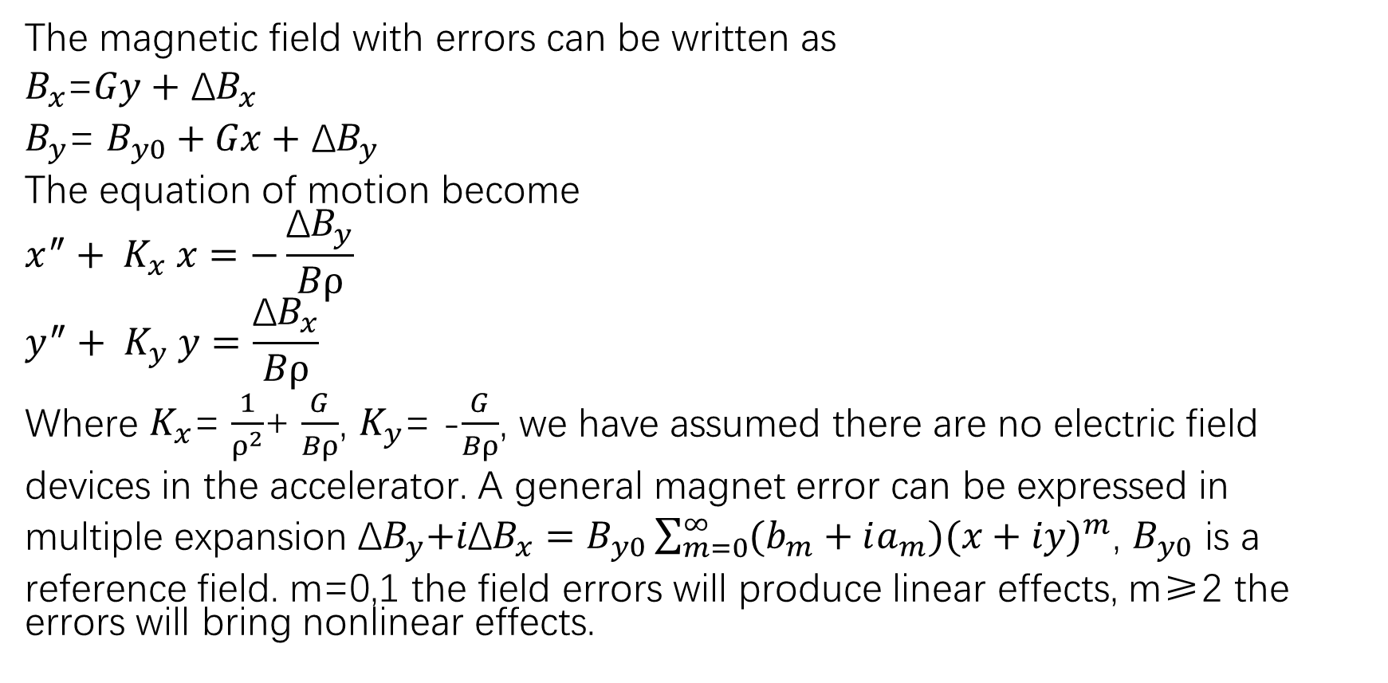
Field error(场误差)
The magnetic field with errors can be written as
$B_{x}$=$Gy+$ ${\text{Δ}B}_{x}$
$B_{y}$= $B_{y0}+Gx+$ ${\text{Δ}B}_{y}$
The equation of motion become
$$x^{″}+ K_{x} x=−\frac{{\text{Δ}B}_{y}}{Bρ}$$
$$y^{″}+ K_{y} y=\frac{{\text{Δ}B}_{x}}{Bρ}$$
Where $K_{x}$= $\frac{1}{ρ^{2}}$+ $\frac{G}{Bρ}$, $K_{y}$= -$\frac{G}{Bρ}$, we have assumed there are no electric field
devices in the accelerator. A general magnet error can be expressed in
multiple expansion ${{\text{Δ}B}_{y}\text{+}i\text{Δ}B}_{x}=B_{y0}\sum_{m=0}^{∞}{(b_{m}+ia_{m}){(x+iy)}^{m}}$, $B_{y0}$ is a
reference field. m=0,1 the field errors will produce linear effects, m≥2 the errors will bring nonlinear effects.

Slide 29
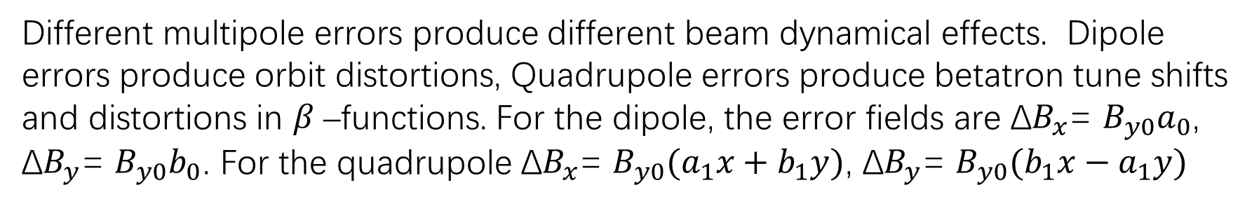
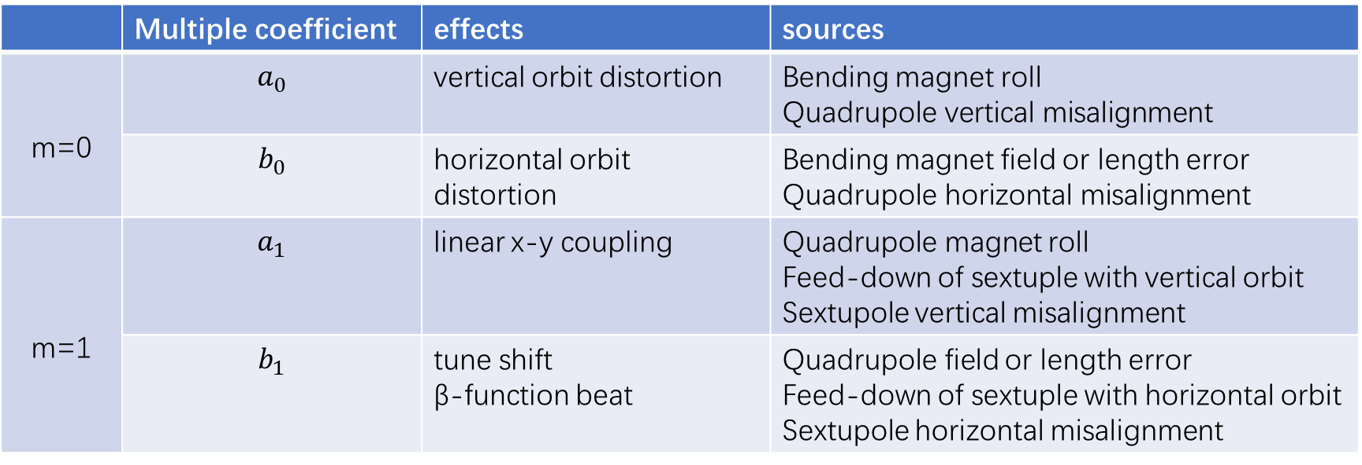
Dipole and quadrupole field errors，effects and sources
(二四极磁铁场误差效应及来源)
 | Multiple coefficient | effects | sources
m=0 | $$a_{0}$$ | vertical orbit distortion | Bending magnet roll Quadrupole vertical misalignment
 | $$b_{0}$$ | horizontal orbit distortion | Bending magnet field or length error Quadrupole horizontal misalignment
m=1 | $$a_{1}$$ | linear x-y coupling | Quadrupole magnet roll Feed-down of sextuple with vertical orbit Sextupole vertical misalignment
 | $$b_{1}$$ | tune shift β-function beat | Quadrupole field or length error Feed-down of sextuple with horizontal orbit Sextupole horizontal misalignment
Different multipole errors produce different beam dynamical effects. Dipole errors produce orbit distortions, Quadrupole errors produce betatron tune shifts and distortions in $β$–functions. For the dipole, the error fields are ${\text{Δ}B}_{x}$= $B_{y0}a_{0}$, ${\text{Δ}B}_{y}$= $B_{y0}b_{0}$. For the quadrupole ${\text{Δ}B}_{x}$= $B_{y0}(a_{1}x+b_{1}y)$, ${\text{Δ}B}_{y}$= $B_{y0}(b_{1}x−a_{1}y)$

Slide 30
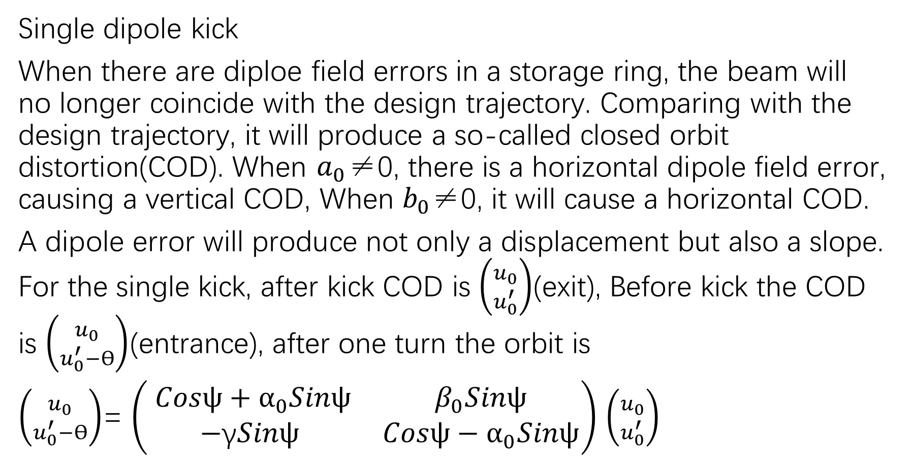
Orbit distortion(轨道畸变)
Single dipole kick
When there are diploe field errors in a storage ring, the beam will no longer coincide with the design trajectory. Comparing with the design trajectory, it will produce a so-called closed orbit distortion(COD). When $a_{0}$≠0, there is a horizontal dipole field error, causing a vertical COD, When $b_{0}$≠0, it will cause a horizontal COD.
A dipole error will produce not only a displacement but also a slope. For the single kick, after kick COD is $\left({u_{0} \atop u_{0}^{′}}\right)$(exit), Before kick the COD is $\left({u_{0} \atop u_{0}^{′}−ϴ}\right)$(entrance), after one turn the orbit is
$\left({u_{0} \atop u_{0}^{′}−ϴ}\right)$= $\left(\begin{matrix} Cosψ+α_{0}Sinψ & β_{0}Sinψ \\ −\text{γ}Sinψ & Cosψ−α_{0}Sinψ\end{matrix}\right)$ $\left({u_{0} \atop u_{0}^{′}}\right)$

Slide 31
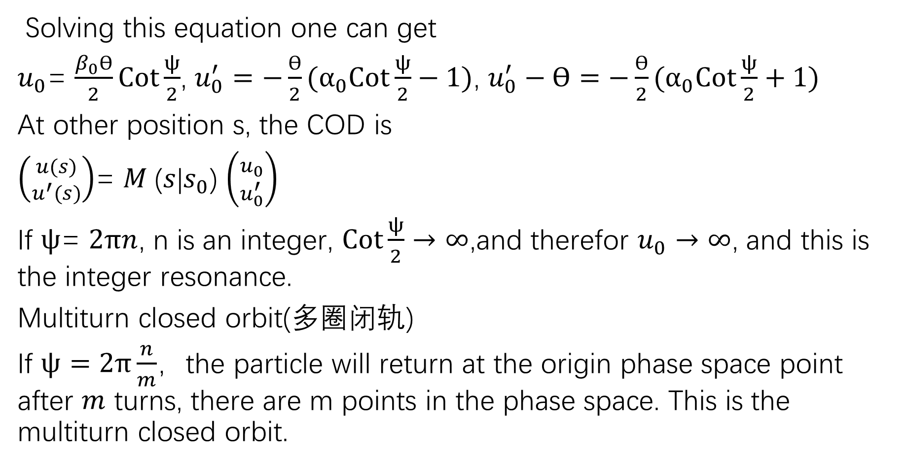
Solving this equation one can get
$u_{0}$= $\frac{β_{0}ϴ}{2}Cot\frac{ψ}{2}$, $u_{0}^{′}=−\frac{ϴ}{2}(α_{0}Cot\frac{ψ}{2}−1)$, $u_{0}^{′}−ϴ=−\frac{ϴ}{2}(α_{0}Cot\frac{ψ}{2}+1)$
At other position s, the COD is
$\left({u(s) \atop u^{′}(s)}\right)$= $M$($s$|$s_{0}$) $\left({u_{0} \atop u_{0}^{′}}\right)$
If $ψ$= $2πn$, n is an integer, $Cot\frac{ψ}{2}→∞$,and therefor $u_{0}→∞$, and this is the integer resonance.
Multiturn closed orbit(多圈闭轨)
If $ψ=2π\frac{n}{m}$，the particle will return at the origin phase space point after $m$ turns, there are m points in the phase space. This is the multiturn closed orbit.

Slide 32
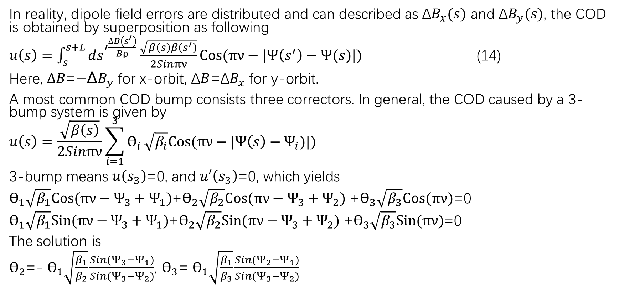
Distributed dipole error and closed orbit bump
(分布式二极误差及局部突轨)
In reality, dipole field errors are distributed and can described as ${\text{Δ}B}_{x}(s)$ and ${\text{Δ}B}_{y}(s)$, the COD is obtained by superposition as following
$u\left(s\right)=\int_{s}^{s+L}{ds^{′\frac{∆B\left(s^{′}\right)}{Bρ}}}\frac{\sqrt{β\left(s\right)β\left(s^{′}\right)}}{2Sinπν}Cos(πν−|Ψ\left(s^{′}\right)−Ψ(s)|)$ (14)
Here, $∆B$=${\text{−}\text{∆}B}_{y}$ for x-orbit, $\text{Δ}B$=${\text{Δ}B}_{x}$ for y-orbit.
A most common COD bump consists three correctors. In general, the COD caused by a 3-bump system is given by
$$u\left(s\right)=\frac{\sqrt{β\left(s\right)}}{2Sinπν}\sum_{i=1}^{3}{ϴ_{i}}\sqrt{β_{i}}Cos(πν−|Ψ\left(s\right)−Ψ_{i})|)$$
3-bump means $u\left(s_{3}\right)$=0, and $u′\left(s_{3}\right)$=0, which yields
$ϴ_{1}\sqrt{β_{1}}Cos(πν−Ψ_{3}+Ψ_{1})$+$ϴ_{2}\sqrt{β_{2}}Cos(πν−Ψ_{3}+Ψ_{2})$ +$ϴ_{3}\sqrt{β_{3}}Cos(πν)$=0
$ϴ_{1}\sqrt{β_{1}}Sin(πν−Ψ_{3}+Ψ_{1})$+$ϴ_{2}\sqrt{β_{2}}Sin(πν−Ψ_{3}+Ψ_{2})$ +$ϴ_{3}\sqrt{β_{3}}Sin(πν)$=0
The solution is
$ϴ_{2}$=- $ϴ_{1}\sqrt{\frac{β_{1}}{β_{2}}}\frac{Sin(Ψ_{3}−Ψ_{1})}{Sin(Ψ_{3}−Ψ_{2})}$, $ϴ_{3}$= $ϴ_{1}\sqrt{\frac{β_{1}}{β_{3}}}\frac{Sin(Ψ_{2}−Ψ_{1})}{Sin(Ψ_{3}−Ψ_{2})}$

Slide 33
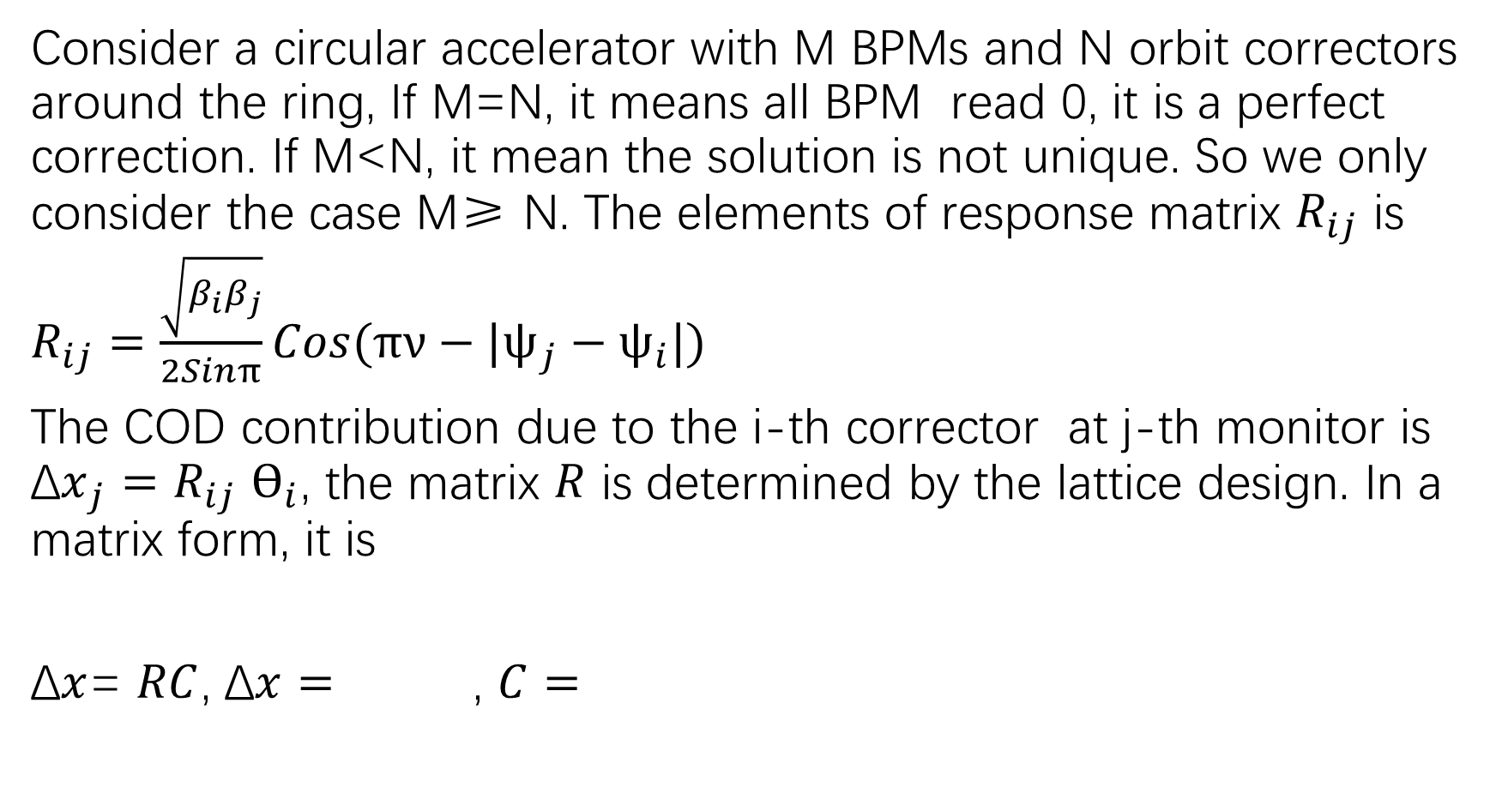
Orbit correction(轨道校正)
Consider a circular accelerator with M BPMs and N orbit correctors around the ring, If M=N, it means all BPM read 0, it is a perfect correction. If M<N, it mean the solution is not unique. So we only consider the case M≥ N. The elements of response matrix $R_{ij}$ is
$R_{ij}=\frac{\sqrt{β_{i}β_{j}}}{2Sinπ}Cos(πν−|ψ_{j}−ψ_{i}|)$
The COD contribution due to the i-th corrector at j-th monitor is ${\text{Δ}x}_{j}=R_{ij}$ $ϴ_{i}$, the matrix $R$ is determined by the lattice design. In a matrix form, it is
$\text{Δ}x$= $RC$, $\text{Δ}x=$ , $C=$

Slide 34
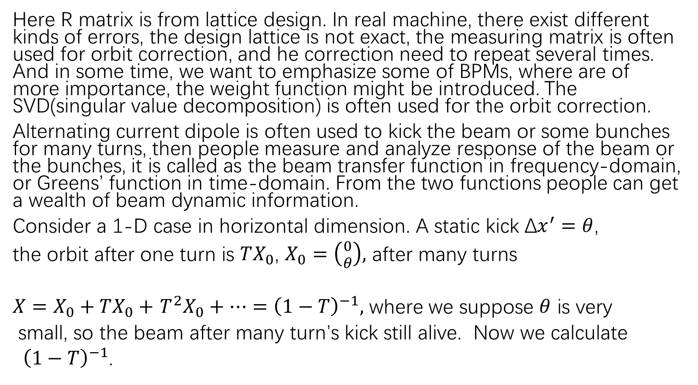
Here R matrix is from lattice design. In real machine, there exist different kinds of errors, the design lattice is not exact, the measuring matrix is often used for orbit correction, and he correction need to repeat several times. And in some time, we want to emphasize some of BPMs, where are of more importance, the weight function might be introduced. The SVD(singular value decomposition) is often used for the orbit correction.
Alternating current dipole is often used to kick the beam or some bunches for many turns, then people measure and analyze response of the beam or the bunches, it is called as the beam transfer function in frequency-domain, or Greens’ function in time-domain. From the two functions people can get a wealth of beam dynamic information.
Consider a 1-D case in horizontal dimension. A static kick $\text{Δ}x^{′}=θ$,
the orbit after one turn is $TX_{0}$, $X_{0}=\left({0 \atop θ}\right),$ after many turns
$X=X_{0}+TX_{0}+$ $T^{2}X_{0}+…={\left(1−T\right)}^{−1},$ where we suppose $θ$ is very
small, so the beam after many turn’s kick still alive. Now we calculate
${\left(1−T\right)}^{−1}$.

Slide 35
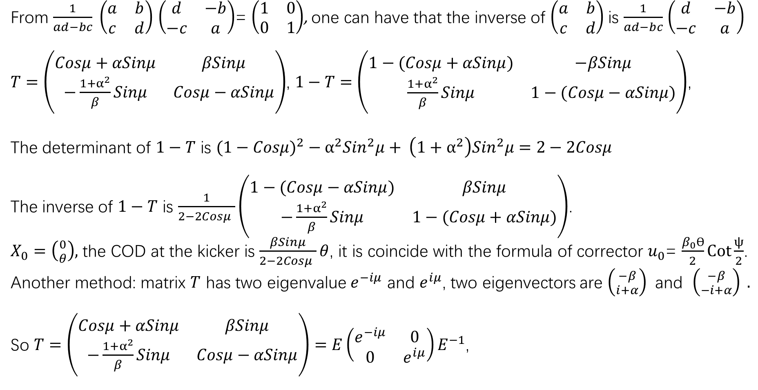
From $\frac{1}{ad−bc} \left(\begin{matrix}a & b \\ c & d\end{matrix}\right)$ $\left(\begin{matrix}d & −b \\ −c & a\end{matrix}\right)$= $\left(\begin{matrix}1 & 0 \\ 0 & 1\end{matrix}\right)$, one can have that the inverse of $\left(\begin{matrix}a & b \\ c & d\end{matrix}\right)$ is $\frac{1}{ad−bc}$ $\left(\begin{matrix}d & −b \\ −c & a\end{matrix}\right)$
$T=\left(\begin{matrix}Cosμ+αSinμ & βSinμ \\ −\frac{1+α^{2}}{β}Sinμ & Cosμ−αSinμ\end{matrix}\right)$, $1−T=$ $\left(\begin{matrix}1−(Cosμ+αSinμ) & −βSinμ \\ \frac{1+α^{2}}{β}Sinμ & 1−(Cosμ−αSinμ)\end{matrix}\right)$,
The determinant of $1−T$ is $(1−Cosμ)^{2}−α^{2}{Sin}^{2}μ+ \left(1+α^{2}\right){Sin}^{2}μ=2−2Cosμ$
The inverse of $1−T$ is $\frac{1}{2−2Cosμ }\left(\begin{matrix}1−(Cosμ−αSinμ) & βSinμ \\ −\frac{1+α^{2}}{β}Sinμ & 1−(Cosμ+αSinμ)\end{matrix}\right)$.
$X_{0}=\left({0 \atop θ}\right),$ the COD at the kicker is $\frac{βSinμ}{2−2Cosμ }θ$, it is coincide with the formula of corrector $u_{0}$= $\frac{β_{0}ϴ}{2}Cot\frac{ψ}{2}$.
Another method: matrix $T$ has two eigenvalue $e^{−iμ}$ and $e^{iμ}$, two eigenvectors are $\left({−β \atop i+α}\right)$ and $\left({−β \atop −i+α}\right) .$
So $T=\left(\begin{matrix}Cosμ+αSinμ & βSinμ \\ −\frac{1+α^{2}}{β}Sinμ & Cosμ−αSinμ\end{matrix}\right)=E\left(\begin{matrix}e^{−iμ} & 0 \\ 0 & e^{iμ}\end{matrix}\right)E^{−1}$,

Slide 36
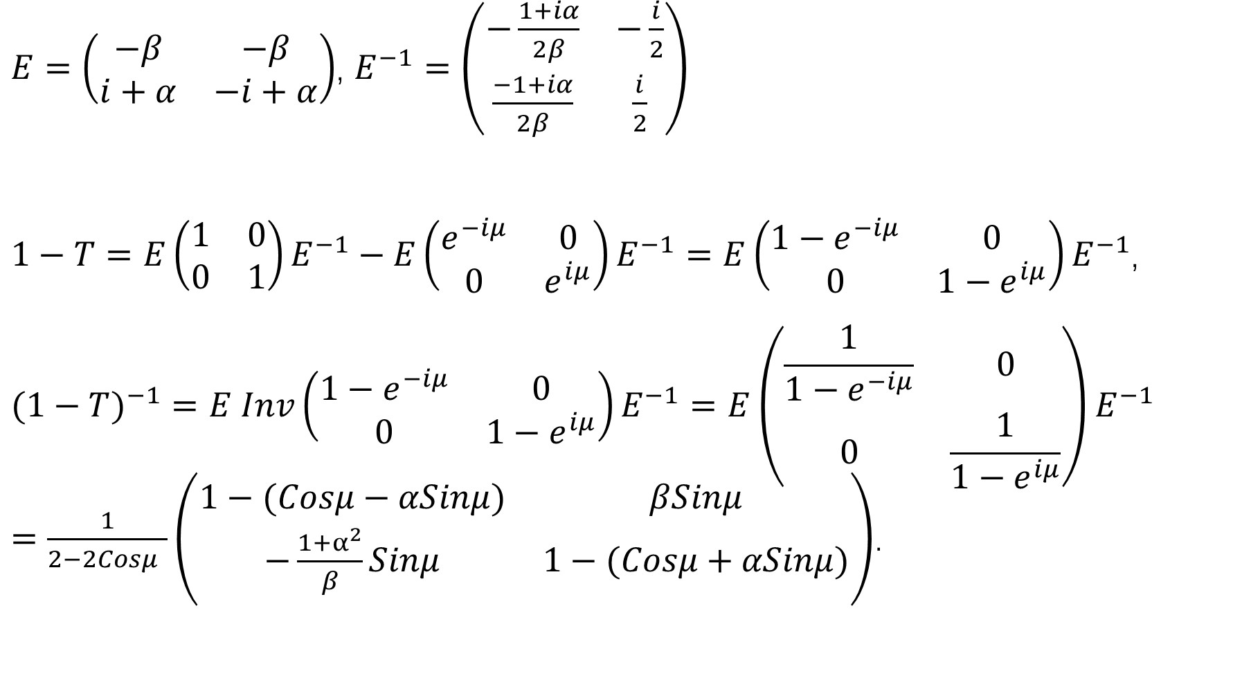
$E=\left(\begin{matrix}−β & −β \\ i+α & −i+α\end{matrix}\right)$, $E^{−1}=\left(\begin{matrix}−\frac{1+iα}{2β} & −\frac{i}{2} \\ \frac{−1+iα}{2β} & \frac{i}{2}\end{matrix}\right)$
$1−T=E\left(\begin{matrix}1 & 0 \\ 0 & 1\end{matrix}\right)E^{−1}−E\left(\begin{matrix}e^{−iμ} & 0 \\ 0 & e^{iμ}\end{matrix}\right)E^{−1}=E\left(\begin{matrix}{1−e}^{−iμ} & 0 \\ 0 & {1−e}^{iμ}\end{matrix}\right)E^{−1}$,
$$(1−T)^{−1}=E Inv\left(\begin{matrix}{1−e}^{−iμ} & 0 \\ 0 & {1−e}^{iμ}\end{matrix}\right)E^{−1}=E\left(\begin{matrix}\frac{1}{{1−e}^{−iμ}} & 0 \\ 0 & \frac{1}{{1−e}^{iμ}}\end{matrix}\right)E^{−1}$$
$=\frac{1}{2−2Cosμ }\left(\begin{matrix}1−(Cosμ−αSinμ) & βSinμ \\ −\frac{1+α^{2}}{β}Sinμ & 1−(Cosμ+αSinμ)\end{matrix}\right)$.

Slide 37
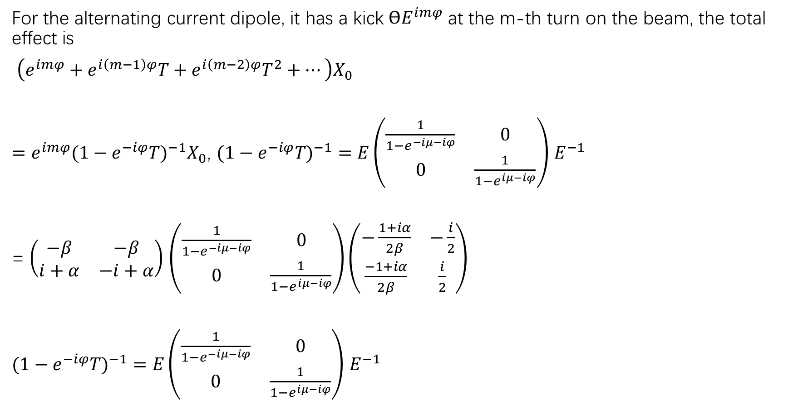
For the alternating current dipole, it has a kick $ϴE^{imφ}$ at the m-th turn on the beam, the total effect is
$\left(e^{imφ}+e^{i\left(m−1\right)φ}T+e^{i\left(m−2\right)φ}T^{2}+…\right)X_{0}$
$=e^{imφ}(1−e^{−iφ}T)^{−1}X_{0}$, $(1−e^{−iφ}T)^{−1}=E\left(\begin{matrix}\frac{1}{{1−e}^{−iμ−iφ}} & 0 \\ 0 & \frac{1}{{1−e}^{iμ−iφ}}\end{matrix}\right)$ $E^{−1}$
= $\left(\begin{matrix}−β & −β \\ i+α & −i+α\end{matrix}\right)$ $\left(\begin{matrix}\frac{1}{{1−e}^{−iμ−iφ}} & 0 \\ 0 & \frac{1}{{1−e}^{iμ−iφ}}\end{matrix}\right)\left(\begin{matrix}−\frac{1+iα}{2β} & −\frac{i}{2} \\ \frac{−1+iα}{2β} & \frac{i}{2}\end{matrix}\right)$
$(1−e^{−iφ}T)^{−1}=E\left(\begin{matrix}\frac{1}{{1−e}^{−iμ−iφ}} & 0 \\ 0 & \frac{1}{{1−e}^{iμ−iφ}}\end{matrix}\right)$ $E^{−1}$

Slide 38
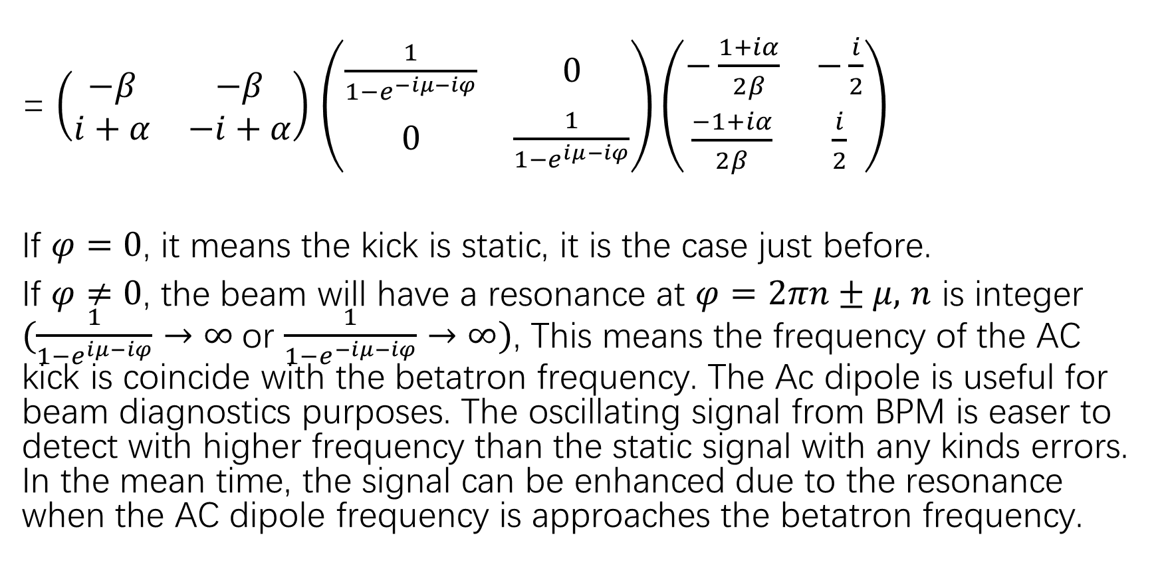
= $\left(\begin{matrix}−β & −β \\ i+α & −i+α\end{matrix}\right)$ $\left(\begin{matrix}\frac{1}{{1−e}^{−iμ−iφ}} & 0 \\ 0 & \frac{1}{{1−e}^{iμ−iφ}}\end{matrix}\right)\left(\begin{matrix}−\frac{1+iα}{2β} & −\frac{i}{2} \\ \frac{−1+iα}{2β} & \frac{i}{2}\end{matrix}\right)$
If $φ=0$, it means the kick is static, it is the case just before.
If $φ≠0$, the beam will have a resonance at $φ=2πn±μ,$ $n$ is integer $(\frac{1}{{1−e}^{iμ−iφ}}→∞$ or $\frac{1}{{1−e}^{−iμ−iφ}}→∞)$, This means the frequency of the AC kick is coincide with the betatron frequency. The Ac dipole is useful for beam diagnostics purposes. The oscillating signal from BPM is easer to detect with higher frequency than the static signal with any kinds errors. In the mean time, the signal can be enhanced due to the resonance when the AC dipole frequency is approaches the betatron frequency.

Slide 39
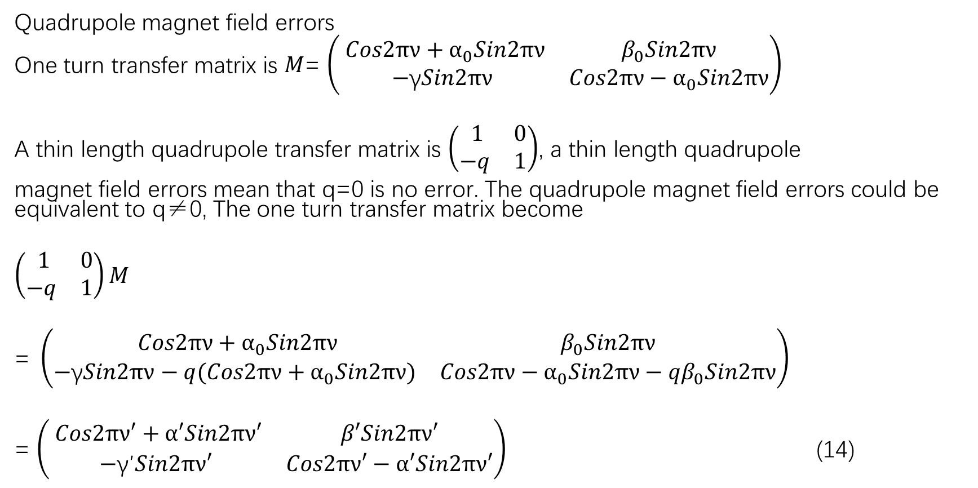
Tune shift(频移)
Quadrupole magnet field errors
One turn transfer matrix is $M$= $\left(\begin{matrix} Cos2πν+α_{0}Sin2πν & β_{0}Sin2πν \\ −\text{γ}Sin2πν & Cos2πν−α_{0}Sin2πν\end{matrix}\right)$
A thin length quadrupole transfer matrix is $\left(\begin{matrix} 1 & 0 \\ −q & 1\end{matrix}\right)$, a thin length quadrupole
magnet field errors mean that q=0 is no error. The quadrupole magnet field errors could be equivalent to q≠0, The one turn transfer matrix become
$$\left(\begin{matrix} 1 & 0 \\ −q & 1\end{matrix}\right)M$$
$$\text{= }\left(\begin{matrix} Cos2πν+α_{0}Sin2πν & β_{0}Sin2πν \\ −\text{γ}Sin2πν−q(Cos2πν+α_{0}Sin2πν) & Cos2πν−α_{0}Sin2πν−{qβ}_{0}Sin2πν\end{matrix}\right)$$
= $\left(\begin{matrix} Cos2πν′+α′Sin2πν′ & β′Sin2πν′ \\ −\text{γ}\text{′}Sin2πν′ & Cos2πν′−α′Sin2πν′\end{matrix}\right)$ (14)

Slide 40
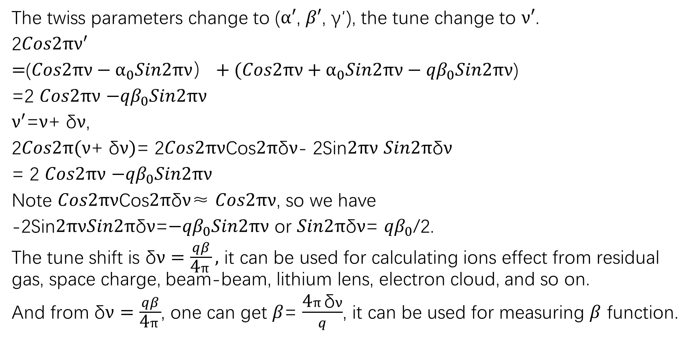
The twiss parameters change to ($α′$, $β′$, $\text{γ}\text{′}$), the tune change to $ν′$.
2$Cos2πν^{′}$
$=$($Cos2πν−α_{0}Sin2πν）+(Cos2πν+α_{0}Sin2πν−{qβ}_{0}Sin2πν$)
=2 $Cos2πν$ $−{qβ}_{0}Sin2πν$
$ν^{′}$=$ν$+ δ$ν$,
2$Cos2π(ν\text{+} \text{δ}ν)$= 2$Cos2πν$Cos$2π\text{δ}ν$- 2Sin$2πν$ $Sin2π\text{δ}ν$
= 2 $Cos2πν$ $−{qβ}_{0}Sin2πν$
Note $Cos2πν$Cos$2π\text{δ}ν$≈ $Cos2πν$, so we have
-2Sin$2πνSin2π\text{δ}ν$=$−{qβ}_{0}Sin2πν$ or $Sin2π\text{δ}ν$= ${qβ}_{0}$/2.
The tune shift is $\text{δ}ν=\frac{qβ}{\text{4}π},$ it can be used for calculating ions effect from residual gas, space charge, beam-beam, lithium lens, electron cloud, and so on.
And from $\text{δ}ν=\frac{qβ}{\text{4}π}$, one can get $β$= $\frac{\text{4}π\text{δ}ν}{q}$, it can be used for measuring $β$ function.

Slide 41
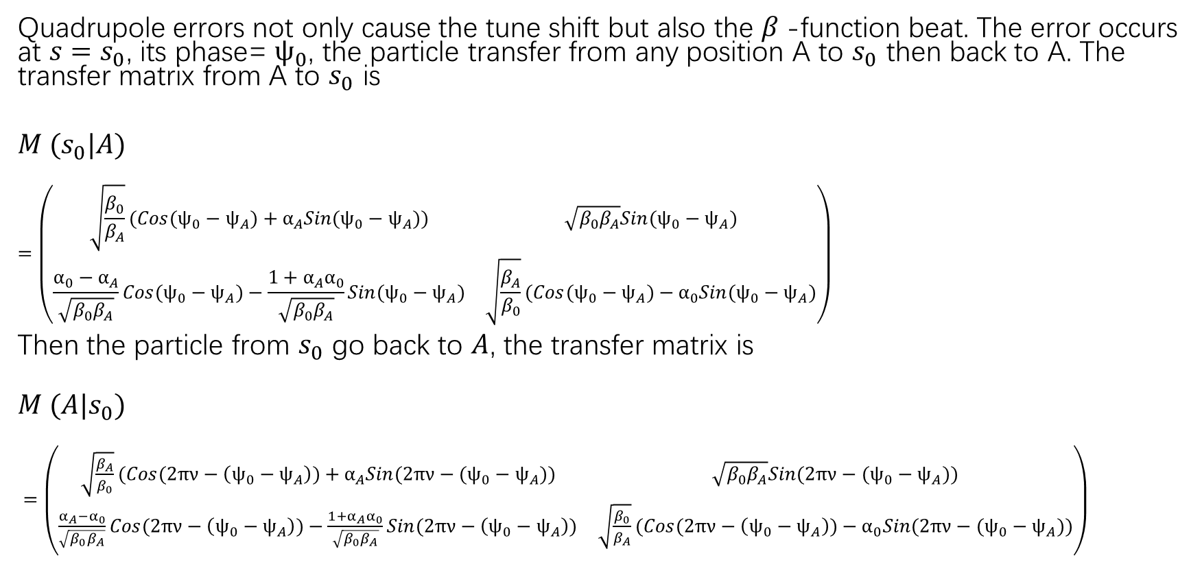
β-beat and half integer resonances(β拍波与半整数共振)
Quadrupole errors not only cause the tune shift but also the $β$-function beat. The error occurs at ${s=s}_{0}$, its phase= $ψ_{0}$, the particle transfer from any position A to $s_{0}$ then back to A. The transfer matrix from A to $s_{0}$ is
$M {(s}_{0}|A)$
$$=\left(\begin{matrix}\sqrt{\frac{β_{0}}{β_{A}}}(Cos({ψ_{0}−ψ}_{A})+α_{A}Sin({ψ_{0}−ψ}_{A})) & \sqrt{β_{0}β_{A}}Sin({ψ_{0}−ψ}_{A}) \\ \frac{α_{0}−α_{A}}{\sqrt{β_{0}β_{A}}}Cos({ψ_{0}−ψ}_{A})−\frac{{1+α_{A}α}_{0}}{\sqrt{β_{0}β_{A}}}Sin({ψ_{0}−ψ}_{A}) & \sqrt{\frac{β_{A}}{β_{0}}}(Cos({ψ_{0}−ψ}_{A})−α_{0}Sin({ψ_{0}−ψ}_{A})\end{matrix}\right)$$
Then the particle from $s_{0}$ go back to $A$, the transfer matrix is
$$M {(A|s}_{0})$$
$=\left(\begin{matrix}\sqrt{\frac{β_{A}}{β_{0}}}(Cos(2πν−\left({ψ_{0}−ψ}_{A}\right))+α_{A}Sin(2πν−({ψ_{0}−ψ}_{A})) & \sqrt{β_{0}β_{A}}Sin(2πν−({ψ_{0}−ψ}_{A})) \\ \frac{α_{A}−α_{0}}{\sqrt{β_{0}β_{A}}}Cos(2πν−\left({ψ_{0}−ψ}_{A}\right))−\frac{{1+α_{A}α}_{0}}{\sqrt{β_{0}β_{A}}}Sin(2πν−\left({ψ_{0}−ψ}_{A}\right)) & \sqrt{\frac{β_{0}}{β_{A}}}(Cos(2πν−\left({ψ_{0}−ψ}_{A}\right))−α_{0}Sin(2πν−({ψ_{0}−ψ}_{A}))\end{matrix}\right)$

Slide 42
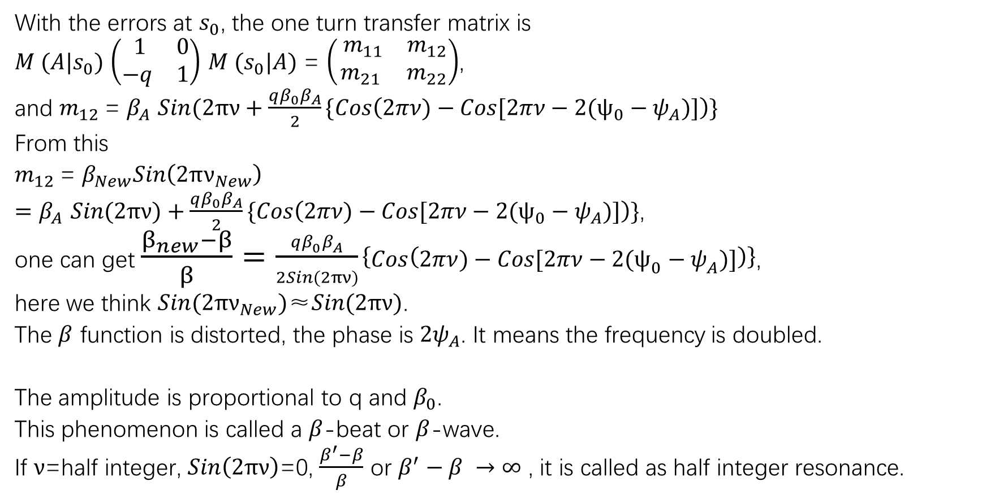
With the errors at $s_{0}$, the one turn transfer matrix is
$M {(A|s}_{0})$ $\left(\begin{matrix} 1 & 0 \\ −q & 1\end{matrix}\right)$ $M {(s}_{0}|A)$ = $\left(\begin{matrix} m_{11} & m_{12} \\ m_{21} & m_{22}\end{matrix}\right)$,
and $m_{12}$= $β_{A}$ $Sin(2πν+\frac{qβ_{0}β_{A}}{2}\{Cos\left(2πν)−Cos[2πν−2({ψ_{0}−ψ}_{A})]\right)\}$
From this
$m_{12}$= $β_{New}Sin\left(2πν_{New}\right)$
$=β_{A} Sin(2πν)+\frac{qβ_{0}β_{A}}{2}\{Cos\left(2πν)−Cos[2πν−2({ψ_{0}−ψ}_{A})]\right)\}$,
one can get $\frac{β_{new}−β}{β}=\frac{qβ_{0}β_{A}}{2Sin(2πν)}\left\{Cos\left(2πν)−Cos[2πν−2({ψ_{0}−ψ}_{A})]\right)\right\}$,
here we think $Sin(2πν_{New})\text{≈}Sin(2πν)$.
The $β$ function is distorted, the phase is ${2ψ}_{A}$. It means the frequency is doubled.
The amplitude is proportional to q and $β_{0}$.
This phenomenon is called a $β$-beat or $β$-wave.
If $ν$=half integer, $Sin\left(2πν\right)$=0, $\frac{β^{′}−β}{β}$ or $β^{′}−β →∞$ , it is called as half integer resonance.

Slide 43
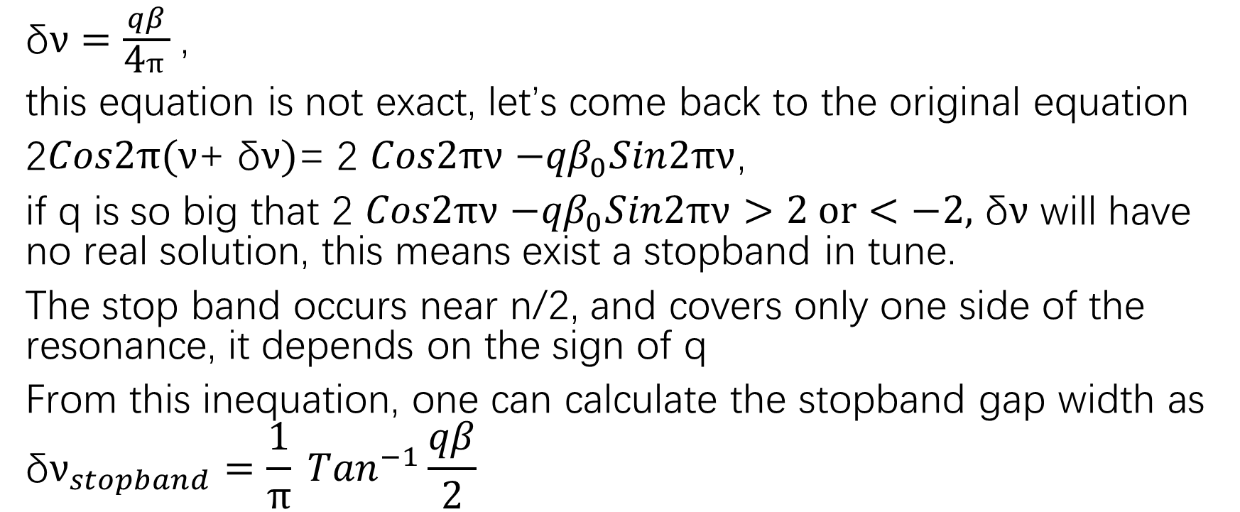
Stopband(禁带)
$\text{δ}ν=\frac{qβ}{\text{4}π}$,
this equation is not exact, let’s come back to the original equation
2$Cos2π(ν\text{+} \text{δ}ν)$= 2 $Cos2πν$ $−{qβ}_{0}Sin2πν$,
if q is so big that 2 $Cos2πν$ $−{qβ}_{0}Sin2πν>2 or<−2,$ $\text{δ}ν$ will have no real solution, this means exist a stopband in tune.
The stop band occurs near n/2, and covers only one side of the resonance, it depends on the sign of q
From this inequation, one can calculate the stopband gap width as
$${\text{δ}ν}_{stopband}=\frac{1}{π} {Tan}^{−1}\frac{qβ}{\text{2}}$$

Slide 44
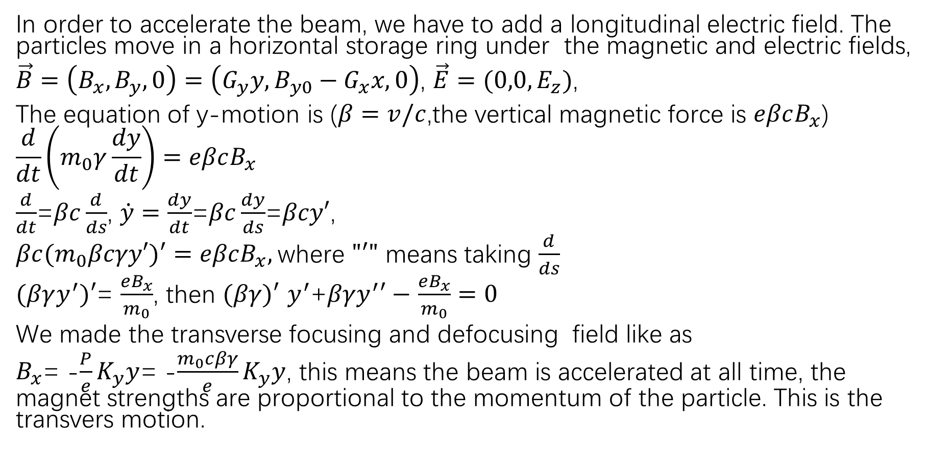
Adiabatic damping（绝热阻尼）
In order to accelerate the beam, we have to add a longitudinal electric field. The particles move in a horizontal storage ring under the magnetic and electric fields,
$\vec{B}=\left(B_{x},B_{y},0\right)=\left(G_{y}y,{B_{y0}−G}_{x}x,0\right)$, $\vec{E}=(0,0, E_{z})$,
The equation of y-motion is ($β=v/c$,the vertical magnetic force is $eβcB_{x}$)
$$\frac{d}{dt}\left(m_{0}γ\frac{dy}{dt}\right)=eβcB_{x}$$
$\frac{d}{dt}$=$βc\frac{d}{ds}$, $\dot{y}=\frac{dy}{dt}$=$βc\frac{dy}{ds}$=$βcy′$,
$βc{(m}_{0}βcγy′)′=eβcB_{x},$where $"′"$ means taking $\frac{d}{ds}$
$(βγy^{′})′$= $\frac{eB_{x}}{m_{0}}$, then $(βγ)′$ $y^{′}$+$βγy^{′}′−$ $\frac{eB_{x}}{m_{0}}=0$
We made the transverse focusing and defocusing field like as
$B_{x}$= -$\frac{P}{e}K_{y}y$= -$\frac{m_{0}cβγ}{e}K_{y}y$, this means the beam is accelerated at all time, the magnet strengths are proportional to the momentum of the particle. This is the transvers motion.

Slide 45
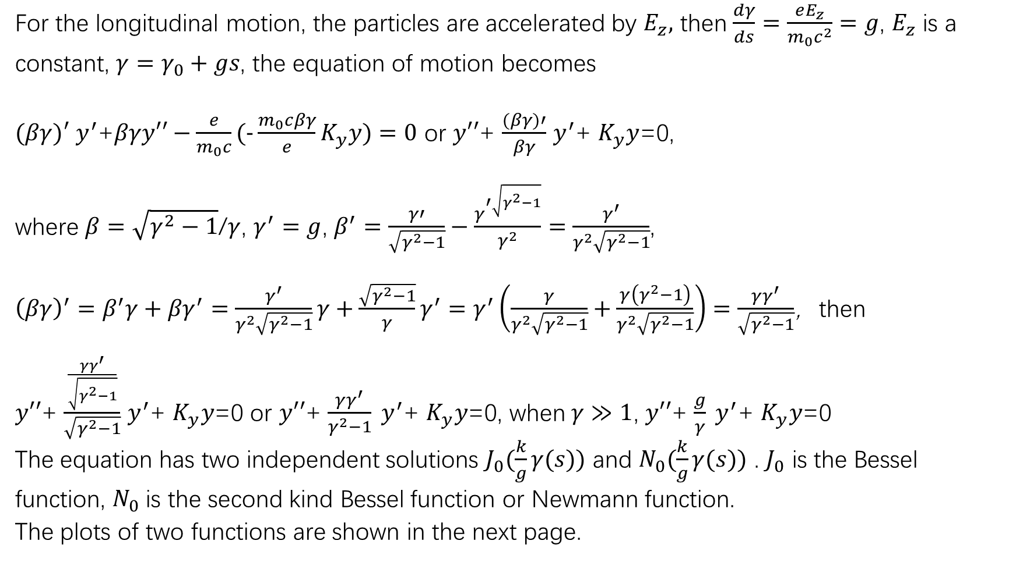
For the longitudinal motion, the particles are accelerated by $E_{z},$ then $\frac{dγ}{ds}=\frac{eE_{z}}{m_{0}c^{2}}=g$, $E_{z}$ is a
constant, ${γ=γ}_{0}+gs$, the equation of motion becomes
$(βγ)′$ $y^{′}$+$βγy′′−\frac{e}{m_{0}c}\text{(−}\frac{m_{0}cβγ}{e}K_{y}y)=0$ or $y′′$+ $\frac{(βγ)′}{βγ}$ $y^{′}$+ $K_{y}y$=0,
where $β=\sqrt{γ^{2}−1}$/$γ$, $γ^{′}=g$, $β^{′}=\frac{γ′}{\sqrt{γ^{2}−1}}−\frac{γ^{′\sqrt{γ^{2}−1}}}{γ^{2}}=\frac{γ^{′}}{γ^{2}\sqrt{γ^{2}−1}}$,
${\left(βγ\right)}^{′}=β^{′}γ+{βγ}^{′}=\frac{γ^{′}}{γ^{2}\sqrt{γ^{2}−1}}γ+\frac{\sqrt{γ^{2}−1}}{γ}γ^{′}$ $=γ^{′}\left(\frac{γ}{γ^{2}\sqrt{γ^{2}−1}}+\frac{γ\left(γ^{2}−1\right)}{γ^{2}\sqrt{γ^{2}−1}}\right)=$ $\frac{γγ^{′}}{\sqrt{γ^{2}−1}}$，then
$y′′$+ $\frac{\frac{γγ^{′}}{\sqrt{γ^{2}−1}}}{\sqrt{γ^{2}−1}}$ $y^{′}$+ $K_{y}y$=0 or $y′′$+ $\frac{γγ^{′}}{γ^{2}−1} y^{′}$+ $K_{y}y$=0, when$γ≫1$, $y′′$+ $\frac{g}{γ} y^{′}$+ $K_{y}y$=0
The equation has two independent solutions $J_{0}(\frac{k}{g}γ(s))$ and $N_{0}(\frac{k}{g}γ(s))$ . $J_{0}$ is the Bessel
function, $N_{0}$ is the second kind Bessel function or Newmann function.
The plots of two functions are shown in the next page.

Slide 46
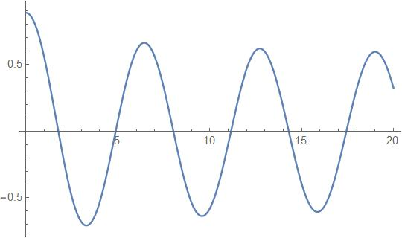


From the plot one can see that the oscillation decay
with the distance or time. It is a damping effect. This
is called the adiabatic approximation, because there
is no any median, the damping is only from acceleration.
With adiabatic damping, the beam emittance scales as
$ε∝\frac{1}{βγ}$, one can define a normalized emittance $ε_{N}=βγε$.
Usually, it is used for comparing different types of
accelerators. Physically, adiabatic damping comes
from the following: a particle with momentum $P$,
and the phase space coordinate $(y,y′)$, after accelerating
the longitudinal momentum get a increase $∆P$, its $y$
is unchanged, but its slope is reduced a little
$y^{′}→\frac{P_{y}}{P_{z}}=\frac{P}{P+∆P}$ $y^{′}<$ $y^{′}$, it is decrease turn by turn.
Bessel function
Newmann function

Slide 47

Linear coupling(线性耦合)
Consider a single thin-length skew quadrupole with a strength k, it will perturbate the particle motions over the x and y plane by the following equations
$∆x^{′}=−\frac{B_{y}l}{Bρ}=−ky$, $∆y^{′}=−\frac{B_{x}l}{Bρ}=−kx$
To describe the linear coupled motion, we need skew $4×4$
matrices, the vector is , the matrix that describes the skew
quadrupole action is $M_{sq}=$

Slide 48

The one turn map is $M_{0}=$
The one turn map around the exit of the skew quadrupole is $M_{tot}=M_{sq}M_{0}$
This total map have 4 new eigenvalues $e^{±i2πν_{+}}$, $e^{±i2πν_{−}}$, and
$2Cos2πν_{±}=Cos2πν_{x}+Cos2πν_{y}$ $±\sqrt{({Cos2πν_{x}−Cos2πν_{y})}^{2}+k^{2}β_{x}β_{y}Sin2πν_{x}Sin2πν_{y}}$ (15)
The real solution $ν_{±}$ requires $k$ must be limited in a certain value, otherwise $ν_{±}$ have no real solution. When $ν_{x}$+ $ν_{y}=n,n$ is the integer, $Cos2πν_{x}$= $Cos2πν_{y}$, $Sin2πν_{x}$= $−Sin2πν_{y}$, $k^{2}β_{x}β_{y}Sin2πν_{x}Sin2πν_{y}$≦0, $ν_{±}$ have no real solution. This is called the sum resonance, the stop band width is the distance with the integer part of $ν_{x}$+ $ν_{y}$, or
$ν_{x}$+ $ν_{y}$-n=2 $∆ν_{sb}$, $∆ν_{sb}≈\frac{|k|}{4π}\sqrt{β_{x}β_{y}}$
When $ν_{x}−$ $ν_{y}=n,n$ is the integer, $Cos2πν_{x}$= $Cos2πν_{y}$, $Sin2πν_{x}$= $Sin2πν_{y}$, $ν_{±}$ have the real solution. But the amplitude will increase to $\sqrt{k^{2}β_{x}β_{y}+1}$, this is called as the difference resonance.

Slide 49

Coupling coefficient and emittance beating
(耦合系数与发射度跳动)
From the eq.(14), one can write it as $ν_{±}=\frac{ν_{x}+ν_{y}}{2}±\sqrt{\frac{{(ν}_{x}−ν_{y}−n)^{2}}{4}+∆ν_{sb}^{2}}$, ${∆ν}_{sb}$is the stopband width, it is the minimum difference value of the two eigen-tunes, sometimes referred to as the coupling coefficient.
The coupled x-y motion allows the two beam emittances $ε_{x}$ and $ε_{y}$ to exchange. The unperturbed emittances are no longer constant of the motion, the two emittance will exchange slowly near the difference resonance, the beating frequency is the difference of the two eigen-tunes
$ν_{+}−ν_{−}=2\sqrt{\frac{{(ν}_{x}−ν_{y}−n)^{2}}{4}+∆ν_{sb}^{2}}$

Slide 50

Linear x-y coupling due to solenoid(螺线管磁铁的线性耦合)
Body field Solenoids are another important element that couple x and y. The equation
of motion in a uniform solenoidal field $B_{0}\hat{z}$ is given by $mγ\dot{\vec{v}}=e\vec{v}{×B}_{0}\hat{z}$,
so ${\dot{v}}_{x}=\frac{eB_{0}}{mγ}v_{y}$, ${\dot{v}}_{y}=−\frac{eB_{0}}{mγ}v_{x}$, and $v_{x}^{′}={Kv}_{y}$, $v_{y}^{′}={−Kv}_{x},$ with $K=\frac{eB_{0}}{mγ}$,
Therefore $x^{′′}=Ky′$ and $y^{′′}=−Kx′$.
Let $u=x+iy$, then $u^{′′}=−iKu′$, so $u^{′}\left(s\right)=u^{′}\left(0\right)e^{−iKs}$,
and $u\left(s\right)=u\left(0\right)+i\frac{u^{′}\left(0\right)}{K}（e^{−iKs}−1）$, Therefore one can get its transfer matrix,
Note that this is not symplectic. We need calculate the contribution of the end fields, the details see in Gang XU, PRAB, VOLUME 7,044001(2004)

Slide 51

The edge effect at entrance and exit are respectively
and
The total solenoid matrix is therefore
$M_{solenoid}=M_{exit}M(L|0)M_{entrance}$=
$$C=CosKL, S=SinKL$$

Slide 52

Rotation(转动)
Rotation is the transformation of x-y rotation
The rotation $X=\left(\begin{matrix} CosΘ & SinΘ \\ −SinΘ & CosΘ\end{matrix}\right)$ $\left({x \atop y}\right)$, $Y=\left(\begin{matrix} CosΘ & −SinΘ \\ SinΘ & CosΘ\end{matrix}\right)$ $\left({x \atop y}\right)$
And the angle $X′$and $Y′$are the same.
For the magnet rotation, the $x−y$ motions are consisted of the entrance and exit. At the entrance the coordinate rotates angle$Θ$, at the exit the coordinate rotates angle $−Θ,$so the total matrix is
$T_{rotate}=R^{−1}TR$, in 4-D phase space, $R$ is

Slide 53

If T is uncoupled with $\left(\begin{matrix} T_{x} & 0 \\ 0 & T_{y}\end{matrix}\right)$, and $T_{x}$ and $T_{y}$ is $2×2$ maps then
$T_{rotate}=$ $\left(\begin{matrix} T_{x}{Cos}^{2}Θ+T_{y}{Sin}^{2}Θ & −{(T}_{x}−T_{y})SinΘCosΘ \\ −{(T}_{x}−T_{y})SinΘCosΘ & T_{x}{Sin}^{2}Θ+T_{y}{Cos}^{2}Θ\end{matrix}\right)$
When $T_{x}$= $T_{y}$, the rotation does not change the map. For the thin
length quadrupole, $T_{x}$= $\left(\begin{matrix} 1 & 0 \\ −\frac{1}{f} & 1\end{matrix}\right)$, $T_{y}$= $\left(\begin{matrix} 1 & 0 \\ \frac{1}{f} & 1\end{matrix}\right)$,
$$T_{rotate}=$$

Slide 54

Nonlinear resonance(非线性共振)
Nonlinear perturbations have no exact solutions in general. Consider a thin-length perturbation is very weak, we can do some calculation.
Nonlinear 1-D resonanceLet us consider the nonlinearity give $Δx′∝x^{m}$, the equation of motion will look like $\frac{d^{2}η}{dθ^{2}}+ν^{2}η={εη}^{m}δ(θ)$, $δ(θ)$ is a periodic $δ$ function with period 2π in $θ$. m=2 for sextupole, and m=3 for
octupole, when $ε$= $0$, $η$~$\left\{\begin{aligned}Sin νθ \\ Cos νθ\end{aligned}\right.$, when $ε≠0$ the perturbation ~$\left\{\begin{aligned}δ(θ){Sin}^{m} νθ \\ δ(θ) {Cos}^{m} νθ\end{aligned}\right.$,
Nonlinear 1-D resonances driven by nonlinearities of varies order
XX means lowest order and strongest resonance, X means is driven
nonlinearity | m | ν=K | ν=K/2 | ν=K/3 | ν=K/4 | ν=K/5
dipole | 1 | XX
quadrupole | 2 |  | XX
sextupole | 3 | X |  | XX
octupole | 4 |  | X |  | XX
decapole | 5 | X |  | X |  | XX

Slide 55

Multiturn closed orbit(多圈闭轨)
In a linear system, multiturn closed orbit requires $M^{m}=I$, the tune
ν must be an exact rational number, or ν= $\frac{K}{m}$, both $K$ and $m$ are
integer. The situation change when nonlinearities are introduced. Under this case, the orbit is depend on the initial condition, and it is not linear relation, it is nonlinear relation. The solutions may not be unique. More over, the multiturn orbit may be not a stable orbit, this means around the orbit have no other particle except the ideal particle self. For the stable orbit, it is a island on the phase space. Different turns will lead to different islands. To get these islands one can do particles tracking. The centers of the islands constitute the multiturn closed orbit(COD)

Slide 56


Nonlinear coupling resonance(非线性耦合共振)
In a 2-D case, a resonance occur
when $m_{x}ν_{x}+m_{y}ν_{y}=n$, where $m_{x}$ and $m_{y}$ are integers. The order of the resonance is given by
$|m_{x}|$+$|m_{y}|$. The figure shows the resonances up to 8th order.
One have to select the working point to avoid some resonance. In general, the integer and half integer resonance must be avoided, and then sum resonance, because the beam will lose due to these resonance.
X Tune

Slide 57

Chromatic effect(色品效应)
Dispersion function(色散函数)
Momentum error（动量误差）
In the beam, the particles have different energy and also the momentum. They have different trajectories in banding magnets, the momentum deviation $∆P=P(1+δ)$, the ratio is $1+δ$.
The energy ratio is $\frac{∆E}{E}=\frac{β_{0}^{2}}{{1+β}_{0}^{2}δ}\frac{∆P}{P}=β_{0}^{2}(1+δ)$, for high energy electron machine $E=100MeV$, γ=100/0.51099891=195.695,$β_{0}=0.999987,$ $β_{0}^{2}$= 0.999974=1, so $\frac{∆E}{E}$= $\frac{∆P}{P}=1+δ$
For the proton machine, for example CSNS, E=1.6GeV, γ≈1.7, $β$≈0.808

Slide 58

Equation of motion
According to eq.(3), the equation of motion with momentum deviation is
$x^{″}−\frac{ρ+x}{ρ^{2}}=\frac{{\text{e}B}_{y}}{P_{0}\left(1+δ\right)}{(1+\frac{x}{ρ})}^{2}$ (16)
Keep the first order about $x$ and $δ$ we can have $\frac{d^{2}x}{ds^{2}}+(\frac{G}{B\text{ρ}}+\frac{1}{{\text{ρ}}^{2}}$) $x$= $\frac{δ}{ρ(s)}$, the right hand $\frac{δ}{ρ(s)}$ will drive the x-motion of an off-momentum particle, it is called horizontal dispersion. Solve this equation, one can set the solution $x\left(s\right)=x_{β}\left(s\right)+D(s)δ$, substituting in the equation one can get $D^{′′}+K_{x}\left(s\right)D=\frac{1}{ρ},K_{x}\left(s\right)=\frac{G}{B\text{ρ}}+\frac{1}{{\text{ρ}}^{2}}$, the equation have the general solution $D(s)= c1 Sin\left(πνs\right)+c2 Cos\left(πνs\right)+c3,$ and $c1, c2, c3$ to be determined.
$x_{β}\left(s\right)=\int_{s}^{s+L}{ds^{′\frac{∆B\left(s^{′}\right)}{Bρ}}}\frac{\sqrt{β\left(s\right)β\left(s^{′}\right)}}{2Sinπν}Cos(πν−|Ψ\left(s^{′}\right)−Ψ(s)|)$ , this is the solution of eq.(13) , $c3$ is to be determined.
A simplest solution is $x=Dδ$, $D$ is a constant, it means the orbit is a circle, the radius of the orbit is proportional the beam energy.

Slide 59


High order dispersion(高阶色散函数)
Let $x\left(s\right)=x_{β}\left(s\right)+D_{1}\left(s\right)δ+D_{2}\left(s\right)δ^{2}$, one can get $D_{2}\left(s\right)$, it is the 2nd dispersion, in principle one can get higher than 3rd dispersion. The 2nd dispersion satisfy the following equation:
$${D_{2}}^{′′}+(\frac{G}{B\text{ρ}}+\frac{1}{{\text{ρ}}^{2}}{)D}_{2}=−\frac{1}{ρ}+(\frac{G}{B\text{ρ}}+\frac{2}{{\text{ρ}}^{2}}{)D}_{1}$$
Dispersion-free storage ring(无色散储存环)
A special case is when there is electric field in the ring, the equation of motion as
$\frac{d^{2}x}{ds^{2}}+(\frac{G}{B\text{ρ}}+\frac{1}{{\text{ρ}}^{2}}$) $x$= $\frac{1}{ρ}+\frac{−ev_{s}B_{y}+eE_{x}}{mγv_{s}^{2}}$, the momentum error $δ$, the velocity $v_{s}$≈ $v_{s0}(1+\frac{δ}{γ^{2}})$, $v_{s0}$ is the designed velocity. Let $B_{y}$= $B_{y0}+Gx$ and set bending radius satisfying $\frac{1}{ρ}=\frac{−eB_{y0}}{P_{0}}−\frac{eE_{x}}{P_{0}v_{s0}}$, keeping first order in $x$ and $δ$, one can get $x^{′′}+K_{x}x=(\frac{1}{ρ}−\frac{eE_{x}}{P_{0}v_{s0}γ^{2}})δ$, the dispersion function satisfies $D^{′′}+K_{x}D=\frac{1}{ρ}−\frac{eE_{x}}{P_{0}v_{s0}γ^{2}}$. If we choose $\frac{eE_{x}}{P_{0}}=$ $\frac{v_{s0}γ^{2}}{1+γ^{2}}$ $\frac{eB_{y0}}{P_{0}}$= $\frac{v_{s0}γ^{2}}{ρ}$, the storage ring will be dispersion free.
The ring consists of a set of high voltage plates surround combined bending magnets.

Slide 60

Calculation of dispersion function(色散函数的计算)
The $3×3$ matrix formalism
Consider a separated-function storage ring, the bending radius of the sector dipole is $ρ$, let the initial dispersion function $D\left(0\right),D′(0)$,
$D(s)$ satisfy the following equation $D^{′′}(s)+\frac{D(s)}{ρ^{2}}=\frac{1}{ρ}$, $ρ$ is a constant, the solution is
$\left({D(s) \atop D^{′} (s)}\right)=$ $\left(\begin{matrix}Cos\frac{s}{ρ} & ρSin\frac{s}{ρ} \\ −\frac{1}{ρ}Sin\frac{s}{ρ} & Cos\frac{s}{ρ}\end{matrix}\right)$ $\left({D(0) \atop D^{′} (0)}\right)$+ $\left({ρ(1−Cos\frac{s}{ρ}) \atop Sin\frac{s}{ρ}}\right)$
Introduce a vector $\left(\begin{matrix}D \\ D′ \\ 1\end{matrix}\right)$, the transfer matrix can be written as a $3×3$map,
$\left(\begin{matrix}D(s) \\ D′(s) \\ 1\end{matrix}\right)$= $\left(\begin{matrix}Cos\frac{s}{ρ} & ρSin\frac{s}{ρ} & ρ(1−Cos\frac{s}{ρ}) \\ −\frac{1}{ρ}Sin\frac{s}{ρ} & Cos\frac{s}{ρ} & Sin\frac{s}{ρ} \\ 0 & 0 & 1\end{matrix}\right)$ $\left(\begin{matrix}D(0) \\ D′(0) \\ 1\end{matrix}\right)$.

Slide 61

For a short sector bend, $θ=\frac{l}{ρ}≪1$, the matrix can be written as $\left(\begin{matrix}1 & l & \frac{lθ}{2} \\ 0 & 1 & θ \\ 0 & 0 & 1\end{matrix}\right)$.
The upper-left $2×2$ is a drift space. It can be written as two drifts insert a thin-length kick as
$\left(\begin{matrix}1 & l/2 & 0 \\ 0 & 1 & 0 \\ 0 & 0 & 1\end{matrix}\right)$ $\left(\begin{matrix}1 & 0 & 0 \\ 0 & 1 & θ \\ 0 & 0 & 1\end{matrix}\right)$ $\left(\begin{matrix}1 & l/2 & 0 \\ 0 & 1 & 0 \\ 0 & 0 & 1\end{matrix}\right)$= $\left(\begin{matrix}1 & l & \frac{lθ}{2} \\ 0 & 1 & θ \\ 0 & 0 & 1\end{matrix}\right)$
The quadruple can be written as $\left(\begin{matrix}m_{11} & m_{12} & 0 \\ m_{21} & m_{22} & 0 \\ 0 & 0 & 1\end{matrix}\right)$, upper-left $2×2$ use for calculating the betatron map.

Slide 62

General expression of the $3×3$ map($3×3$映射的一般表达式)
In general, if the $3×3$ one-period map around position s is given as
$\left(\begin{matrix}m_{11} & m_{12} & m_{13} \\ m_{21} & m_{22} & m_{23} \\ 0 & 0 & 1\end{matrix}\right).$
The dispersion transfer equation is $\left(\begin{matrix}D(s+L) \\ D′(s+L) \\ 1\end{matrix}\right)$=$\left(\begin{matrix}m_{11} & m_{12} & m_{13} \\ m_{21} & m_{22} & m_{23} \\ 0 & 0 & 1\end{matrix}\right)\left(\begin{matrix}D(s) \\ D′(s) \\ 1\end{matrix}\right)$, the period condition require
$D(s+L)$= $D(s)$, $D′(s+L)$= $D′(s)$, note that determinant $m11 m22$- $m12 m21=1$, one can get
$D(s)$= $\frac{m_{13}\left(1−m_{22}\right)+m_{12}m_{23}}{2−m_{11}−m_{22}}$ $,D′(s)$= $\frac{m_{13}m_{21}+m_{23}(1−m_{11})}{2−m_{11}−m_{22}}$.
This result can be used to calculate dispersion function at any position. Substitute
$m_{11}$= $Cosϕ+αSinϕ$,$m_{12}=βSinϕ$, $m_{21}=$ $−\text{γ}Sin$ $ϕ$, $m_{22}$= $Cosϕ−αSinϕ$ into the equation,
one can get
$D(s)$= $\frac{1}{2}(m_{13}+\left(αm_{13}+βm_{23}Cot\frac{ϕ}{2}\right))$, $D′(s)$= $\frac{1}{2}(m_{23}−\left(\text{γ}m_{13}+αm_{23}Cot\frac{ϕ}{2}\right))$,
Where $α$, $β$, $\text{γ}$ are twiss parameters at s. Alternatively, one can solve $m_{13}$ and $m_{23}$ in terms of $D$ and $D′$,

Slide 63

then we have
$\left(\begin{matrix}Cosϕ+αSinϕ & βSinϕ & \left(1−Cosϕ−αSinϕ\right)D−βD^{′}Sinϕ \\ −\text{γ}Sin ϕ & Cosϕ−αSinϕ & \text{γ}DSinϕ+(1−Cosϕ+αSinϕ)D^{′} \\ 0 & 0 & 1\end{matrix}\right)$,
One can also get the transfer relation of the dispersion,
$\left(\begin{matrix}D(s_{2}) \\ D′(s_{2}) \\ 1\end{matrix}\right)$=$M(s_{2}|s_{1})\left(\begin{matrix}D(s_{1}) \\ D′(s_{1}) \\ 1\end{matrix}\right)$, and the transfer matrix $3×3$ from $s_{1}$ to $s_{2}$,
${M(s}_{2}\left|s_{1}\right)=$ $\left(\begin{matrix}m_{11} & m_{12} & D_{2}−m_{11}D_{1}−m_{12}D_{1}^{′} \\ m_{21} & m_{22} & D_{2}^{′}−m_{21}D_{1}−m_{22}D_{1}^{′} \\ 0 & 0 & 1\end{matrix}\right)$,
where $m_{11}$= $\sqrt{\frac{β_{2}}{β_{1}}}(Cosψ+α_{1}Sinψ)$, $m_{12}$=$\sqrt{β_{1}β_{2}}Sinψ$, $m_{21}=$ $\frac{α_{1}−α_{2}}{\sqrt{β_{1}β_{2}}}Cosψ$-$\frac{1+α_{1}α_{2}}{\sqrt{β_{1}β_{2}}}$ $Sinψ$,
$m_{22}=\sqrt{\frac{β_{1}}{β_{2}}}(Cosψ−α_{2}Sinψ)\text{,}$ $ψ$ is the phase advance from $s_{1}$ to $s_{2}$.

Slide 64

Dispersion suppressor(消色散节)
In accelerator design, the dispersion free section is necessary for many purpose, interaction point, RF cavity, injection point for collider, insertion device for light source. For light source there are DBA, TBA, QBA, 7BA, MBA structures to make dispersion free. In principal, using two banding magnets, at least one quadrupole magnets and enough drift space can make both the dispersion and dispersion angle to 0, such structure can be called dispersion suppressor. Let one quadrupoles between two bands, the structure is ($B_{2}$, $L_{2}$, $Q$, $L_{1}$, $B_{1}$), the total transfer map is
$$M=\left(\begin{matrix}Cosθ_{2} & ρ_{2}Sinθ_{2} & ρ_{2}(1−Cosθ_{2}) \\ −\frac{1}{ρ_{2}}Sinθ_{2} & Cosθ_{2} & Sinθ_{2} \\ 0 & 0 & 1\end{matrix}\right)\left(\begin{matrix}1 & L_{2} & 0 \\ 0 & 1 & 0 \\ 0 & 0 & 1\end{matrix}\right)$$
$$\left(\begin{matrix}Cos\sqrt{K}L_{q} & \frac{1}{\sqrt{K}}Sin\sqrt{K}L_{q} & 0 \\ −\sqrt{K}Sin\sqrt{K}L_{q} & Cos\sqrt{K}L_{q} & 0 \\ 0 & 0 & 1\end{matrix}\right)\left(\begin{matrix}1 & L_{1} & 0 \\ 0 & 1 & 0 \\ 0 & 0 & 1\end{matrix}\right)\left(\begin{matrix}Cosθ_{1} & ρ_{1}Sinθ_{1} & ρ_{1}(1−Cosθ_{1}) \\ −\frac{1}{ρ_{1}}Sinθ_{1} & Cosθ_{1} & Sinθ_{1} \\ 0 & 0 & 1\end{matrix}\right)$$

Slide 65

The initial dispersion ($D_{0}$, $D_{0}^{′}$), the finale dispersion is (0,0), one can solve the equation about ($L_{1}$, $L_{2}$)
$$L_{1}=$$
$${(ρ}_{1}Cosθ_{1}(\sqrt{K}\left({−D}_{0}+ρ_{1}\right)+D_{0}^{′}Cot\sqrt{K}L_{q}−(D_{0}^{′}\sqrt{K}ρ_{1}^{2}+{(D}_{0}−ρ_{1}))Cot\sqrt{K}L_{q})Sinθ_{1}+ρ_{1}(−\sqrt{K}ρ_{1}+Csc\sqrt{K}L_{q}Sinθ_{2}))$$
$/(D_{0}^{′}ρ_{1}Cosθ_{1}+(D_{0}+ρ_{1})Sinθ_{1}),$
$$L_{2}=$$
$$\frac{Cot\sqrt{K}L_{q}}{\sqrt{K}}+ρ_{2}Cotθ_{2}−(Csc\sqrt{K}L_{q}Cscθ_{2}(−D_{0}^{′}ρ_{1}Cosθ_{1}+ρ_{1}ρ_{2}\sqrt{K}Sin\sqrt{K}L_{q}+\left(D_{0}−ρ_{1}\right)Sinθ_{1})/\sqrt{K}ρ_{1}$$
Usually, $B_{1}$ and $B_{2}$ are the same, the length of two drift are equal .ie. $L_{1}$= $L_{2}$, one can get the expression of $L_{1}$ and $K$ in $D_{0},D_{0}^{′},$ $ρ_{1},ρ_{2}, θ_{1}, {\text{and} L}_{q}$. They are too long and complicate, here omitted.

Slide 66



Momentum Compaction(动量压缩)
Path length
The particle with lower energy will have a smaller bending radius(E=0.3Bρ), the circumference of motion will be different to the ideal particle. The difference for a sector dipole is $∆C=\left(ρ+x\right)θ−ρθ=xθ$. For rectangular dipole, the path length difference is $∆C=2xTan\frac{θ}{2}$.
Comparing $xθ，2xTan\frac{θ}{2}\text{,} \text{one} \text{can} \text{get} \text{the} \text{difference} x\left(θ−2\left(\frac{θ}{2}+\frac{{\left(\frac{θ}{2}\right)}^{3}}{3}\right)\right)=x\frac{θ^{3}}{12}$, it is 3rd small quantity.
The change in circumference due to the
horizontal closed orbit distortion is
$∆C=\oint{\frac{x_{COD}(s)}{ρ(s)}}ds$
It is the integral of all bends over the
storage ring.

Slide 67

Momentum compaction factor(动量压缩因子)
Due to the momentum deviation δ of particle, the particle will have a horizontal displacement, $∆x(s)=δ D(s)$, the total over the ring is
$$∆C=δ\oint{\frac{D(s)}{ρ(s)}ds}$$
The momentum compaction factor $α_{c}$ is defined by
$\frac{∆C}{C}=α_{c}δ$ or $α_{c}$= $\frac{1}{δ}$ $\frac{∆C}{C}$= $\frac{1}{C}$ $\oint{\frac{D(s)}{ρ(s)}ds}$
In general, $α_{c}$>0. Sometimes by special design a negative momentum compaction lattice can be designed.

Slide 68


Achromat cell(消色散单元)
The most simple achromat cell is consisted of two bending magnets it is called as double bend achromat(DBA). A achromat cell start from and end to $D=0,D^{′}=0.$ More than two bending magnets can give more flexible achromat structure, and the lattice will give lower natural emittance, more bands much more lower, these structures are used in the lattice design for light source accelerator. The detail will study in the lesson of lattice design.
A DBA consists of $B$, $L$, QF, $L$, $B$, where $B$ is a bend with bending angle $θ$, $L$ is a drift with length $L$, QF is a horizontal focusing
quadrupole with focusing length $f=\frac{L}{2},$the
dispersion at QF is $D_{QF}=Lθ$. In practice,
a DBA cell is more complicated, at least the
defocusing quadrupole is necessary for stabilizing
the particle motion in vertical plane.

Slide 69

Chromaticity(色品)
A quadrupole has focusing or defocusing force. Higher momentum particles $\left(δ>0\right)$ have higher rigidity, and weaker effect due to magnetic field. We have known dispersion is the result of weakened dipoles. The similar thing for quadrupole is that the betatron tune will depend on the momentum $δ$, keep the first order perturbation,
$ν_{x,y}\left(δ\right)=ν_{x,y}\left(0\right)+ξ_{x,y}δ$, where $ξ_{x,y}$ are the chromaticities.
(In Europe the definition is different!!!)
The equation of the motion(Eq.(16)) is
$x^{″}−\frac{ρ+x}{ρ^{2}}=\frac{{\text{e}B}_{y}}{P_{0}\left(1+δ\right)}{(1+\frac{x}{ρ})}^{2}≈\frac{{\text{e}B}_{y}}{P_{0}}$ $\left(1−δ\right)$ $(1+\frac{2x}{ρ})$ or
$x^{″}+K_{x}x=\frac{δ}{ρ}+\left(\frac{2}{ρ^{2}}+\frac{G}{Bρ}\right)xδ$,
$\frac{δ}{ρ}$ is the dispersion term. $K_{x}$ term has a quadrupole error ${∆K}_{x}$= -$\left(\frac{2}{ρ^{2}}+\frac{G}{Bρ}\right)δ$

Slide 70

For the vertical plane, ${∆K}_{y}$= $\frac{G}{Bρ}δ$. The effects should be integrated for all quadrupoles,
$ξ_{x,nat}=−\frac{1}{4π}\oint{ds}$ $β_{x}\left(s\right)[\frac{2}{ρ^{2}(s)}+\frac{G(s)}{Bρ}]≈−\frac{1}{4π}\oint{ds} β_{x}\left(s\right)\frac{G(s)}{Bρ}$,
the $\frac{2}{ρ^{2}(s)}$ term much less than $\frac{G(s)}{Bρ}$, omitted.
But for weak focusing ring this approximation should not be made.
$ξ_{y,nat}=\frac{1}{4π}\oint{ds} β_{y}\left(s\right)\frac{G(s)}{Bρ}$,
they are noted by $nat$ indicate they are the natural chromaticities.
The natural chromaticities are negative in both horizontal and vertical plane, that is because the focus force with higher momentum is weaker than on momentum. In contrast, tune shifts in x and y planes from the quadrupole field error have opposite signs.

Slide 71

Chromaticity correction(色品校正)
The particles have different momentum, it will lead to a tune spread $ξδ$($ξ$=-30, $δ$=1%, $ξδ$=0.3) and further the particles will cross dangerous nonlinear resonance. On the other hand, negative natural chromaticities will lead head-tail instability, the nagetive chromaticities have to be corrected above 0 a little. The way to correct chromaticities is to use sextupoles. Unfortunately, sextupoles will bring nonlinear effects for example dynamic aperture problems, people have to do something to make the balance between chromaticity correction and nonlinear effects. In order to correct the horizontal and vertical chromaticities we need the two-family sextupole. A sextupole magnet has fields
$B_{x}=Sxy,B_{y}=\frac{S}{2}(x^{2}−y^{2})$,
where $S=\frac{∂^{2}B_{x}}{∂x^{2}}$ is the strength of the sextupole.
An off-momentum particle passing through the sextupole has displacements $x=x_{β}+Dδ$, $y=y_{β}$,$β$ means the betatron component of the displacement, which is $δ$-independent. The fields seen by particles are
$B_{x}=Sx_{β}y_{β}+{Sy}_{β}Dδ$, $B_{y}=\frac{S}{2}\left(x_{β}^{2}−y_{β}^{2}\right)+Sx_{β}Dδ+{\frac{S}{2}D}^{2}δ^{2}$,

Slide 72

the term of $D$ relative linear parts are
$B_{x}={Sy}_{β}Dδ$, $B_{y}=Sx_{β}Dδ$,
It shows that the sexupole must be placed at the position where $D≠0$. they are quadrupole-like terms.
$${∆ν_{x}=\frac{1}{4π}\oint{ds\frac{S\left(s\right)}{Bρ}}β}_{x}(s)D(s)δ$$
$${∆ν_{y}=\frac{1}{4π}\oint{ds\frac{S\left(s\right)}{Bρ}}β}_{y}(s)D(s)δ$$
Combined the natural and sextupoles chromaticityies, we can get
$ξ_{x}$=- $\frac{1}{4π}$ $\oint{ds}$ $β_{x}\left(s\right)[\frac{2}{ρ^{2}\left(s\right)}+\frac{G\left(s\right)}{Bρ}−\frac{S\left(s\right)}{Bρ}D(s)]$
$ξ_{y}$= $\frac{1}{4π}$ $\oint{ds}$ $β_{y}\left(s\right)[\frac{G\left(s\right)}{Bρ}−\frac{S\left(s\right)}{Bρ}D(s)]$

Slide 73

Dynamic aperture(动力学孔径)
Consider a particle moving along the closed orbit with design momentum. If there is no sextupole, due to the natural chromaticity its momentum deviation must be less than a small value, in order to increase the acceptance of the momentum, sextupoles are adopted to decrease the chromaticities in horizontal and vetical planes. The instability require the chromaticities must be above 0 a little.
This is a contradiction, but we must accept it. Digital tracking in 6D phase space can seek the dynamic aperture(DA). Some clever arrangements can increase the DA, for example, -I structure, the detail see in Gang XU, PRAB, 8,104002(2005),
The following picture shows some other different structure.
Unfortunately -I is an approximation on the 2nd order level, it is
based on thin length approximation. In the 3rd order it has
some remnants. Deal with the remnants one can use more
sextupoles or octupoles even higher order multipoles. You
can not do this infinitely due to limited space.
More over, there are many thing affect beam motion for examples
the oscillating perturbation from ground vibration, power supply
ripple, noise from RF, cooling water, etc.

