Slide 1
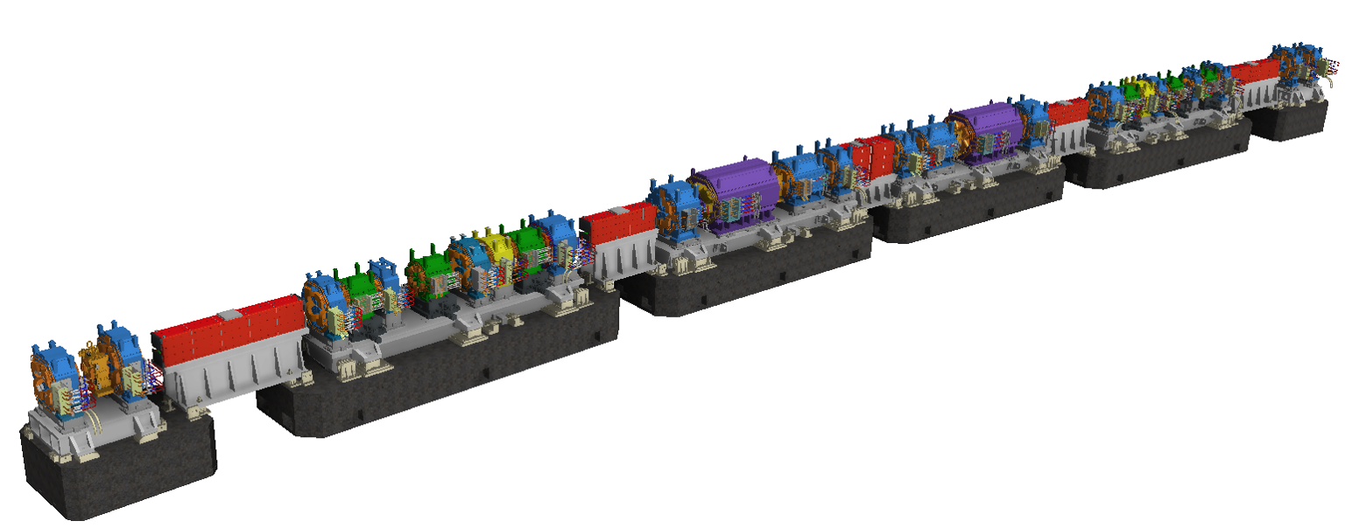
Magnet Technology
CHEN, Fusan 陈福三
chenfs@ihep.ac.cn
2025-8-3

Slide 2
Contents
1
Introduction and basic theories
2
Iron dominated electromagnet
3
Superconducting magnet
4
Permanent magnet
5
Magnetic field measurement
6
Special topics

Slide 3
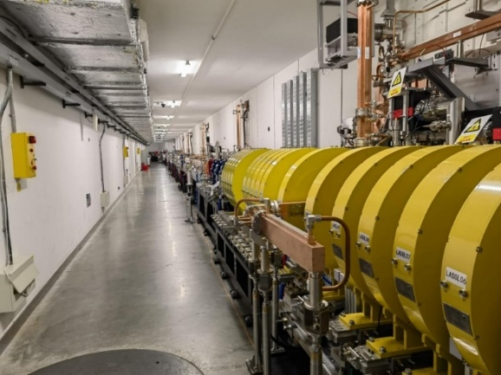
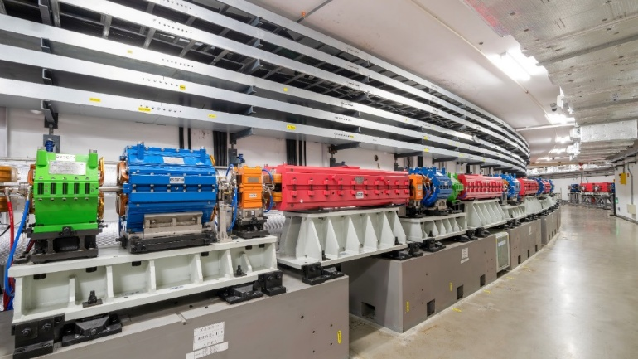
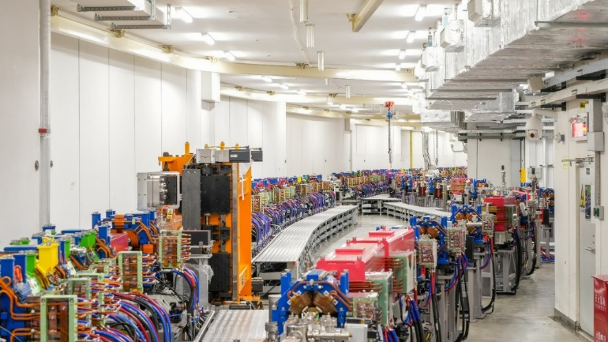
Introduction
Magnet system – the foundation of accelerator
  Only multipole magnet for Lattice is discussed in this lecture.
  High Energy Photon Source (HEPS) magnets as examples.
Accelerator Magnet
Multipole magnet for Lattice
Dipole
(Bending magnet)
Quadrupole
(Focus magnet)
Insertion devices
Sextupole
Octupole
Wiggler
Undulator
Inj/extraction magnet
Linac
Booster
Storage ring

Slide 4
Functions of magnets
Lorentz force
Magnet types
  Dipole: bend the beam and generate synchrotron radiation
  Quadrupole: focus/defocus the beam
  Sextupole: chromaticity correction
  Octupole: Landau damping
  Insertion devices: a series of periodically arranged dipole to generate high quality synchrotron radiation
For particles with velocity of light (c), 1T of magnetic field is equivalent to 300 MV/m of electric field.

Slide 5
Functions of magnets
Magnet functions diagrammatic sketch

Slide 6
Maxwell’s equations
Differential form of Maxwell’s equations
Electric displacement
Magnetic flux density, magnetic induction
Electric field strength
Magnetic intensity
Current density
Charge density
Electric permittivity
Magnetic permeability
Conductivity

Slide 7
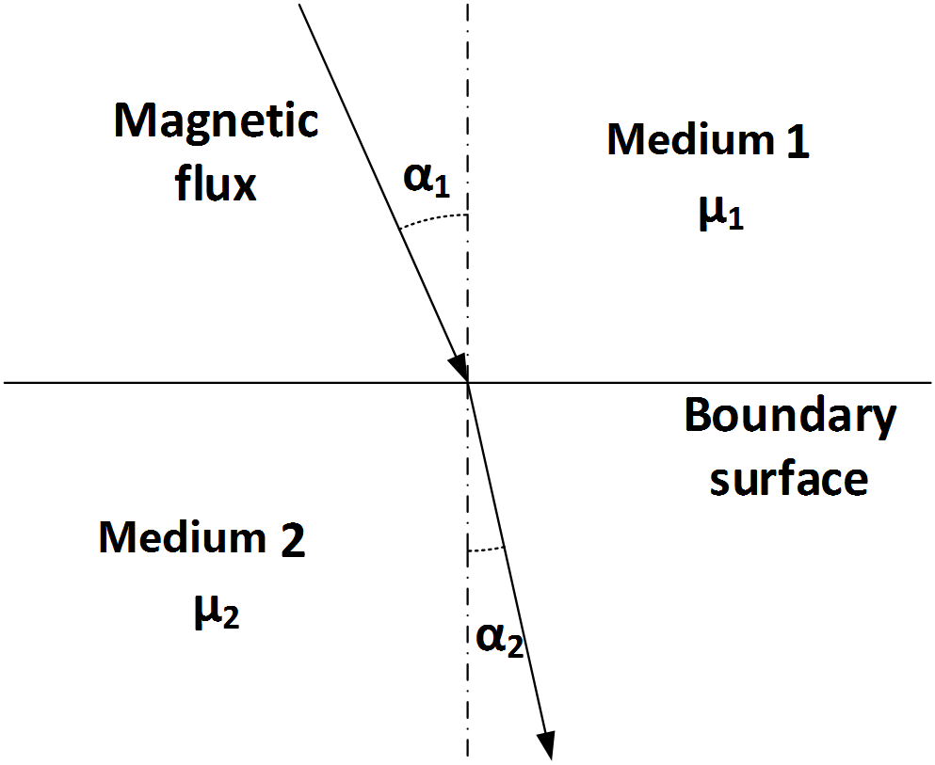
Principles of magnetic field
Ampere’s law
Boundary condition between two materials
for static magnetic field generated by constant current
=0
Normal component of the magnetic flux density and tangential component of the magnetic intensity are continuous across a boundary.
For the incident angle α₁ and exit angle α₂:
and
if

Slide 8

Scalar potential and vector potential
Magnetic scalar potential:
Magnetic vector potential:
For a static magnetic field with
no current in the region:
For example: in vacuum chamber
Curl
The magnet flux density can be described with the gradient of a scalar field:
For any vector field $\vec{A}$:
and
The magnet flux density can be derived from the curl of a vector field:

Slide 9
Laplace equation and Poisson equation
Laplace equation in the region with no current:
Poisson equation in the region with current:
Coulomb gauge used here:
The solution of the Poisson equation is:

Slide 10
Two-dimensional field
Simplify 3-d problem to 2-d cause:
  The particle feels integral field along z direction.
  For most magnet, stray field is quite small to integral field.
2-d variables represented by complex number:
  Coordinate:
  Magnet field:
  Differential operator:
  Constant:

Slide 11
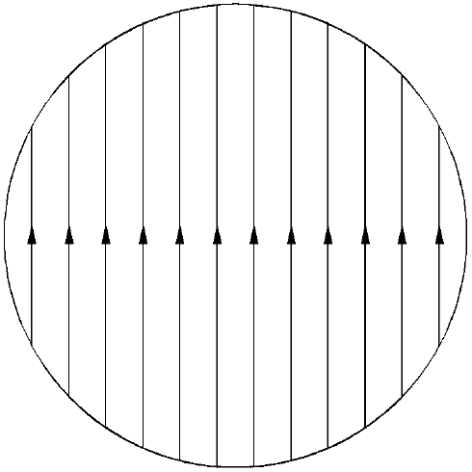
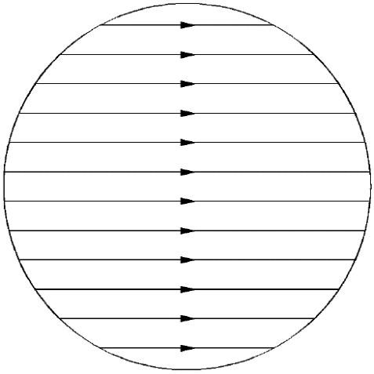
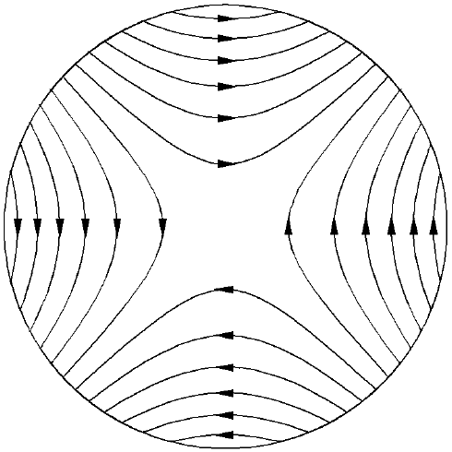
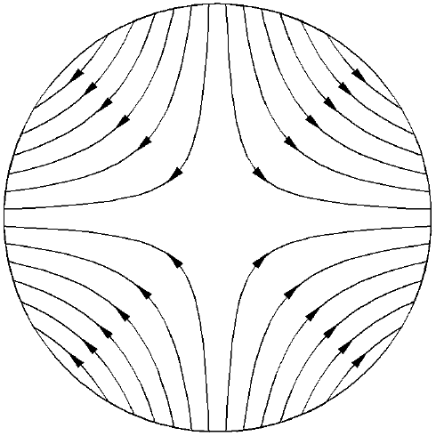

Multipole magnetic field
Consider the field satisfy:
  It is demonstrable that $\vec{B}$ is a solution of Maxwell’s equations and a possible physical magnetic field, which is know as multipole fields.
Magnetic flux of multipole fields with different orders:
equivalent
Phase
Normal dipole
Skew dipole
Normal quadrupole
Skew quadrupole

Slide 12
Magnetic scalar equipotential
Consider the scalar potential
The n-order magnetic scalar equipotential is:
Here we get the n-order multipole field:
The magnetic scalar equipotential is a series of curve which is perpendicular to the magnetic flux, where r₀ gives the minimum distance from the origin to the equipotential curve.
Let:
We get:

Slide 13
Contents
1
Introduction and basic theories
2
Iron dominated electromagnet
3
Superconducting magnet
4
Permanent magnet
5
Magnetic field measurement
6
Special topics

Slide 14
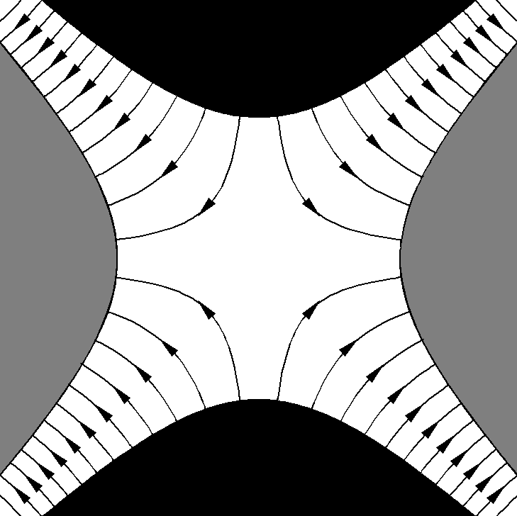
Generate multipole with Iron
Recall the boundary condition:
Generate field with Iron
if
Consider medium 1 is a high permeability material such as pure iron or silicon steel, and medium 2 is vacuum or air, so that above condition satisfied. The magnetic flux is perpendicular to the boundary surface.
N pole
Make high permeability material (Iron) surface fitting the equipotential, the so-called magnet pole, and we will get desired field between the poles.
r₀
S pole
S pole
For example:
skew quad.
N pole

Slide 15
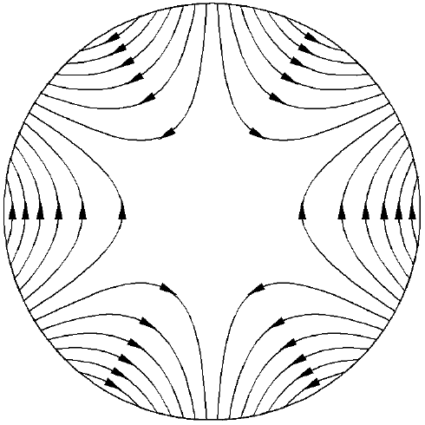
Characteristics of multipoles
For n-order multipole fields
Normal dipole
Normal quadrupole
Normal sextupole
n=1, dipole has uniform field with no field center
n=2, the strength of a quadrupole is proportional to the distance to the origin.
n=3, the strength of a sextupole is proportional to the square of the distance to the origin.

Slide 16
Real magnet
Ideal magnet has only specified multipoles
  The poles profile fits the equation,
  so the poles expand to infinity while
  The length of the magnet is infinite.
  The permeability is infinite high.
  The pole surface is absolutely smooth.
  The excitation coil is infinite away from the center.
All above conditions can not be satisfied. So real multipole magnet consists of main component and infinite number of other multipole fields.

Slide 17
Field error – high order harmonics
High order field are categorized into:
  Systematic errors: have the same symmetry as main field.
  Nonsystematic errors:
  Field quality evaluation:
and
Main field | Systematic error
N=1, dipole | n=3,5,7,…
N=2, quadrupole | n=6,10,14,…
N=3, sextupole | n=9,15,21,…
Systematic errors can be optimized on the design stage
Nonsystematic errors are zero on the design stage, and come from the imperfection of material and fabrication.

Slide 18
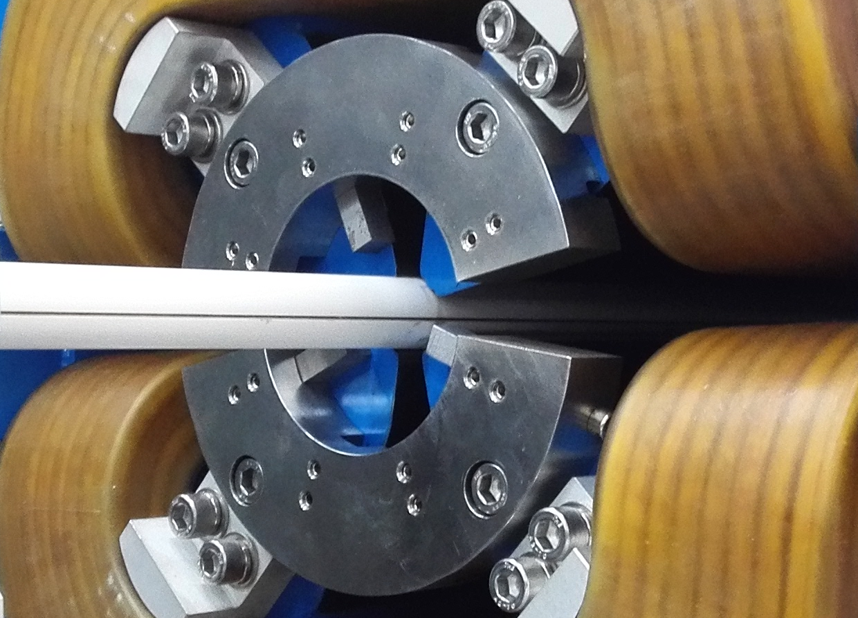
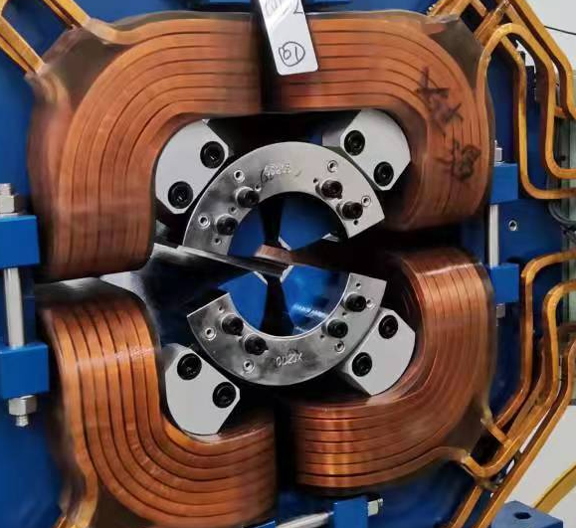
Shimming and Chamfering
Pole profile shimming
  Compensate the systematic errors
  and widen the good field region
Pole end shimming
  Correct the nonsystematic errors
  according to the measurement result
Pole chamfering
Chamfering on the pole end can correct the field errors as well as reduce the saturation of the pole corner.
‘Magic finger’ used for HEPS magnet

Slide 19
Magnet design – considerations
Compromise of various factors

Slide 20
Magnet design – excitation current
Dipole：
Quadrupole：
Ampere’s law
Divide the integral path into 3 segments:
I_{iron}, a small value
Zero
f, ampere factor, about 1.01~1.06 for unsaturated magnet
Use same method to calculate the exci-tation current of sextupole, noting that

Slide 21
Magnet design – cooling water
For the current density of coil
Cooling water calculation
Air cooling
The water cooling coil is made of hollow copper conductor
Water cooling
Water flow velocity
[m/s]
Water pressure drop
[kg/cm²]
Hole diameter of conductor
[mm]
Length of cooling loop
[m]
Too fast leading to vibration
Flow rate of water
[l/s]
Acceptable velocity range
Temperature rise of water
[°C]
Good velocity range
Power consumption of coil
[kW]
Too slow to form turbulence

Slide 22
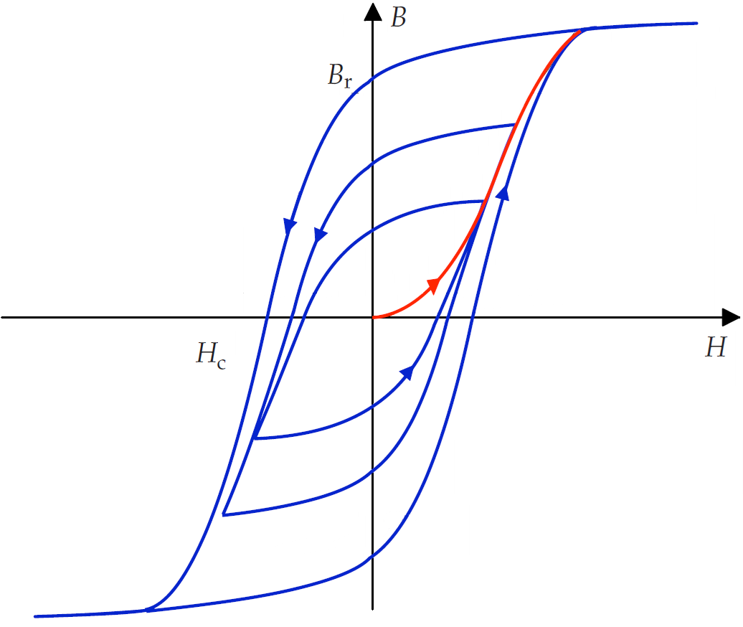
Standardization and I-B curve
The magnet core material has hysteresis loop:
  Ramping up and down have different path
  Magnetic flux density is nonlinear to current
Standardization and I-B curve
  Power the magnet by 0 → I_{max} → 0 for 3
  times, then ramp to I_{op1}. If next operation
  current I_{op2} > I_{op1}, ramp to I_{op2} directly; if
  I_{op2} < I_{op1}, ramp to I_{max} → 0 → I_{op2}.
  Only ramping up I-B curve is adopted.
  I-B curve is measured in 10~20 points and
  interpolation is used for other values

Slide 23
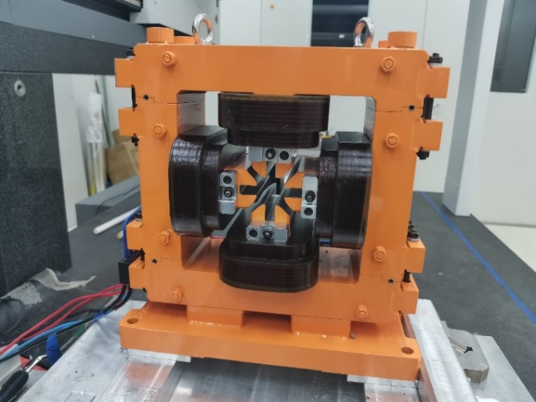
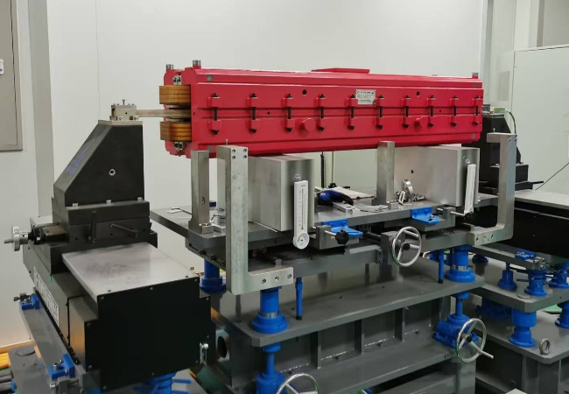
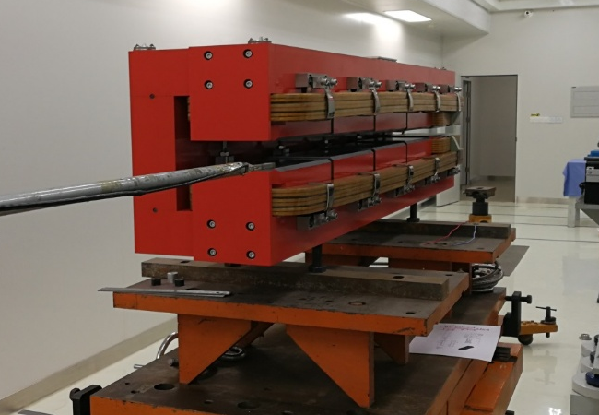
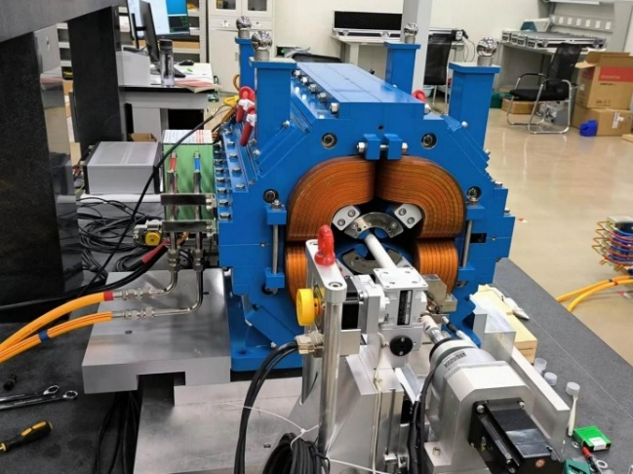
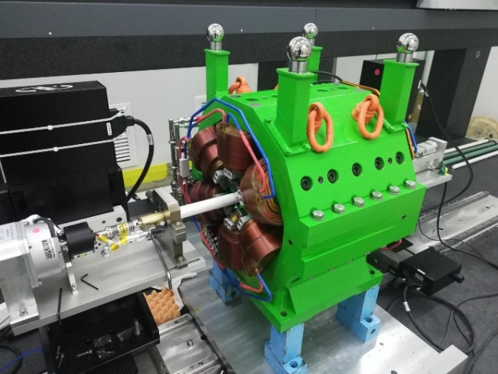
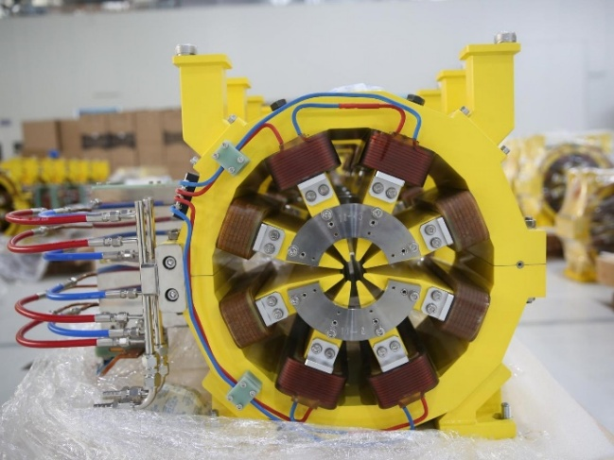
Photos of HEPS magnets
HEPS booster dipole
HEPS storage ring dipole prototype
HEPS storage ring fast corrector
HEPS storage ring quadrupole
HEPS storage ring sextupole
HEPS storage ring octupole

Slide 24
Contents
1
Introduction and basic theories
2
Iron dominated electromagnet
3
Superconducting magnet
4
Permanent magnet
5
Magnetic field measurement
6
Special topics

Slide 25
Superconducting materials
NbTi is the most widely
used SC material
Low temperature superconductor
Copper based materials
Iron based materials
NbTi
High temperature superconductor
Nb₃Sn, Nb₃Al
ReBCO
BSCCO
Metal compounds
MgB2, …
Tc < 77K
cooled with liquid Helium
Tc > 77K
cooled with liquid Nitrogen
Three critical
conditions for SC material

Slide 26
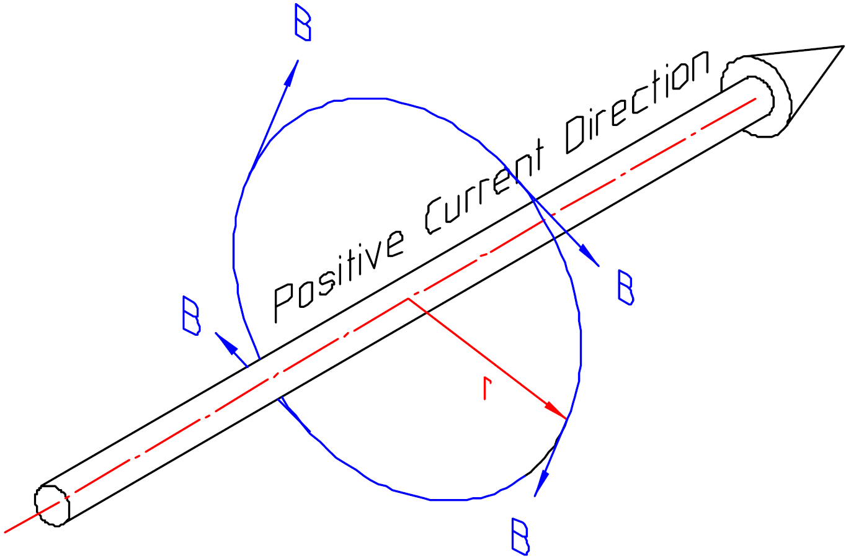
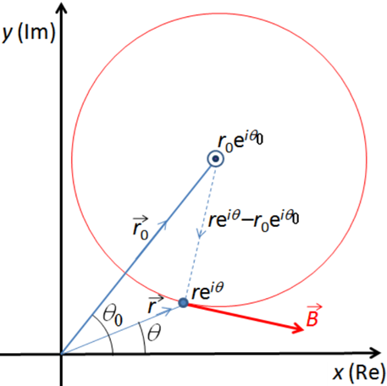
Generate multipoles with current
Magnetic field from a line current

Slide 27
Generate multipoles with current
Use Tayler series expansion
where
For the region
we get
Consider the current distributed on a circle of radius r₀ satisfy
The integral field generated in the circle is:
This is a typical 2N-pole magnetic field.
Dipole field with

Slide 28
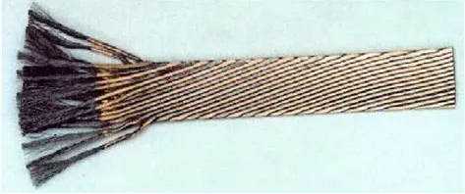
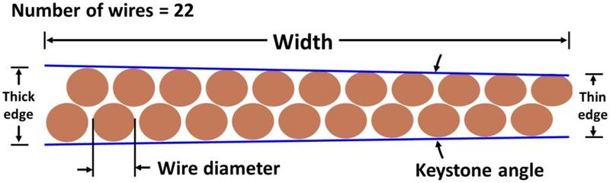
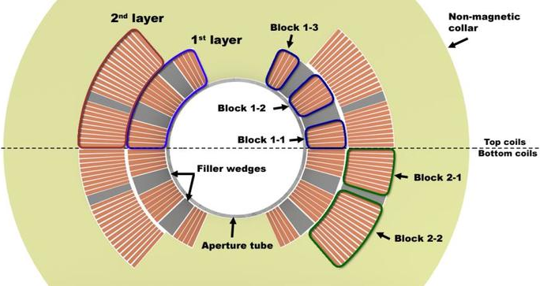
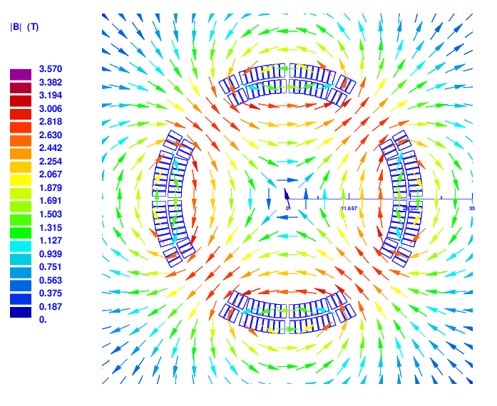
Superconducting magnet type
Cosine theta with Rutherford cable
Rutherford cable
Cross section of Rutherford cable
Discrete blocks instead of continuously distributed current
Cross section of dipole
Field distribution of quadrupole

Slide 29
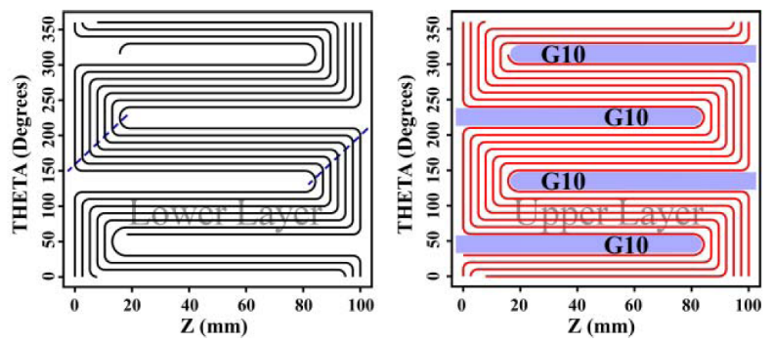
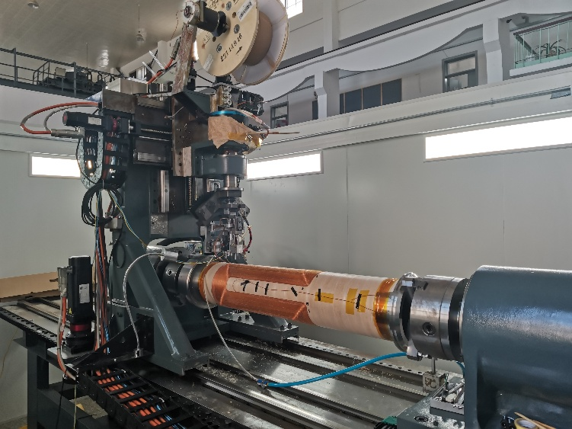
Superconducting magnet type
Serpentine style cosine theta type magnet
  The straight segments have the same length → 2d simulation has the same result as 3d simulation → Fast and easy design
  Double layers form a complete multipole field.
  Suitable for fabrication with direct winding machine.

Slide 30
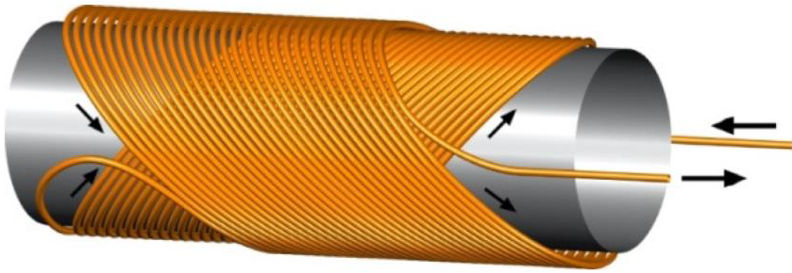
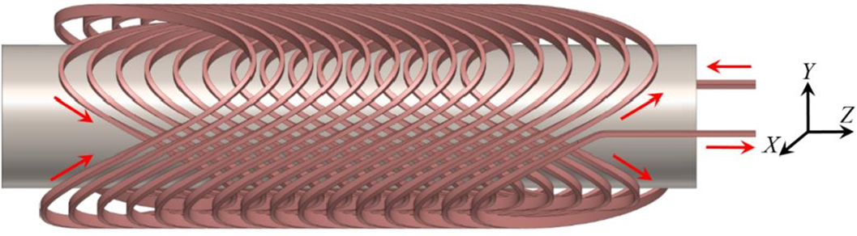
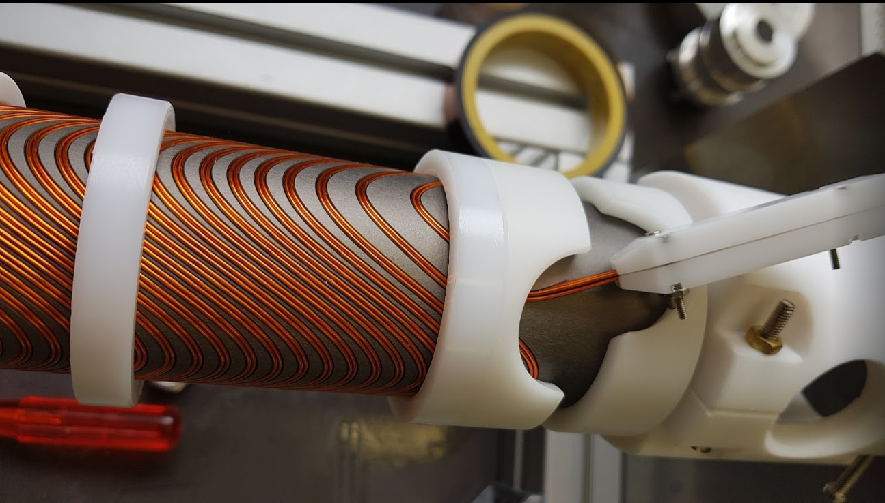
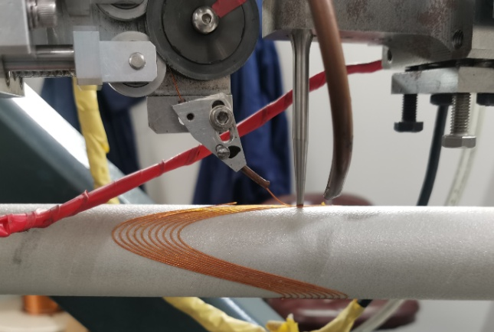
Superconducting magnet type
Canted cosine theta (CCT)
Two tilted solenoid with transverse components superposed and longitudinal component cancelled.
The wire path defined by:
CCT
dipole
CCT
quadrupole
Double layers form complete field
Quadrupole prototype for FCC-ee, wires-in-groove technology.
Quadrupole prototype for CEPC, direct winding technology.

Slide 31
Quench and quench protection
Quench: a sustaining process
brings whole magnet into
normal conducting state.
Potential risks:
  Wire performance decline, insulation damage, magnet burnt out.
Quench protection system (QPS):
  Dump the stored energy outside or scattered inside to avoid hot spot over-heated. → < 300K.
    Quench detector identifies the quench, QPS shuts down the power supply, switches to the protection circuit and triggers the quench heater.
    QPS needs to record all the quench data for diagnostics.
Heat conduction to nearby region
Normal conducting
Joule heat
Temperature rise
Hot spot
A small region exceed the critical surface
Whole magnet into normal conducting

Slide 32
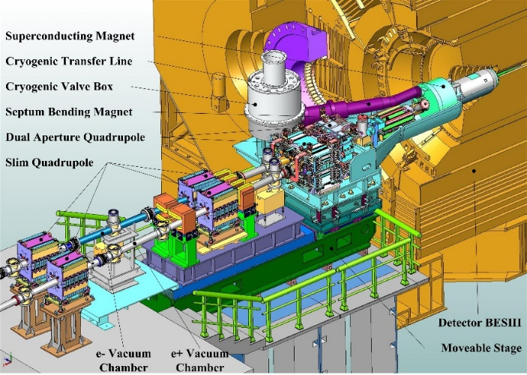
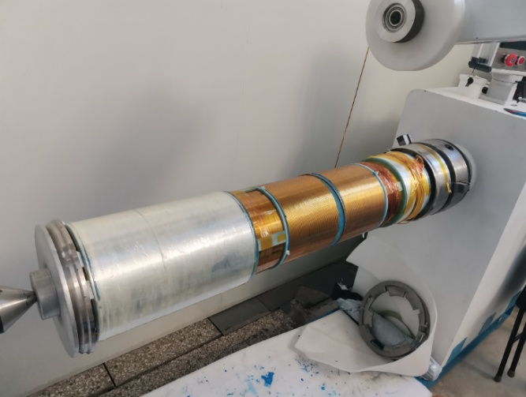
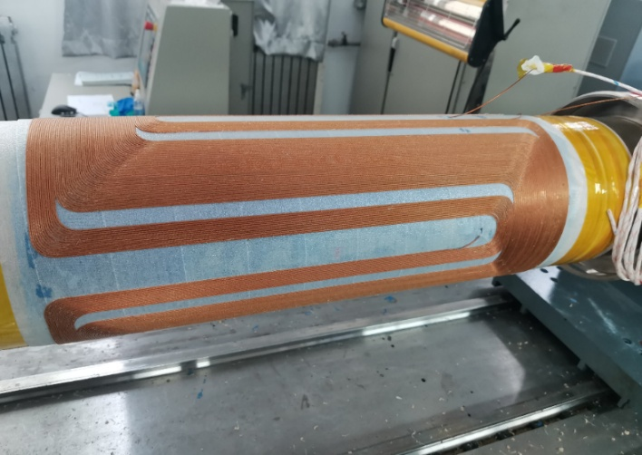
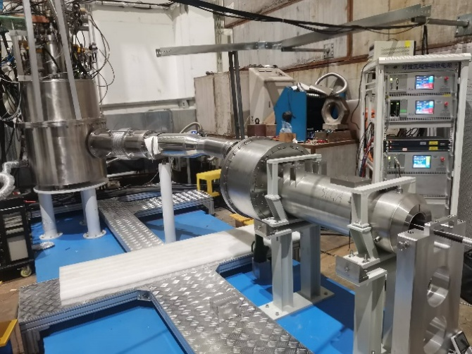
Superconducting magnet of BEPCII
Two SC magnets are installed on each side of the BEPCII interaction point as final focus magnet.
The interaction region SC magnet of BEPCII is inserted into the detector.
BEPCII SC magnet has 3 anti-solenoids to compensate the detector’s field.
The main coil is a 10-layers quadrupole which can provide 25T/m field.
Horizontal cryogenic test with field measurement.

Slide 33
Contents
1
Introduction and basic theories
2
Iron dominated electromagnet
3
Superconducting magnet
4
Permanent magnet
5
Magnetic field measurement
6
Special topics

Slide 34
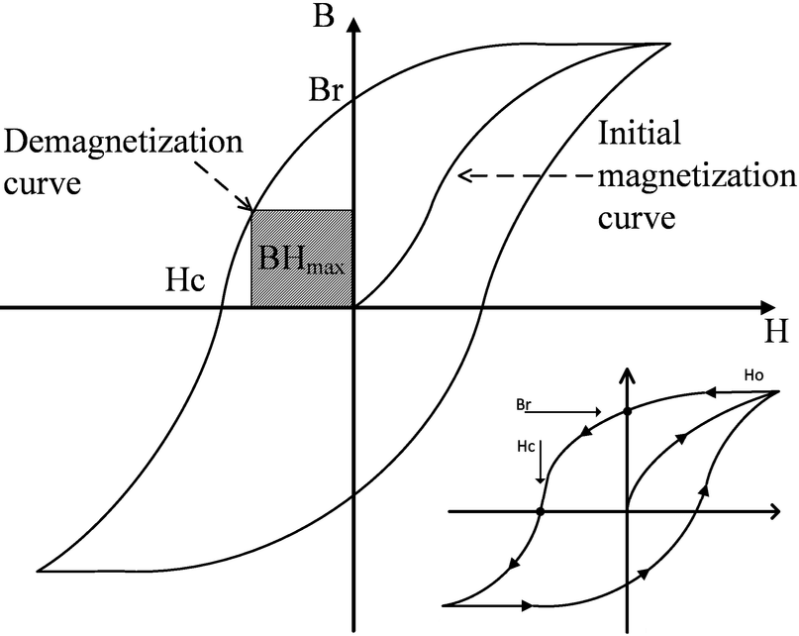
Permanent magnet materials
Permanent magnet material characteristics:
  High remanence & high coercivity → High energy product BH_{max}
  Demagnetization in high temperature and irradiation condition
  Permeability is close to μ₀ (vacuum)
  Easy axis: the direction of the remanence B_{r} points to.
Materials | Remanence | BH_{max} | Work temperature | Temperature coefficient
Unit | T | KJ/m³ | °C | 10⁻⁴/°C
AlNiCo | 0.7~1.3 | 30~100 | <550 | 1
Ferrite | 0.3~0.4 | 10~30 | <250 | 13
SmCo | 1.0~1.3 | 180~250 | <500 | 3
NdFeB | 1.1~1.4 | 240~440 | <220 | 10

Slide 35
Advantage and disadvantage of PM
Comparing to the electromagnet
 | Electromagnet | Permanent magnet
Advantage | Tuning field by changing current High field achieved with SC magnet Improve field quality by shimming and chamfering | No power consumption, low operating cost Compact structure, saving longitudinal space without coils No need for power supply and cooling water system
Disadvantage | Power consumption Need auxiliary systems including power supply, power cables and cooling water system | Field is not easy to change Large dispersion for material property and field quality is not so good Temperature coefficient demands stable operating condition Demagnetization by heat or radiation

Slide 36
Generate multipole with pure PM
Current sheet equivalent model (CSEM)
Complex conjugate B* is used cause it is analytic
Here is remanence, not the radial component
for

Slide 37
Generate multipole with pure PM
Consider a PM ring with the
easy axis satisfy:
Inside the ring:
This is a N-order multipole field.
It can be proved that the field outside the ring is zero.

Slide 38
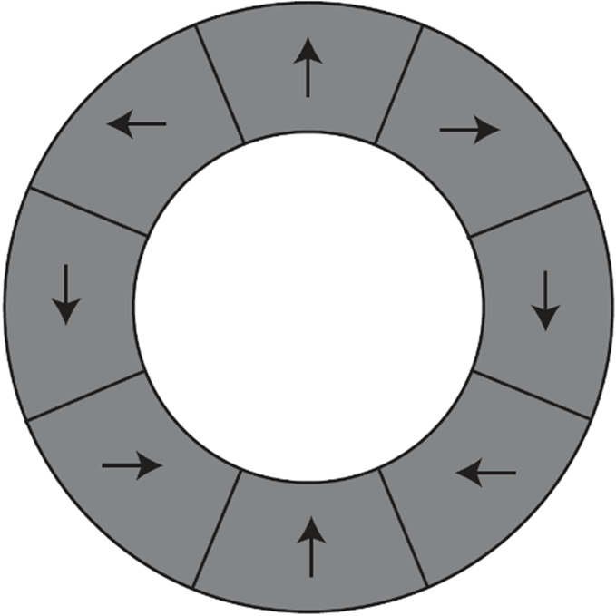
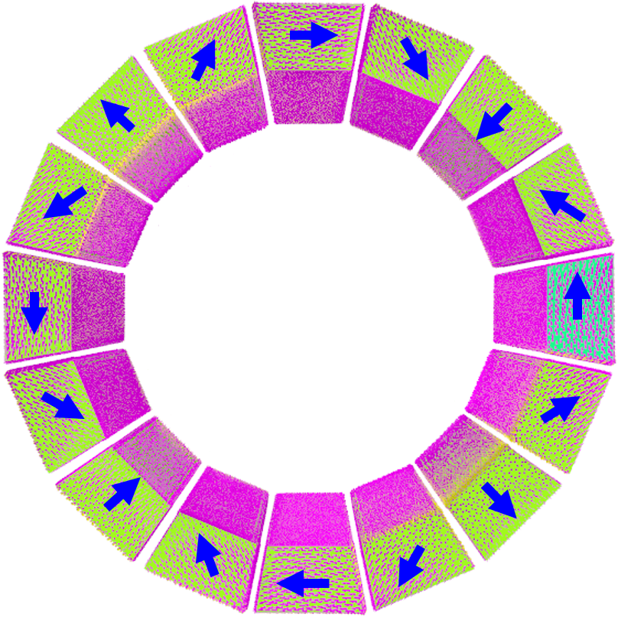
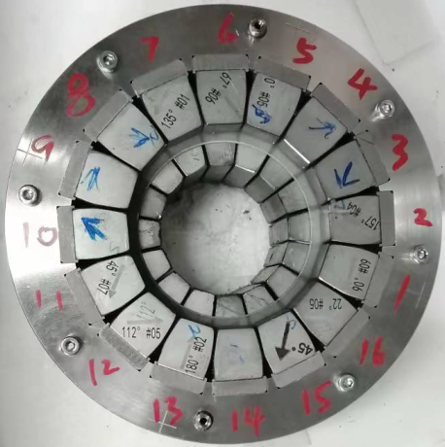
Field errors and correction method
Simplify for practice
  Idea distribution → Discrete distribution → Wedges assembly
  The field quality is not ideal because of various of errors.
  Correction method: change the radial position of the wedges Intentionally to induce the multipoles opposite to the errors.
Halbach array
Dipole with 8 pieces
Quad. with 16 wedges
Photo of a quad.
Errors for one wedge

Slide 39
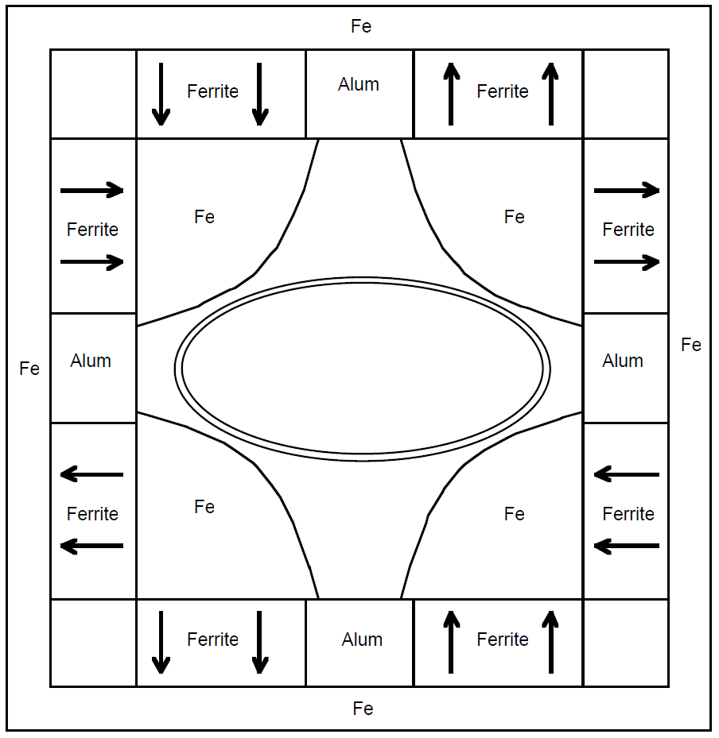
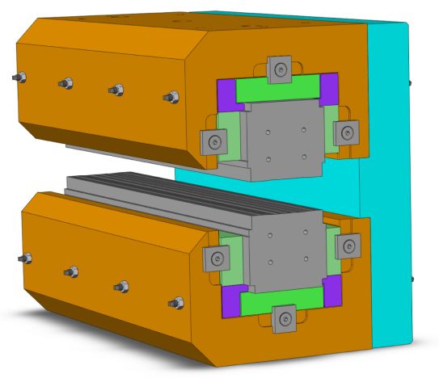
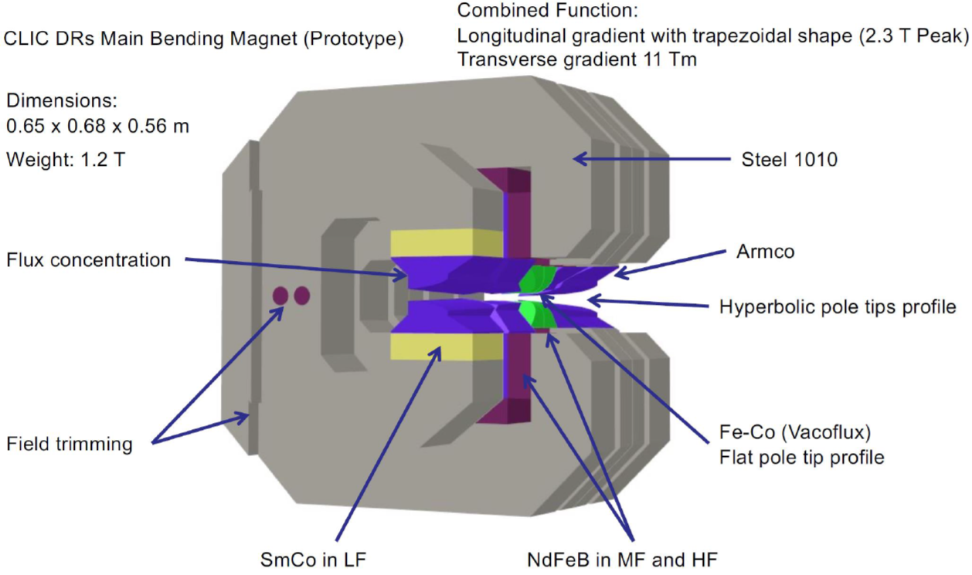
Hybrid magnet: PM+Iron
PM substitute for the coils of iron-based magnet
Fermilab Recycler Ring quadrupole, made of ferrite.
Dipole of ESRF-EBS storage ring, made of Samarium Cobalt.
Prototype of CLIC bending magnet designed by ALBA, both Neodymium Ferrum Boron and Samarium Cobalt are used.
All these magnets have Iron poles to form desired multipole field just like electromagnet.

Slide 40
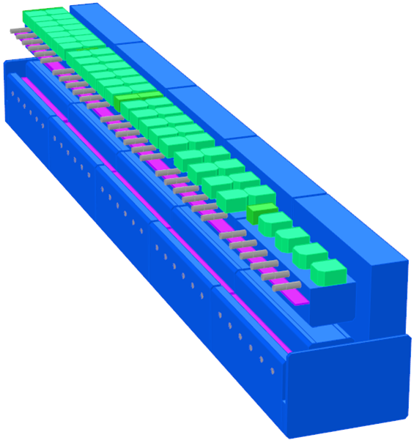
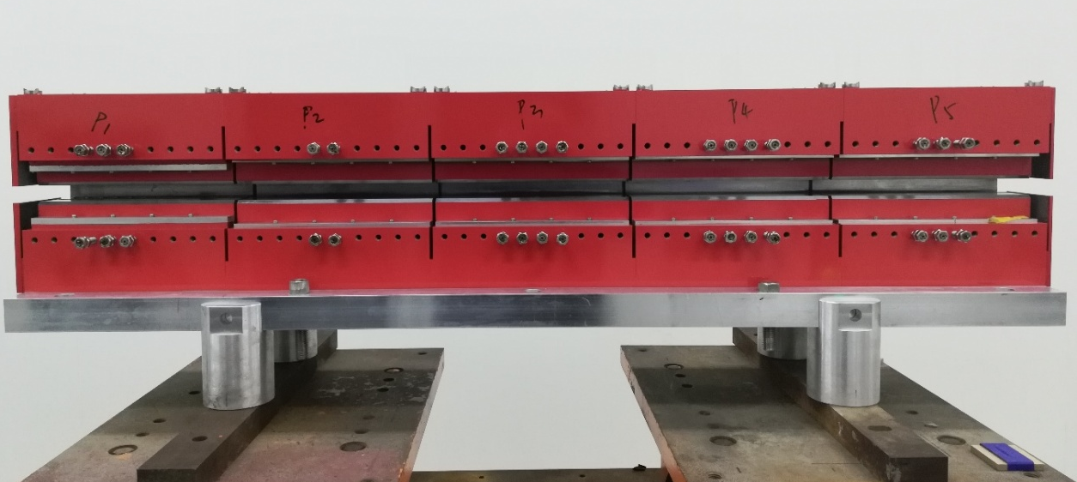
BLG magnet of HEPS
240 longitudinal gradient PM dipoles used for HEPS storage ring.
  FeNi alloy is used to compensate the temperature coefficient to less than 50ppm/°C
  Adjusting bolts are used to tuning the integral field in ±50ppm
Offline tuning during field measurement

Slide 41
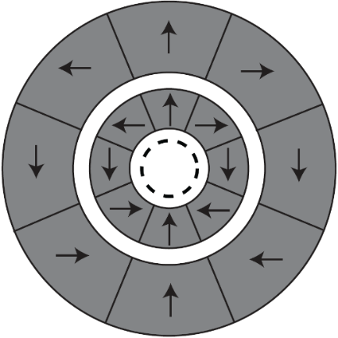
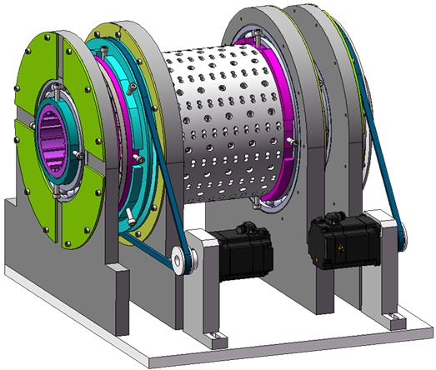
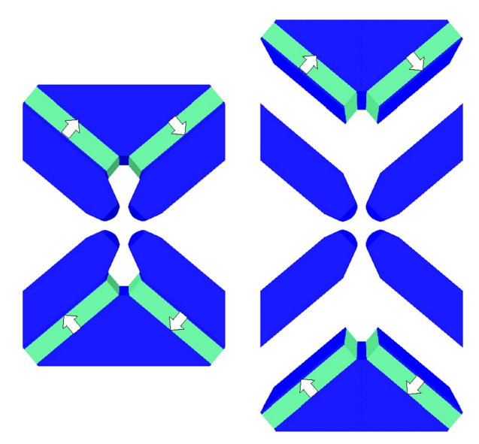
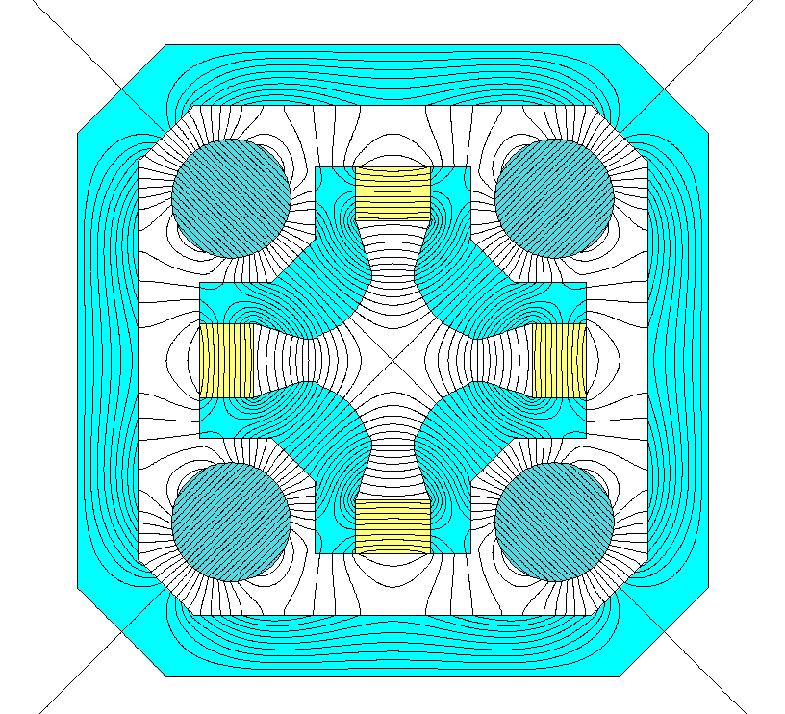

Future technology: strength tunable
On-line tunable is necessary for quad. and sext.
  Hybrid magnet with trim coil: tuning ratio <10%.
  Large scale tunable method:
    Change the flux path
    Change the superposition
Rotate the inner and outer Halbach ring to change the superposition value with different intersection angle
Pull open the PM and pole to add air gap in the integral path of ampere’s law
Rotate the cylinders to change the field at the center

Slide 42
Contents
1
Introduction and basic theories
2
Iron dominated electromagnet
3
Superconducting magnet
4
Permanent magnet
5
Magnetic field measurement
6
Special topics

Slide 43




Photos of measurement system
Hall probe system
Moving long coil system
Rotating coil system
Stretched wire system

Slide 44
NMR & Hall probe system
Absolute measurement with probe
  NMR system has very high accuracy independent to temperature, but the operation condition is very strict.
  Hall probe system is used for general purpose, and has very precise positioning.
  NMR system is used to calibrate the Hall probe system.
 | NMR system | Hall probe system
Principle | Nuclear magnetic resonance | Hall effect
Accuracy | 5*10⁻⁷ T | 0.01% of reading
Measuring speed | 10 s/sample | 0.1 s/sample
Field gradient | < 1000 ppm/cm | -
Sensor size | ~ 10*10 mm | ~ 0.15*0.15 mm
Temperature effect | no | yes

Slide 45
Rotating coil system
Induced voltage of coil moving in the multipole
Consider the multipole field:
The radial component is:
The voltage induced by a one-turn coil perpendicular to the paper surface moving around the origin is:

Slide 46
Rotating coil system
Integrate the voltage over time:
After integration, the function no more depends on the rotating speed.
On the other hand, use Fourier Series to express the periodic function:
Ignore the imaginary part and take symmetry into account.
So the amplitude of n-order multipole is:
It means, using Fourier Transform on integral of the induced voltage of rotating coil, we will get the amplitude of multipoles from the coefficients of the Transform.
Of which:

Slide 47
Rotating coil system
Rotating coil system is used to measure the multipoles, usually the ratio to main component of integral field.
‘Spill-down’ field and the magnetic center
The n-order (n>=2) multipole:
If the magnet center shift:
A n-1 order field induced, so called ‘spill down’ field
So we can calculate the offset of magnetic center to rotating axis according to the ‘spill down’ field.

Slide 48
Alignment in field measurement
Align the magnetic center to the fiducial targets.
  The magnetic center to the rotating
  coil axis, from field measurement:
  The rotating coil axis to fiducial targets:
    Optical instruments such as theodolite,
    precision: 30~50 μm
    Laser tracker, precision: 20~25 μm
    Coordinate measuring machine,
    precision: 5~7 μm
  4th generation light source alignment
  requirement: 30 μm on same girder.

Slide 49


Automation in magnet measurement
By programming the alignment and motion devices, alignment process is implemented automatically.
  Magnet to measuring coil or measuring coil to magnet.
  Improve the measurement efficiency and precision dramatically.
Fiducial target
Articulated arm CMM
Fiducial target
5d automatic adjustment support
Longmen CMM
Rotating coil
Moving long coil system
Newport moving stage
Rotating coil system

Slide 50

Effect of lab environment
Warming up before
measurement
Keep the temperature
and humidity steady.

Slide 51
Contents
1
Introduction and basic theories
2
Iron dominated electromagnet
3
Superconducting magnet
4
Permanent magnet
5
Magnetic field measurement
6
Special topics

Slide 52



Crosstalk studies in HEPS
Cross-talk is caused by leakage field
Magnet type | BLG3 | BD1/2 | QD5 | SD2/3 | OCT1/2
Magnet aperture[mm] | 26 | 45 | 26 | 26.6 | 30
Influence range [mm] * | 30 ** | 260 | 240 | 130 | 145
240mm
* Influence range is defined by leakage field < 10Gs
** Leakage field of BLG magnet is suppressed by end shielding plate
QD5
QD4
Iron to Iron distance is ~62mm
BLG3

Slide 53






Crosstalk simulation and correction
Modelling for different situations in OPERA-3d and Calculating the variations of dipole and quadrupole
along the beam direction
Dipole component induced by cross-talk
(BLG3+QD4) – (BLG3-only) – (QD4-only)
(BLG3+QD5) – (BLG3-only) – (QD5-only)
(BLG3+QD4+QD5) – (BLG3-only) – (QD4-only) – (QD5-only)
For permanent magnet, the crosstalk induced variation must be corrected before the magnet installed into tunnel.
QD4-only
QD5-only
BLG3-only
BLG3+QD4
BLG3+QD5
BLG3+QD4+QD5

Slide 54


Interference of trim coil & main coil
To save space, some quad. and sext. have trim coils to provide horizontal or vertical beam orbit correction.
The main field changes when trim coils are powered.
In case of sextupole, the change ratio of the main field is up to 0.45% and depends on the current of trim coils.

Slide 55


Trim coil effect
The change ratio of main field$δφ$ depends on main coil current (I_{M}) and trim coil currents (I_{H}/I_{V}).

Slide 56
Codes for magnet design
Code Name | Description
Poisson | A free 2d code package developed by Los Alamos National Lab and still be often used for quick rough simulation and iteration.
OPERA (CST) | A powerful commercial 3d code package developed by a British company and now belongs to a French company DASSAULT. This code is widely used for magnet design. The simulation result is highly consistent to the real magnet.
RADIA | A professional free 3d code package based on a commercial software Mathematics and developed by a French laboratory ESRF. This code is widely used for permanent magnet design as well as electromagnet.
ROXIE | A 3d program developed by CERN and dedicated to electro-magnet, especially to superconducting magnet simulation. A one-off fee is required for non-profit institutions such as universities and labs.

Slide 57
References
Iron dominated electromagnets design, fabrication, assembly and measurements, Jack Tanabe, Jan. 6, 2005.
Proceedings of the CAS – CERN Accelerator School: Magnets, 16-25 Jun 2009, CERN-2010-004.
Field computation for accelerator magnets, Stephan Russenschuck.
Magnet technology, 10th OCPA accelerator school, Jyh-Chyuan Jan, 2018.

Slide 58

Thanks for your attention
Welcome to HEPS, the first 4th Generation light source in Asia

