Slide 1
FEL principle (G8)
Tao Liu (liut@sari.ac.cn)
Shanghai Advanced Research Institute, Chinese Academy of Sciences
OCPA2025, Khao Yai, Nakhon Ratchasima, Thailand, 07.29-08.07, 2025

Slide 2
Lecture Outline
 |  | Time
Introduction and electron motions in an undulator |  | 14:00-15:00
Low-gain and high-gain FEL Theory |  | 15:00-16:00
Break
High-gain FEL Analysis and SASE |  | 16:15-17:15
Seeded FELs |  | 17:15-18:15
Selected references:
P. Schmuser, M. Dohlus, and J. Rossbach, Free Electron Lasers in the UV and X‐Ray Regime, Springer, 2014
K‐J. Kim, Z. Huang, R. Lindberg, Synchrotron Radiation and Free-Electron Lasers, Cambridge University Press, 2017
赵振堂等， 先进X射线光源加速器原理与关键技术，上海交通大学出版社，2017

Slide 3
Introduction

Slide 4
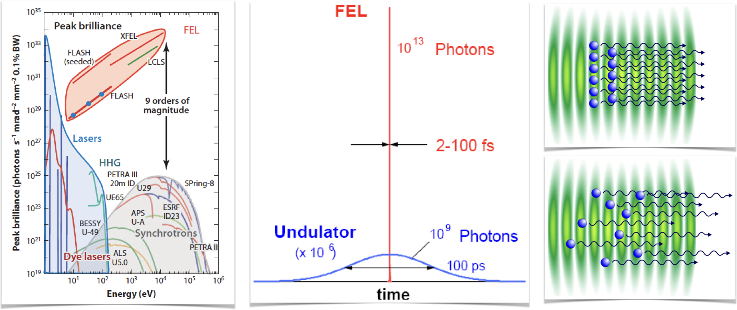
XFEL: one of the most powerful tools for science
Extremely Bright, Ultrafast, Quasi-Fully Coherence and Wavelength continuous tunability

Slide 5
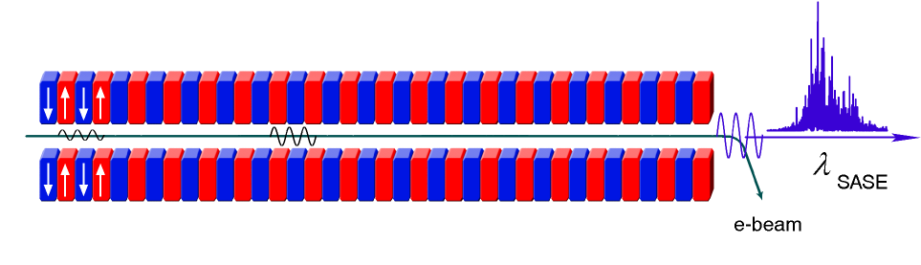
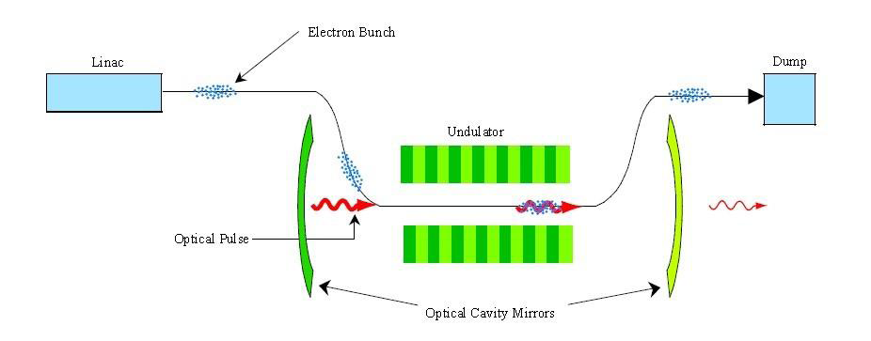
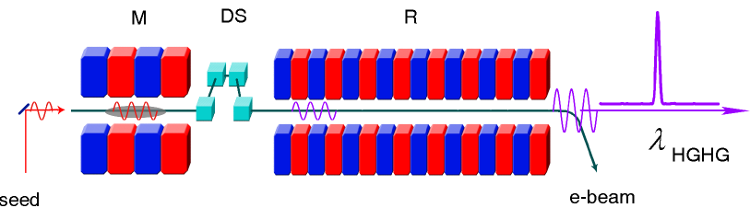
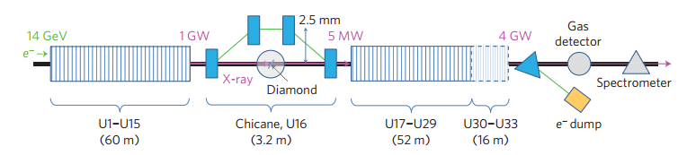
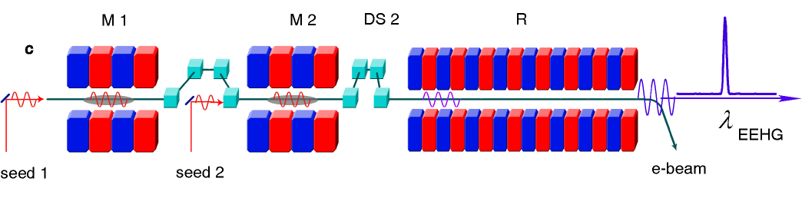
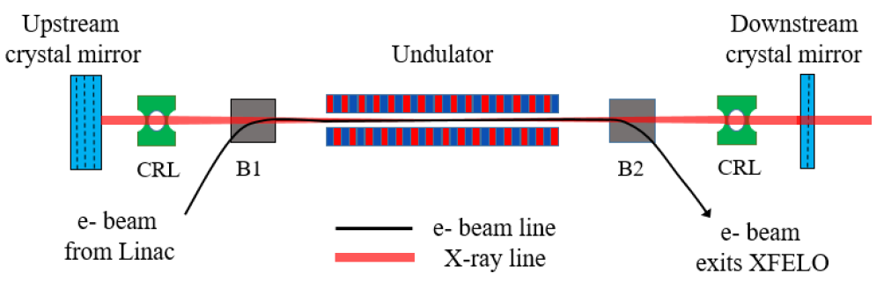
FEL operation modes

Slide 6

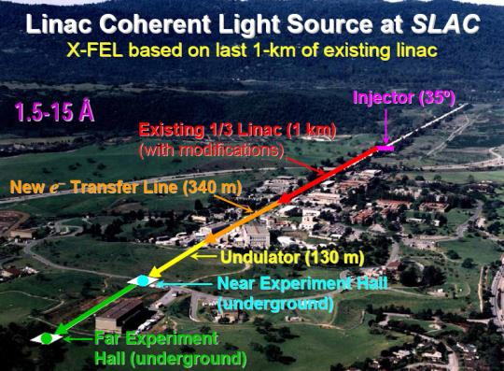
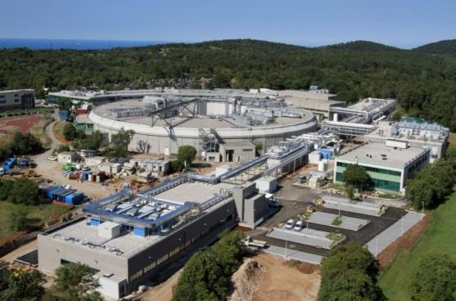

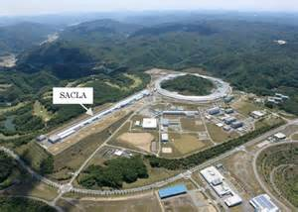


Major Photon Science Centers in the World
Germany
1999
2008
USA
1995
2003
Italy
1994
2007
Japan
1997
2006
China
2009
2014
Switzerland
2001
2010
South Korea
1995
2012

Slide 7
Basic FEL principle
Electron beam
Interaction
Light wave
Motion equation in undulator
Energy exchange
Electromagnetic field
Maxwell equation
Stable energy exchange induces resonance condition
Electric field evolution
Energy evolution
Particle distribution evolution

Slide 8
Essential Concepts
Electron beam
  Electron energy, relativistic energy factor, relativistic velocity
  Beam envelope, Twiss parameters, emittance
  Phase space: transverse and longitudinal
  Beam transport and optics
Light
  Photons: photon energy, wavelength, frequency, wave number
  Transverse coherence (Diffraction Limit), longitudinal coherence (time-frequency domain, Fourier transform limited)
  Bunching and intensity enhancement

Slide 9
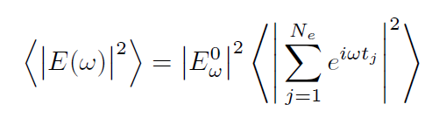
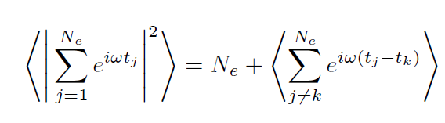
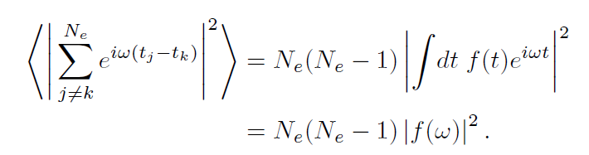
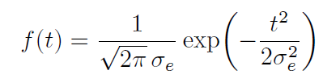

Bunching and intensity enhancement
Average electric field intensity generated by electron beam:
Divide the double sum into the piece where the particles are identical and the remaining terms:
Incoherent radiation
Coherent FEL emission

Slide 10
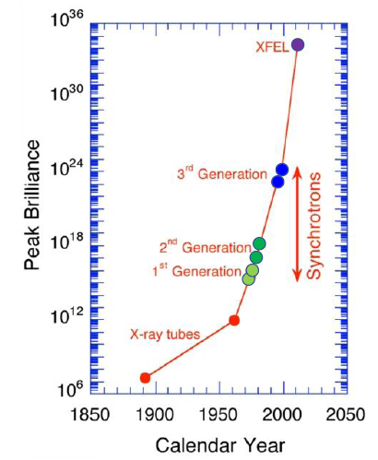
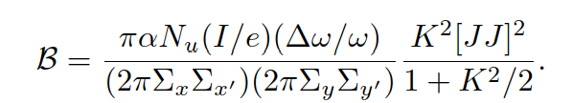
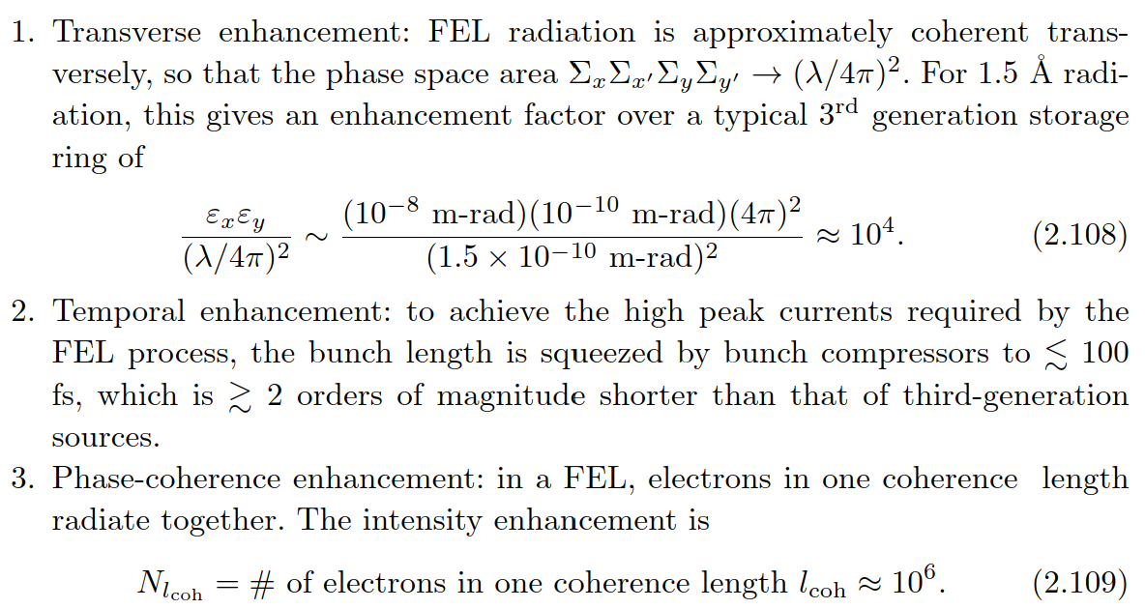
Undulator Radiation Brightness
Brightness definition：
  B=(spectral flux)÷(transverse phase space area)
Undulator Radiation Brightness：
9
11
2

Slide 11
Electron motions in an undulator

Slide 12
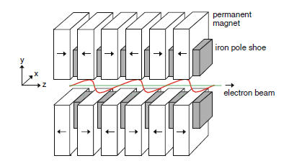
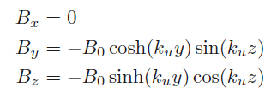







Electron trajectory in a planar undulator
Magnetic field in a planar undulator
On-axis y=0:
Transverse motion equations
Lorentz force：
Coupled equations：
1st order solution:
Undulator parameter K

Slide 13
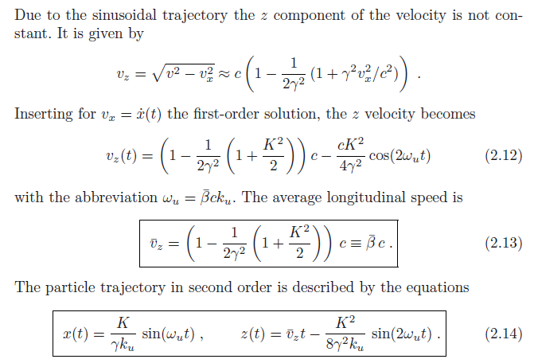
Electron trajectory in a planar undulator
In beam frame
8

Slide 14
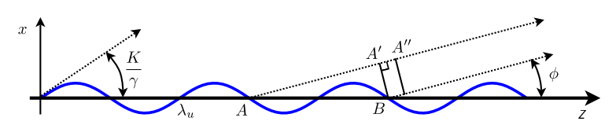

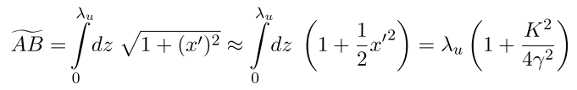

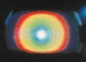
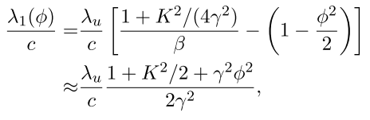
Undulator radiation resonant wavelength
UVSOR, Okazaki, Japan
Works for harmonics λ_{h}=λ₁/h

Slide 15
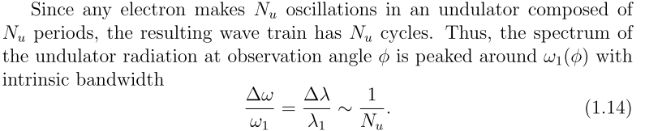
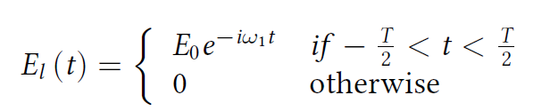
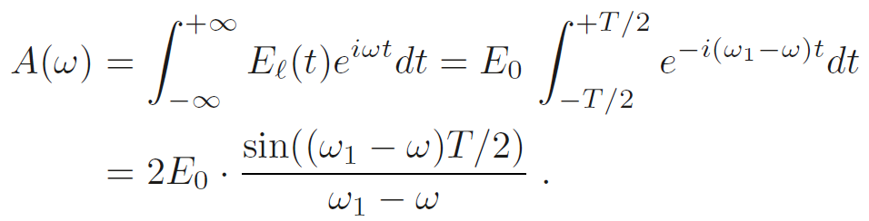
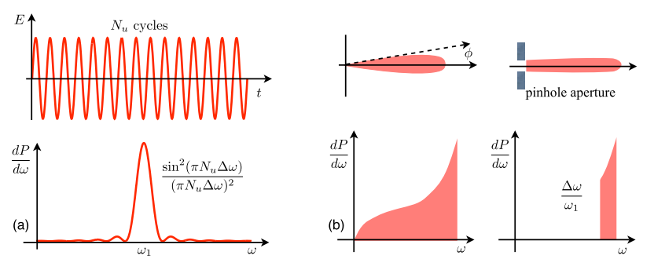
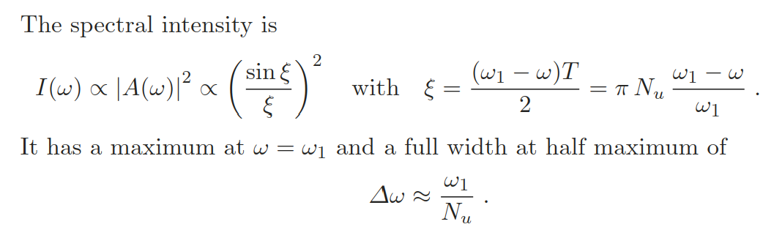
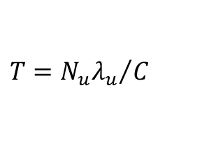
Radiation spectrum
$$T={N_{u}λ_{u}}/C$$

Slide 16

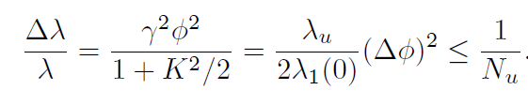

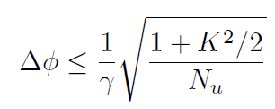
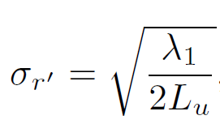
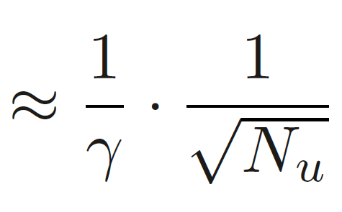
Radiation angular divergence
1）Φ~1/γ，large bandwidth (bending)
2）Φ<<1/γ，observe intrinsic bandwidth
Observing the intrinsic bandwidth to obtain the natural divergence of undulator radiation
Defining rms angular divergence

Slide 17
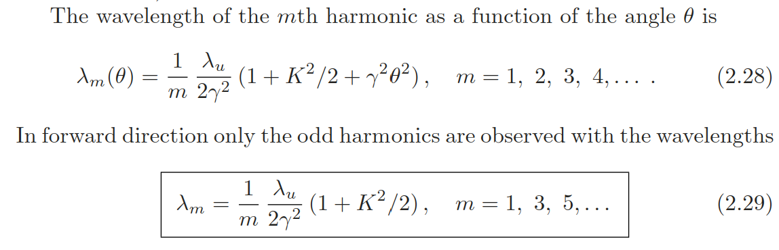
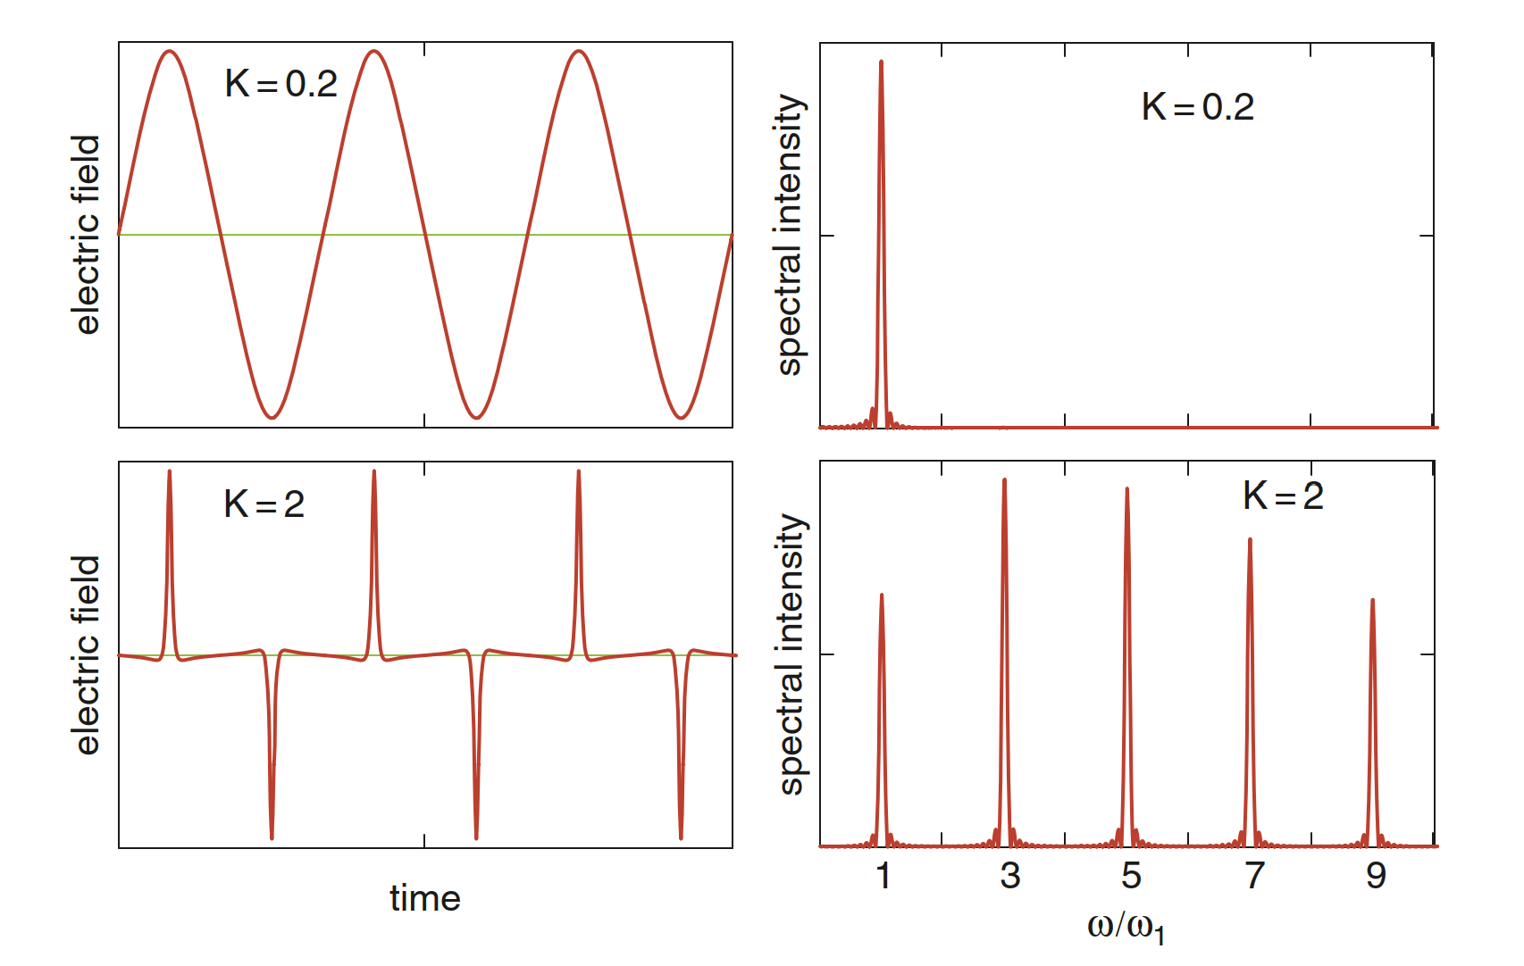
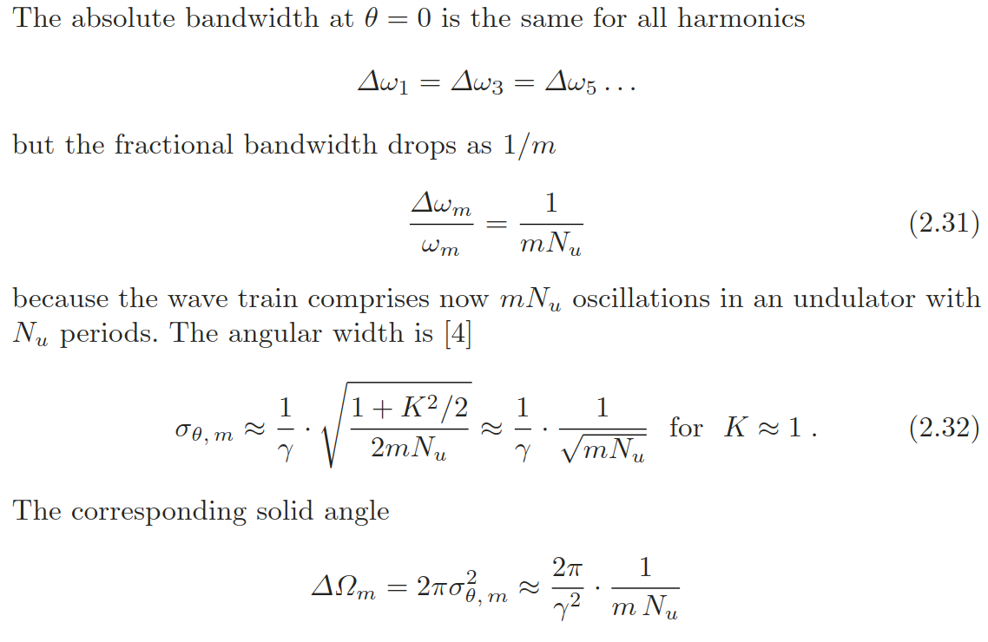
Higher harmonics

Slide 18
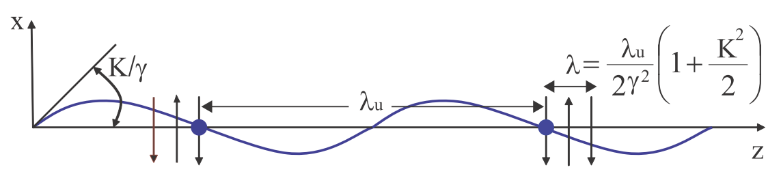
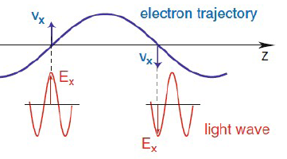
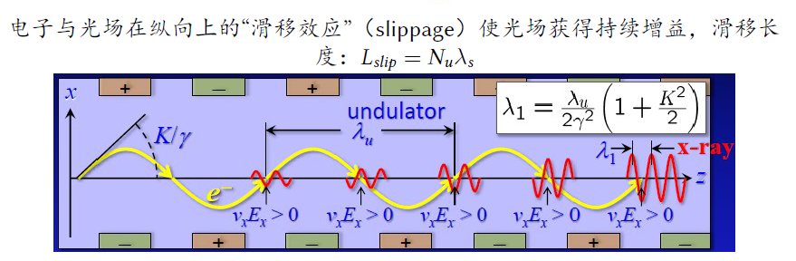
Interaction and energy exchange
Energy exchange: coupling between electron transverse velocity and transverse electric field; continuous energy transfer.

Slide 19
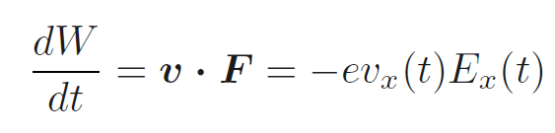

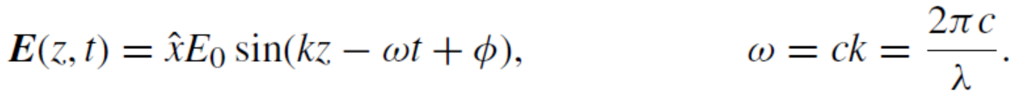
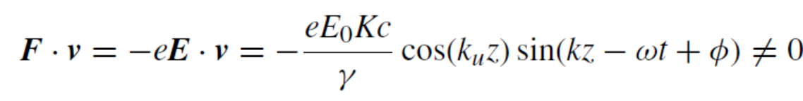
Interaction and energy exchange
Energy transfer（Power）
F∙v > 0, inverse FEL F∙v < 0, FEL

Slide 20
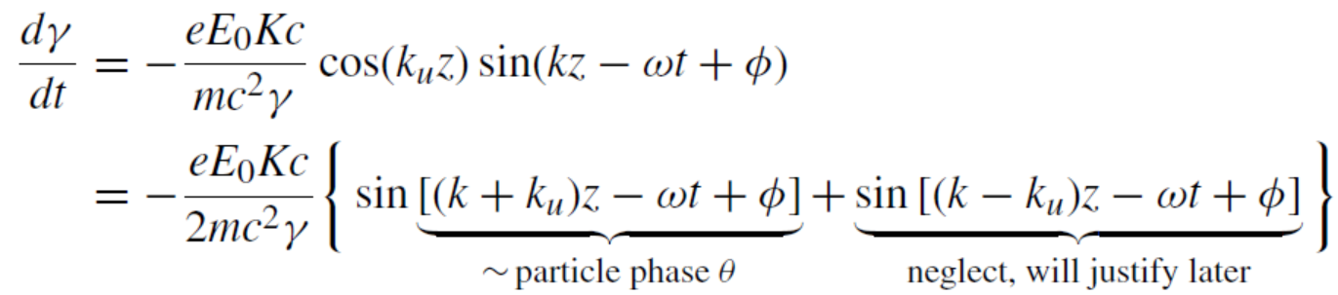


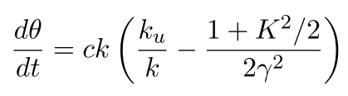
Interaction and energy exchange
The time derivative of the electron energy
The time derivative of the particle phase:
the ponderomotive phase

Slide 21
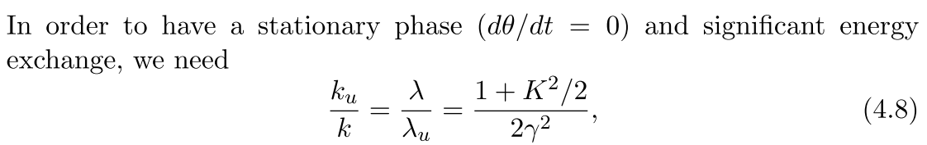
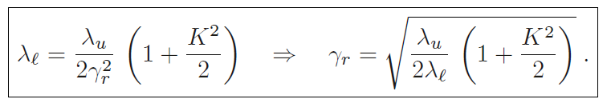

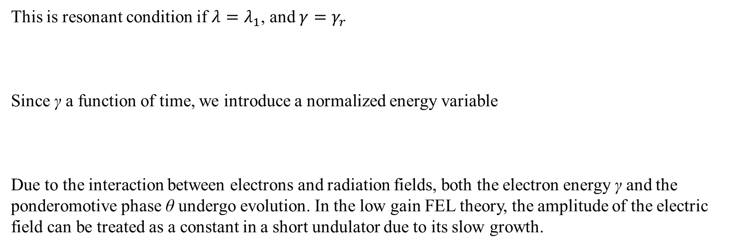
Interaction and energy exchange
This is resonant condition if $λ=λ_{1}$, and $γ=γ_{r}$
Since γ a function of time, we introduce a normalized energy variable
Due to the interaction between electrons and radiation fields, both the electron energy γ and the ponderomotive phase θ undergo evolution. In the low gain FEL theory, the amplitude of the electric field can be treated as a constant in a short undulator due to its slow growth.

Slide 22


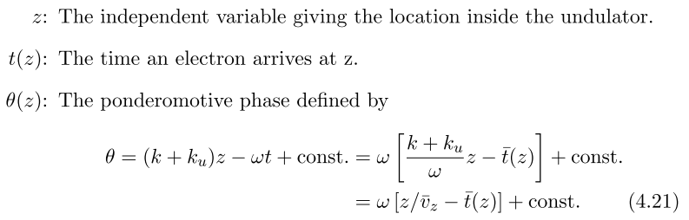
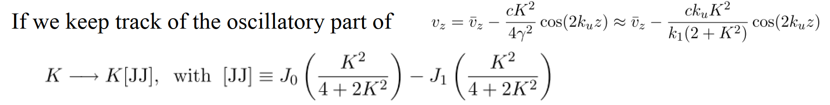
Interaction and energy exchange
The coupled phase-energy equations
(j for each individual electron)
It is convenient to use z as the independent variable z ~ ct

Slide 23







FEL Pendulum equation
The Hamiltonian form of the low-gain FEL:
$\dot{θ}=\frac{∂H}{∂η}=2k_{u}η$,
$$\dot{η}=−\frac{∂H}{∂θ}=−\frac{ε}{2k_{u}L_{u}^{2}}\sin{θ}$$
The trajectories in the (θ, η) phase space are the curves of a constant H with the separatrices joining the two unstable points at (θ=±$π$, η=0)
θ
Approximately written as a 2nd order equation
The natural oscillation frequency is given by
with period
FEL bucket

Slide 24
Low gain FEL theory
(Small-signal gain)

Slide 25

Low-gain regime
Recall the phase & energy equation
We will solve the pendulum equations in the low-gain regime where the amplification in a single-pass of the undulator is small, so that ε ≈ constant.

Slide 26

Low-gain regime
Inserting the expansion into the equations of motion, yields
3 phase equations
3 energy equations
Then, at 0-th order, we have
with (φ₀, η₀) defined to be the initial particle coordinates in phase space. At lowest order the particles move in straight lines with constant velocity.

Slide 27


Low-gain regime
The interaction with the field comes in with the first-order equations
Putting the 0-th order solutions into above equation, and solving for η₁, we have
Note that the average of the first-order energy deviation over the initial electron phases vanishes, i.e., <η₁>_{φ0} = 0. Thus, there is no energy exchange between the particles and field at this order. There is, however, energy modulation, since

Slide 28

Low-gain regime
Up to now, we view the modulation in η as a precursor to FEL gain, however a variety of longitudinal phase space manipulation techniques take advantage of this phenomenon by employing an optical laser as the driving EM field.
The FEL gain appears at second order in ε when the energy modulation evolves into a density modulation that can radiate coherently. First, we solve for θ₁

Slide 29

Low-gain regime
Recall that,

Slide 30

Low-gain regime: gain function
Madey's theorem

Slide 31




Low-gain regime: FEL gain
FEL Gain maximum：
x=1.3, g(x)=0.54
Radiation gain
And the optimal initial energy offset:
The rms width of the gain curve is of order unity around its maximum, which translates to a deviation in beam energy:
Radiation loss
Using the resonance condition, the frequency width of the gain curve is

Slide 32




Low-gain regime: Saturation
Maximum energy exchange will occur at particle motion from the top to bottom of the phase space:
The electron contribution to the optical energy:
The efficiency of an FEL oscillator：
$$η_{max}≈\frac{1}{{2N}_{u}}$$
Numerical illustrations of longitudinal phase space at the beginning (a), middle (b), and end (c) of the undulator for a saturated FEL oscillator. The dashed lines show the separatrix of the bucket, while the beam is initially centered at the optimal energy for gain defined by k_{u}L_{u}η ≈ 1.3
The ideal output power for FEL oscillator can be estimated:
$$ΔP≈\frac{1}{{2N}_{u}}P_{beam}$$
Note of FELO: low-gain saturation cavity saturation

Slide 33
High gain FEL theory

Slide 34

High-gain regime
N
S
N
S
N
S
N
S
N
S
N
S
N
S
N
S
N
S
N
S
N
S
N
S
N
S
N
S
N
S
N
S
S
N
S
N
S
N
S
N
S
N
S
N
S
N
S
N
S
N
S
N
S
N
S
N
S
N
S
N
S
N
S
N

Slide 35






1D Maxwell Equation
1D Maxwell equation for the transverse electric field
Transverse current density
Use slowly varying phase and amplitude approximation
Final Maxwell equation

Slide 36




FEL equations
Change the field equation variables from (t , z) to (θ , z)
We obtain
And rewrite the pendulum equations in terms of the slowly varying E

Slide 37

Dimensionless FEL equations
①
②
③
Set it to 1

Slide 38





FEL Pierce parameter ρ
To simplify the ﬁeld equation, set the coeﬃcient on its right-hand-side to unity. Thus, the dimensionless FEL pierce parameter must be
At saturation, electrons are fully bunched so that | | →1, which implies maximum radiation amplitude |a|→1, and translate it to so that the maximum field energy density
Because is the electron energy density, we see that ρ presents the FEL eﬃciency at saturation, and FEL saturation power ∼ ρ×(e-beam power)
I_{A}=17 kA is Alfven current

Slide 39



1D solution
Illustrate the essentials of FEL gain by neglecting the θ dependence of the electromagnetic ﬁeld. The 1D FEL equation are

Slide 40

Three coupled first-order equations
However, the system can be linearized in terms of three collective variables
Three coupled ﬁrst-order equations:

Slide 41

Cubic equation

Slide 42





Exponential solution
General solution:
Solving based on the initial conditions:
At a short distance, the growing, decaying and oscillating modes compete with one another.
At a long distance, the exponentially growing mode dominates
Consider the case of SASE (no seed and no energy modulation)
Seeded
SASE(bunched)
Energy-modulation (Pre-bunched)

Slide 43
High-gain FEL Analysis

Slide 44




Gain function
Considering an energy deviation η:
Gain function:
Within the first two gain length, gun function agrees with low gain FEL theory.
In a long undulator, power growth, energy deviation and gain bandwidth are different.
Red curve: high gain; blue curve: low gain

Slide 45


FEL bandwidth
FEL bandwidth is dominated by the FEL Pierce parameter ρ
Considering an energy deviation η, the eigenvalue of the exponential gain term can be expanded in a Taylor series
Only valid in the high gain regime.

Slide 46




High gain FEL saturation
The exponential growth cannot continue indeﬁnitely because the beam energy decreases due to the energy loss by radiation and the modulated current density ${\tilde{j}}_{1}$becomes eventually comparable in magnitude to the DC current density $j_{0}$.
We assume full modulation, i.e. $\left|{\tilde{j}}_{1}\right|=\left|j_{0}\right|$The major part of the intensity is generated in the last section of the exponential regime. The ﬁeld amplitude at saturation is approximately given by the slope of the ﬁeld gain curve, multiplied with the ﬁeld gain length.
The saturation power is:
The electron beam power is $P_{beam}={γ_{s}m_{e}c^{2}I_{0}}/e=E_{0}$ $I_{0}$, and one can estimates the FEL power at saturation

Slide 47

FEL gain curve

Slide 48



Phase space evolution

Slide 49
Self-Amplified Spontaneous Emission
(SASE)
49

Slide 50
What is SASE ?
SASE was proposed in 1980s and experimentally demonstrated at DESY TTF in 2001 at 109nm.
SASE-based hard x-ray FEL facilities all over the world.
SASE eliminates an optical cavity and starts from shot noise, resulting in the lack of longitudinal coherence.
electron arrival time t is random
➔ spontaneous emission
amplified by FEL interaction
quasi-coherent x-rays
… .. . ..
SASE
Δz

Slide 51





Qualitative description
In the high gain regime, we use the radiation intensity in the exponential growth regime
The bunching factor at the undulator entrance b(0) derives from the initial shot noise of the beam, which is subsequently ampliﬁed by the FEL process. This input noise turns out to be approximately given by the spontaneous undulator radiation generated in the ﬁrst gain length of the undulator.
Slippage leads to coherence length as well as spiky structure. Coherence length is usually constructed as slippage over 2 gain length and increases depending on the z position in the undulator
Electrons number in a coherence length

Slide 52
Statistical fluctuation
Due to noise start-up, SASE is a chaotic light temporally with M_{L} coherent modes (M_{L} spikes in intensity profile)
Usually bunch length is much larger than the coherence length, and the longitudinal phase space is M_{L} larger than FT limit.
Integrated energy fluctuation
Singe spike intensity fluctuates 100%
M_{L} is NOT a constant, decreases due to increasing coherence in the exponential growth, and increases due to decreasing coherence after saturation.

Slide 53


Typical SASE spectrum
Spectral properties are similar to temporal domain, except that everything is inverted
spike width ~
Bandwidth
~ 2 ρ
Bunch length Spike bandwidth
Coherence length SASE bandwidth

Slide 54

FEL startup from e-beam noise

Slide 55
Transverse coherence
Z=25m
Z=37.5m
Z=50m
Z=62.5m
Z=75m
Z=87.5m
Single mode dominates ➔ close to 100% transverse coherence

Slide 56

SASE 1D Summary

Slide 57

Three-dimensional effects

Slide 58

Ming-Xie’s 3D fitting formula

Slide 59
Fully coherent FEL
59

Slide 60

Towards fully coherence
SASE is inherently chaotic and noisy
SASE & its advances
  pSASE (Purified SASE)
  iSASE (Improved SASE)
  HB-SASE
  Mode locked SASE
Seeding schemes
  HGHG, EEHG, EEHC…
  SXRSS, HXRSS
  XFELO
SASE-FELs
Fully coherent FEL sources

Slide 61





Seeding schemes
With seed laser
Without seed laser
Self-seeding
SXRSS, HXRSS
LCLS、PAL-XFEL、EXFEL、SACLA、SHINE…
Soft and Hard X-ray
Stability limited by SASE
Cavity based X-ray FEL
XFELO ( and RAFEL)
R&D (first demonstrated in May, 2025)
Simple system and stable output
Depend on cavity
Ideal fully coherent hard X-ray
External-seeding
HGHG, EEHG, EEHC…
FERMI、DCLS、SXFEL、…
UV to soft X-Ray
Complex system

Slide 62
Self-seeding

Slide 63

Hard and soft x-ray self-seeding

Slide 64



Hard x-ray self-seeding
1 GW
25 GW
Geloni, Kocharyan, Saldin (DESY)
FEL spectrum after diamond
Power dist. after diamond
Wide-band power
Why is it FBD, other than BD ?
Self-seeding of 1mm electron bunch at 0.15nm yields 10⁻⁴ BW with low charge mode
Monochromatic seed power
10⁻⁵
5 MW
6 μm ≈ 20 fs

Slide 65

How does HXRSS generate wake pulses

Slide 66


Bragg spectral response function
Monochromator: BD vs FBD

Slide 67

(Reflected) Bragg Diffraction

Slide 68

Forward Bragg Diffraction

Slide 69

Monochromatic wake pulses

Slide 70


Pathlength Delay & Offset in a Chicane

Slide 71

HXRSS Spectral Brightness Enhancement

Slide 72

Soft x-ray self-seeding
Soft x-ray region
Diffraction Grating: Resolution determines bandwidth
Optical system: focusing and optical path return
Chicane: smear bunching, delay, offset
Complex system and unstable

Slide 73
Cavity based XFEL

Slide 74

Cavity based XFEL
Originally, cavity-based FEL is used for FELO (low gain) in the range from infrared to THz FEL.
Recently, due to the development of crystallography, CBXFEL focus on X-ray regime.
Key: Bragg diffraction.
Cavity-based FELs include XFEL oscillators (XFELOs) and X-ray regenerative amplifier FELs (RAFELs).
XFELO: Low gain regime, short undulator, low-quality electron beam, many passes
RAFEL: High gain regime, long undulator, high-quality electron beam, a few passes
In fact, we usually refer to them as XFELO or CBXFEL collectively.
XFELO demonstrated at European-XFEL in May, 2025

Slide 75

X-ray FEL Oscillators

Slide 76

Some detail about FELO
Pass 1: spontaneous emission
Pass i’s initial power intensity
Pass i’s end power intensity
Pass i:
Pass i’s power gain
Pass i’s cavity loss
Pass m’s intensity:
Pass i’s net gain:

Slide 77


Some detail about FELO
Low gain: undulator length ＜ 3 gain length
Initial gain ~ small signal gain $g_{ss}$
As the electric field is amplified, the FEL gain gradually decreases until the balance between the gain and cavity loss, i.e. saturation
At saturation, the net gain is zero:
For the oscillator:

Slide 78


Some detail about FELO
At saturation, the single pass gain equals cavity loss
The condition for the above equal sign to hold is that saturation power of the balance state is equal to small signal saturation power.
And the total passes:
Saturation power in the cavity:
Assuming out-coupling power = cavity loss, so

Slide 79

X-ray RAFEL with Bragg Reflectors

Slide 80
SASE and CBXFEL
 | SASE | XRAFEL | XFELO
Peak Power | ~10 GW | ~50 GW | ~100 MW
Average Power | 100 W (at ~ 1 MHz) | 10 W (at ~ 10 kHz) | 20 W (at ~ 1 MHz)
Spectral Bandwidth | ~10 eV | ~0.1 eV | ~1 meV
Pulse Length | ~1-100 fs | ~20 fs | ~1 ps
Stability | Poor | Excellent | Excellent
Poor | Excellent | Excellent | Excellent
Transverse Mode | Defined by the gain guiding | Defined by the gain guiding | Defined by the optical cavity

Slide 81
External seedings: HGHG and EEHG

Slide 82

Principle of HGHG FEL

Slide 83


HGHG: energy modulation from seed laser
According to the low gain FEL theory, a seed laser interacts with an electron beam in a short undulator and generates energy modulation. Reviewing perturbation analysis, the 1st order is the modulation term
The energy modulation amplitude introduced by seed laser in the modulator
$P_{rel}={mc^{3}}/{r_{e}}≈8.7 GW$，${σ_{r}^{2}=λ}_{l}{Z_{R}}/{4π}$，$Z_{R}\sim {L_{u}}/π$
$$∆η=\frac{eE_{0}K\left[JJ\right]}{2γ_{r}^{2}mc^{2}}L_{u}=\frac{K\left[JJ\right]}{γ_{r}^{2}}\sqrt{\frac{L_{u}^{2}}{σ_{r}^{2}}\frac{e^{2}}{4πε_{0}mc^{2}}\frac{P}{mc^{3}}}$$
$$=\frac{K\left[JJ\right]}{γ_{r}^{2}}\frac{L_{u}}{σ_{r}}\sqrt{\frac{P}{P_{rel}}} → \frac{2πK\left[JJ\right]}{γ_{r}^{2}}\sqrt{\frac{L_{u}}{λ_{l}}\frac{P}{P_{rel}}}$$

Slide 84


HGHG: Initial phase space

Slide 85




HGHG: energy and density modulations

Slide 86




HGHG： bunching factor
Optimal solution for maximal bunching:
$${\{AB\}}_{max}≈1.2$$

Slide 87





Principle of EEHG FEL
G. Stupakov, PRL (2009)

Slide 88






EEHG: phase space
First energy modulation:
After first chicane:
Second energy modulation
After second chicane

Slide 89

EEHG: bunching factor
Optimal solution:

Slide 90





Seeded FEL: FEL performances
During the first two gain length, coherent harmonic generation (CHG) without high gain:
$Z_{0}=377 Ω$ is vacuum impedance and $I_{p}$ is peak current.
After the first two gain length, high gain regime.
When calculating the 3D gain length, it is necessary to consider the energy spread added by modulation. The slice energy spread and the saturation power can be estimated as:
And the saturation length is

Slide 91

HGHG and EEHG bunching factors
HGHG produces narrow-linewidth radiation at the harmonic of the seed laser. HGHG is sensitive to energy spread as well as phase and frequency changes in the laser.
EEHG is an attractive technique to the generation of ultra-high harmonic from the laser-driven harmonic FEL.

Slide 92
XFEL operations worldwide
FLASH | SASE (EEHG)
LCLS (+II+HE): | SASE, self-seeding, (EEHG, XFELO)
SACLA | SASE, self-seeding
FERMI | HGHG, HGHG cascading (EEHG, EEHC)
PAL-XFEL | SASE, self-seeding
European-XFEL | SASE, self-seeding (XFELO)
Swiss-FEL | SASE, self-seeding (EEHG)
SXFEL | SASE, HGHG, EEHG, EEHC, …
SHINE | SASE, self-seeding, EEHG, EEHC, …
S3FEL | EEHG, EEHC, …
… | …

Slide 93
Homework
Derive the electron motion equations and resonance condition in an undulator.
Derive the bunching factor of HGHG.
Assume an FEL facility with 4 GeV beam energy, 1 kA peak current, and 0.5 mm*mrad normalized slice emittance. The average beta function is 10 m in the undulator with 40 mm undulator period length. Considering 3 nm SASE generation, please calculate undulator parameter, Pierce parameter, gain length, saturation length, and saturation power under 1D theoretical condition.

Slide 94
Backup materials

Slide 95

Focusing in long undulators

Slide 96



Natural focusing in an undulator
The undulator ﬁeld is only valid very near the y = 0 plane in 1D theory because it does not satisfy the vacuum Maxwell equations in 3D. An exact solution of Maxwell’s equations describing a planar undulator with ﬂat poles is
Thus, we can find that
The harmonic oscillator equation

Slide 97


FODO lattice in undulators
Strong focusing + natural focusing
SHINE
SXFEL
SHINE:
QF=2.3T
QD=-2.3T
SXFEL:
QF=0.6T
QD=0.6T
No impact of natural focusing
Heavy impact of natural focusing

Slide 98

HGHG&EEHG advances

Slide 99


SM&DE-HGHG/EEHG

Slide 100




Transverse Gradient Undulator
N
降低对束流能量抖动的要求
N
T. I. Smith, et al., Journal of Applied Physics, 50 (1979) 4580.
N. Kroll, et al., IEEE Journal of quantum Electronics, 17 (1981) 1496.
Z. Huang, et al, Physical Review Letter, 109 (2012) 204801.
y
y
x
x
S
S

Slide 101


Phase-merging effect
Modulator (TGU)
Seed laser
Beam

Slide 102

Phase-merging Enhanced Harmonic Generation （PEHG）

Slide 103




Angular dispersion enabled microbunching
ADM
其他:
斜入射模式：
Notes:
角色散机制利用了储存环中电子束垂直方向散角极小的特点，通过引入色散和角色散来大幅增强谐波转换效率，以获得纵向全相干、高亮度的短波长辐射脉冲。与常规CHG相比，角色散机制可以极大拓展输出波长覆盖范围，增加谐波辐射功率，改善辐射时间相干性（接近傅里叶转换极限）；同时角色散机制还可以大幅降低所需的种子激光功率，使得利用目前商业所能获得的100 W平均功率级激光器调制电子束实现高重复频率运行成为可能。

